Slide 1
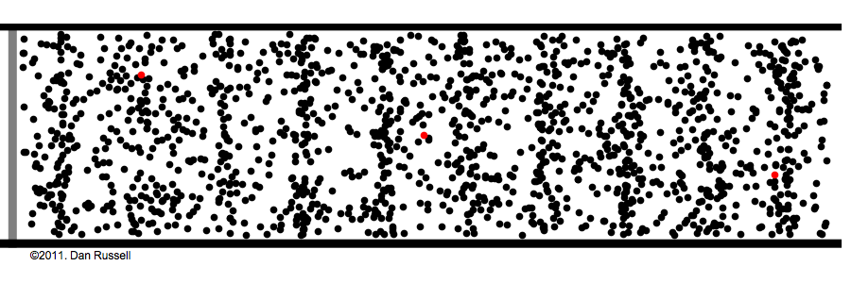
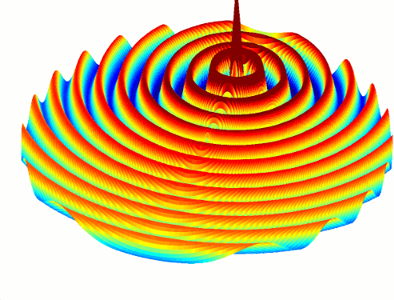
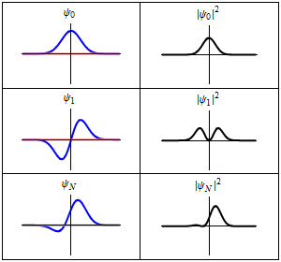
Waves!

Slide 2
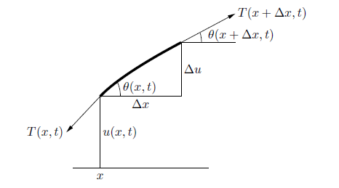
Solving something like this…

Slide 3
The Wave Equation
(1-D)
(n-D)
$$\frac{∂^{2}y}{∂t^{2}}=c^{2}\frac{∂^{2}y}{∂x^{2}}$$
$$\frac{∂^{2}y}{∂t^{2}}=c^{2} ∇^{2}y$$

Slide 4
The Wave Equation
$$\frac{∂}{∂t}\frac{y_{x,t+1}−y_{x,t}}{∆t}=c^{2}\frac{∂}{∂x}\frac{y_{x+1,t}−y_{x,t}}{∆x}$$
→
$$\frac{{(y}_{x,t+1}−y_{x,t})−{(y}_{x,t}−y_{x,t−1})}{{(∆t)}^{2}}=c^{2}\frac{{(y}_{x+1,t}−y_{x,t})−{(y}_{x,t}−y_{x−1,t})}{{(∆x)}^{2}}$$
→
$$y_{x,t+1}=2y_{x,t}−y_{x,t−1}+{\left(\frac{c∆t}{∆x}\right)}^{2}{(y}_{x+1,t}−2y_{x,t}+y_{x−1,t})$$

Slide 5
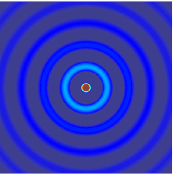
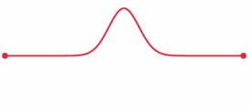
Boundary Conditions
Examples:
Manual motion at an end
u(0, t) = f(t)
Bounded ends:
u(0, t) = u(L, t) = 0 for all t

Slide 6
Discrete solution
Deal with three states at a time (all positions at t -1, t, t+1)
Let L = number of nodes (distinct discrete positions)
Create a 2D array of size 3*L
Denote pointers to where each region begins
Cyclically overwrite regions you don’t need!

Slide 7
Discrete solution
Sequential pseudocode:
fill data array with initial conditions
for all times t = 0… t_max
point old_data pointer where current_data used to be
point current_data pointer where new_data used to be
point new_data pointer where old_data used to be!
(so that we can overwrite the old!)
for all positions x = 1…up to number of nodes-2
calculate f(x, t+1)
end
set any boundary conditions!
(every so often, write results to file)
end

Slide 8
CPU Code

Slide 9
GPU Algorithm - Kernel
(Assume kernel launched at some time t…)
Calculate y(x, t+1)
Each thread handles only a few values of x!
Similar to polynomial problem
$$y_{x,t+1}=2y_{x,t}−y_{x,t−1}+{\left(\frac{c∆t}{∆x}\right)}^{2}{(y}_{x+1,t}−2y_{x,t}+y_{x−1,t})$$

Slide 10
GPU Algorithm – The Wrong Way
Recall the old “GPU computing instructions”:
Setup inputs on the host (CPU-accessible memory)
Allocate memory for inputs on the GPU
Copy inputs from host to GPU
Allocate memory for outputs on the host
Allocate memory for outputs on the GPU
Start GPU kernel
Copy output from GPU to host

Slide 11
GPU Algorithm – The Wrong Way
Sequential pseudocode:
fill data array with initial conditions
for all times t = 0… t_max
adjust old_data pointer
adjust current_data pointer
adjust new_data pointer
allocate memory on the GPU for old, current, new
copy old, current data from CPU to GPU
launch kernel
copy new data from GPU to CPU
free GPU memory
set any boundary conditions!
(every so often, write results to file)
end

Slide 12
GPU Algorithm – The Wrong Way
Insidious memory transfer!
Many memory allocations!

Slide 13
GPU Algorithm – The Right Way
Sequential pseudocode:
allocate memory on the GPU for old, current, new
Either:
Create initial conditions on CPU, copy to GPU
Or, calculate and/or set initial conditions on the GPU!
for all times t = 0… t_max
adjust old_data address
adjust current_data address
adjust new_data address
launch kernel with the above addresses
Either:
Set boundary conditions on CPU, copy to GPU
Or, calculate and/or set boundary conditions on the GPU
End
free GPU memory

Slide 14
GPU Algorithm – The Right Way
Everything stays on the GPU all the time!
Almost…

Slide 15
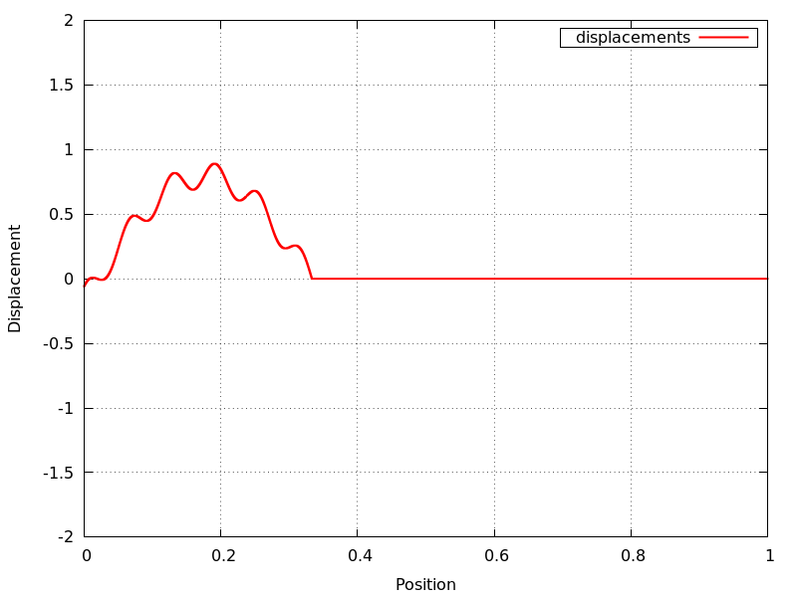
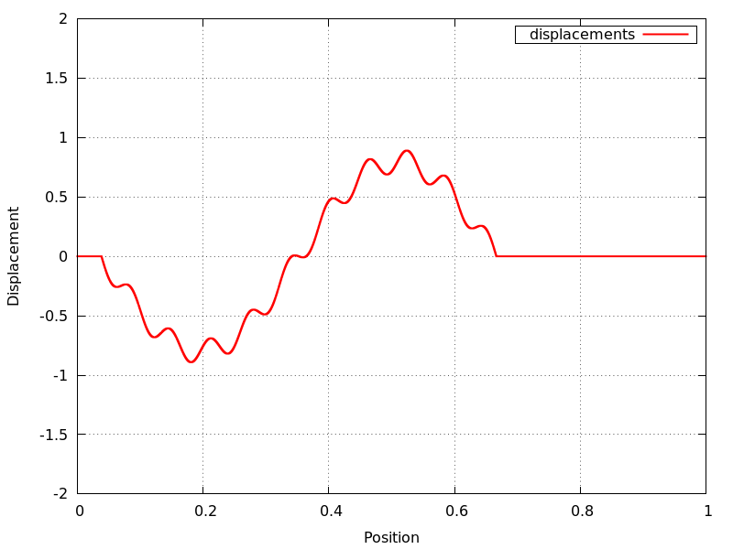
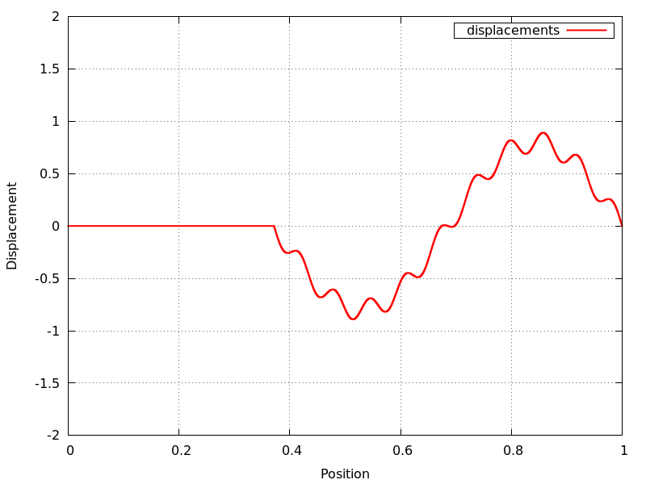
Getting output
What if we want to get a “snapshot” of the simulation?
That’s when we GPU-CPU copy!

Slide 16
GPU Algorithm – The Right Way
Sequential pseudocode:
allocate memory on the GPU for old, current, new
Either:
Create initial conditions on CPU, copy to GPU
Or, calculate and/or set initial conditions on the GPU!
for all times t = 0… t_max
adjust old_data address
adjust current_data address
adjust new_data address
launch kernel with the above addresses
Either:
Set boundary conditions on CPU, copy to GPU
Or, calculate and/or set boundary conditions on the GPU
Every so often, copy from GPU to CPU and write to file
End
free GPU memory

