Slide 1
CS 179 Lecture 15
Set 5 & Machine Learning
<number>

Slide 2
Set 5 Goals
Practice overlapping computation with data movement on a streaming workload - while building a machine learning system.
<number>

Slide 3
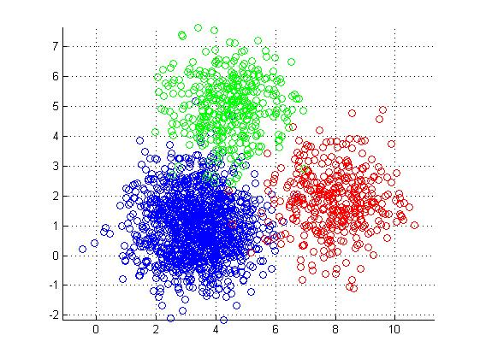
2015 Set 5 Description
Cluster a stream of business review from Yelp.
<number>

Slide 4
Representing Text as Vectors
Yelp reviews are text. How can we quantify the similarity between two snippets of text?
“The doctor has horrible bedside manner”
“The enchiladas were the best I’ve ever had!”
One solution is to represent the snippets as numerical vectors.
<number>

Slide 5
Bag of Words Approach
A very simple but very common approach. Count occurrences of each word
Loses all information on ordering of words.
 | cats | dogs | hats | love | eat
cats love hats | 1 | 0 | 1 | 1 | 0
cats eat hats | 1 | 0 | 1 | 0 | 1
cat eat cats | 2 | 0 | 0 | 0 | 1
document-term
matrix
<number>
Notes:
Want to normalize words when computing document-term matrix. cats = cat. Runs = run = running. Called stemming. Also do things like lowercase.
For the Yelp dataset, there were about 350,000 total terms (didn’t do stemming). Through out all words appearing less than 10 times and got down to 65,000 terms. 1.5 million documents. sparse matrix

Slide 6
Latent Semantic Analysis
Idea: Compute the singular value decomposition (SVD) of the document-term matrix. Singular values correspond to words that commonly appear together, which oftentimes correspond to our notion of a topic.
This is called latent semantic analysis.
Represent each document as coefficients of top-k singular vectors.
<number>
Notes:
Did SVD on term-document matrix to represent each vector as a 50 component vector.

Slide 7
Clustering
Group data points based on some sort of similarity. Clustering is a very common unsupervised learning problem.
Many variants of clustering:
hard/soft
hierarchical
centroid
distribution (Gaussian mixture models)
density
<number>
Notes:
hard/soft: does each point belong to 1 cluster or multiple clusters to different degrees (confidences)
hierarchical - clusters are part of other clusters. top-down (divisive) and bottom-up (agglomerative) algorithms exist
centroid - represent each cluster as a single point
distribution - a cluster is a probability distribution
density - a cluster is an area with a higher density of data points next to areas of lower density
can think of LSA as a form of soft clustering (component values indicate how much point belongs to cluster)

Slide 8
k-means Clustering
Very popular centroid-based hard clustering algorithm.
def k_means(data, k):
randomly initialize k “cluster centers”
while not converged:
for each data point:
assign data point to closest cluster center
for each cluster center:
move cluster center to average of points in cluster
return cluster centers
<number>
Notes:
Hard points: choice of k, random initialization.
NP-hard to find optimal solution (minimizing distance to cluster centers), this just finds local optima. can get bad outputs.
How could we parallelize this?

Slide 9
Stream Clustering
Can we cluster if we can only see each data point once?
def sloppy_k_means(int k):
randomly initialize k “cluster centers”
for each data point:
assign data point to closest cluster center
update closest cluster center with respect to data point
return cluster centers
This algorithm will give poor clustering.
<number>

Slide 10
Cheating at Streaming Algorithms
Idea: Use a streaming algorithm to create a smaller dataset (sketch) with properties similar to stream. Use expensive algorithm on sketch.
k_means(sloppy_k_means(stream, 20 * k), k)
Strategy described here, used by Apache Mahout. If length of stream is known (and finite), use k*log(n) clusters for sketch.
<number>

Slide 11
Parallelization
def sloppy_k_means(int k):
randomly initialize k “cluster centers”
for each data point:
assign data point to closest cluster center
update closest cluster center with respect to data point
return cluster centers
What can we parallelize here?
<number>

Slide 12
Batching for Parallelization
def sloppy_k_means(int k):
randomly initialize k “cluster centers”
for each batch of data points:
par-for point in batch:
assign data point to closest cluster center
update cluster centers with respect to batch
return cluster centers
<number>

Slide 13
Batching
Changing the computation slightly to process a batch of data at a time is a common theme in parallel algorithms.
Although it does change the computation slightly, batching still leads to some sort of local minima of the loss function.
When you already aren’t going to find an optimal solution, cutting corners isn’t that bad :)
<number>

Slide 14
Data Transfer Issues
Your program for set 5 will read LSA representations of reviews from stdin and will sloppy cluster them.
Your tasks:
overlap data transfer and computation between host and device (hopefully saturate interface on haru)
implement sloppy clustering algorithm
analyze latency and throughput of system
<number>

Slide 15
2016 Set 5 Outline
Logistic regression
(Stochastic) gradient descent
Parallelizing SGD for neural nets (with emphasis on Google’s distributed neural net implementation)
<number>

Slide 16
Binary Classification
Goal: Classify data into one of two categories.
“Is this Yelp review of a restaurant or of a different type of business”?
Given:
training set of (data, category) aka (X, y)
test set of (X) for which we want to estimate y
<number>
Notes:
supervised learning task

Slide 17
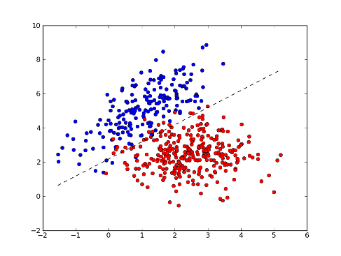
Logistic Regression
There are many other binary classification algorithms (random forests, SVM, Bayesian methods), but we’ll study logistic regression.
<number>
Notes:
logistic regression is a linear method

Slide 18
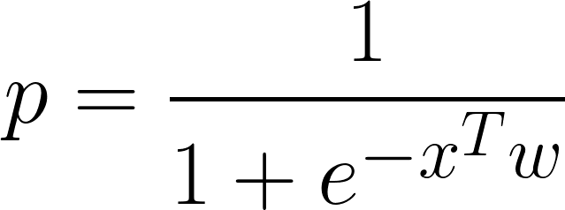
Scalar Logistic Regression
p: probability of belonging to category 1
x: data point as n component vector
w: learned weight vector
<number>

Slide 19
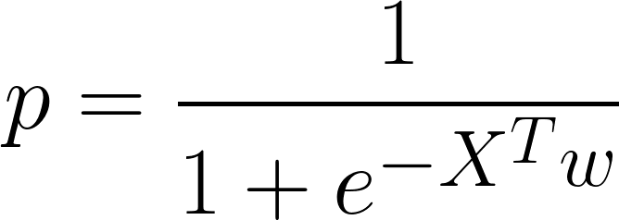
Vectorized Logistic Regression
Let matrix X be n x m with each column being a separate data point.
Now p is an m component vector of probabilities.
<number>

Slide 20
Learning
How can we find an optimal weight vector w from our training set?
In what sense can w be optimal?
<number>

Slide 21
Loss Functions
Weights can only be optimal with respect to some objective function. In general, we call this function the “loss” and we try to minimize it with respect to weights.
is the loss that gives logistic regression.
<number>
Notes:
sum is

Slide 22
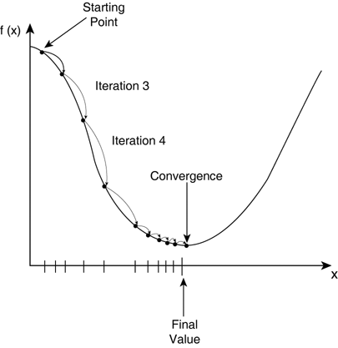
Gradient Descent
Compute the gradient of loss with respect to weights, and update weights in direction of negative gradient.
Repeat until you hit a local minima. Have to pick a step size.
<number>
Notes:
talk about convex functions and how they have global minima. Logistic regression is convex, neural nets are not.

Slide 23
Stochastic Gradient Descent (SGD)
The current formulation of gradient descent involves computing gradient over the entire dataset before stepping (called batch gradient set).
What if we pick a random data point, compute gradient for that point, and update the weights? Called stochastic gradient descent.
<number>

Slide 24
SGD Advantages
easier to implement for large datasets
works better for non-convex loss functions
sometimes faster (you update the gradient much earlier and more incrementally)
Often use SGD on a “mini-batch” rather than just a single point at a time. Allows higher throughput and more parallelization.
<number>

Slide 25
Parallelizing SGD
2 (not mutually exclusive) routes:
parallelize computation of a single gradient (model parallelism)
compute multiple gradients at once (data parallelism)
<number>

Slide 26
Model Parallelism
Model parallelism is “single model with parallel components”.
Can generally parallelize over the mini-batch.
<number>

Slide 27
Model “MATLAB Parallelism”
Many models (including logistic regression!) include matrix multiplication or convolution in gradient computation.
This is a good example of “MATLAB parallelism”, scriptable parallel computation built on top of a few kernels.
<number>

Slide 28
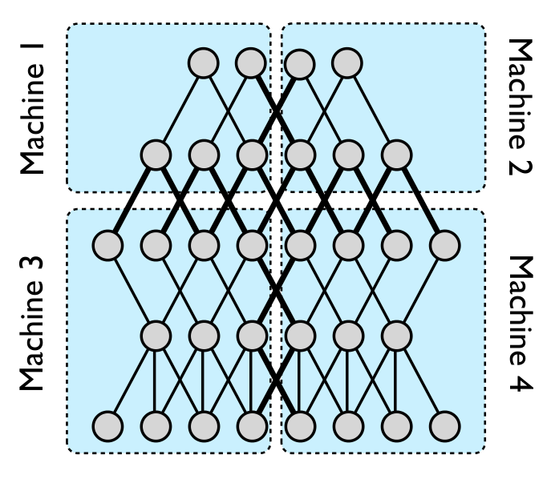
Model pipeline parallelism (in Google Brain neural nets)
<number>
Notes:
Can do pipeline parallelism. All of these ideas about parallelizing on a single GPU mostly carry over to distributed computation.
Can do pipeline parallelism on a single GPU with streams

Slide 29
Data Parallelism
Run multiple copies of the model (that all share weights) on different data
Problem: SGD is very iterative. How do I synchronize updates to the weights?
<number>
Notes:
Grab weights, run computation with weights, update weights with gradient. Can’t technically change weights in this cycle

Slide 30
Hogwild!
Some problems such as matrix completion have sparse gradients. A single output depends only on a single row and column of factorization.
Solution: Don’t worry about synchronization! Gradient updates unlikely to touch each other because of sparsity.
<number>
Notes:
proof of convergence in 2011 paper called “Hogwild!”

Slide 31
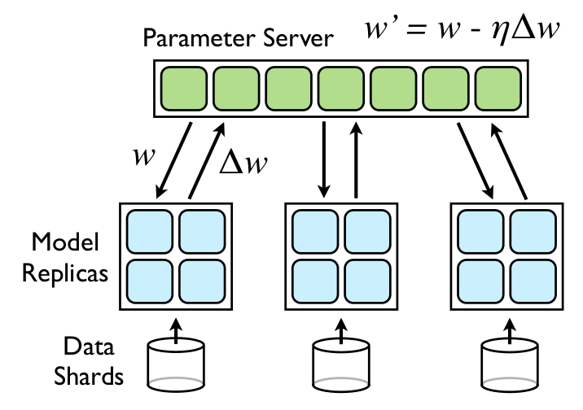
Downpour SGD from Google Brain
<number>
Notes:
combines model parallelism (each 2x2 box) with data parallelism
each replica fetches parameters every n_fetch mini-batches and pushes gradient every n_push mb’s

Slide 32
Downpour SGD
Store all weights on a “parameter server.”
Each model replica fetches updated weights from server every n_{fetch} steps and pushes gradient to server every n_{push} steps.
Not a lot of theoretical justification, but it works :)
<number>
Notes:
parameter server could be a thread
n_fetch and n_push allow lowering communication overhead. want to keep high enough to lower communication overhead but low enough to prevent weight divergence

Slide 33
Google Brain Parallelism Summary
Data parallelism - multiple model replicas communication with parameter server, using downpour SGD
Model pipeline parallelism - each replica consists of a group of machines computing parts of model
Model “MATLAB parallelism” - each part of each pipeline uses GPUs to process mini-batch in parallel
Check out the paper
<number>
Notes:
“train in a day what takes 6 weeks on a single GPU”
“almost anything a human brain can do in 0.1s can be done with a 10 layer neural net now”

Slide 34
Final Thoughts
“MATLAB parallelism” is by far the simplest parallelism and is what you want when you have a single GPU.
Other parallelization techniques needed for bigger systems.
Keep GPUs in mind when doing machine learning, can often get ~10x speed-ups.
<number>
Notes:
GPUs are what brought me here. training neural nets, turn an hour of training into 6 minutes.

Slide 35
General Machine Learning on GPU
Already seen k-means clustering…
Many machine learning numerical algorithms rely on just a few common computational building blocks.
element-wise operations on vectors/matrices/tensors
reductions along axes of vectors/matrices/tensors
matrix multiplication
solving linear systems
convolution (FFT)
<number>

Slide 36
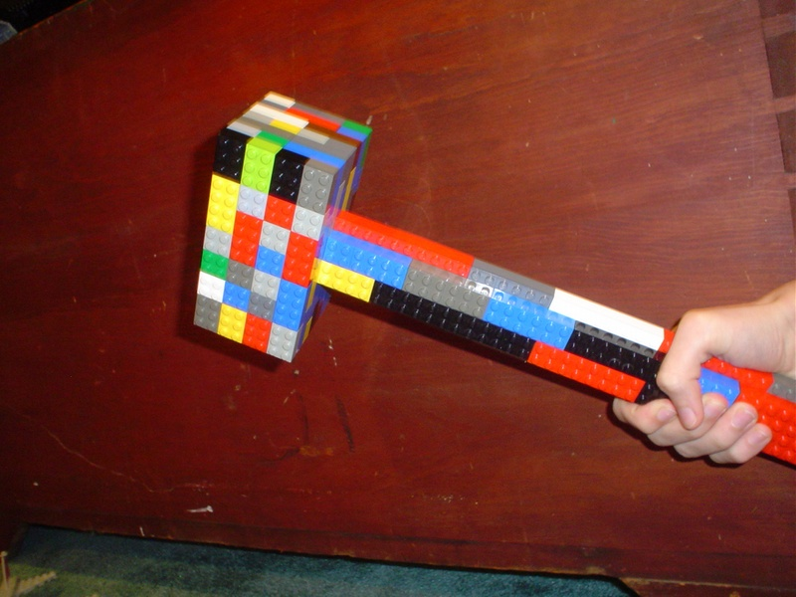
Computational Building Blocks
These building blocks are why scientific scripting (MATLAB or Numpy) is so successful.
Often want to use the GPU by using a framework rather than writing your own CUDA code.
Image from Todd Lehman
<number>
Notes:
Have super fast implementations of building blocks, and then use a convenient language to tie the blocks together.

Slide 37
When to NOT Write Your Own CUDA
Heuristic: If you could write it efficiently in “clean” MATLAB, you could likely accelerate it solely through using libraries either from NVIDIA (cuBLAS, cuSPARSE, cuFFT) or the community (Theano, Torch).
Better to write less CUDA and then
call into a lot.
<number>
Notes:
Scientists in general want to use code to enable their research, not just write code. The less time they spend programming, the better.
Writing in C/CUDA is more time consuming than writing in Python.
Think of CUDA as a way to make libraries rather than applications. Less CUDA code is often better.
To get truly maximum performance, you might need to move larger and larger components to CUDA. Abstractions aren’t perfect.

Slide 38
When to Write Your Own CUDA
Vectorized scripting languages must use a lot of memory when considering all combinations of input.
Example: What is the maximum distance between pairs of n points?
Most vectorized MATLAB implementations will store all n² distances, and then compute the maximum over these. Quadratic memory and time.
An implementation in a language with loops (that you actually want to use) takes linear memory and quadratic time.
<number>
Notes:
k-means clustering in an example of this.

