Slide 1
CS 179: GPU Programming
Lecture 12 / Homework 4

Slide 2
Admin
Lab 4 is out – Due Wednesday, April 27 @3pm
Come to OH this week, this set is more difficult than before.

Slide 3
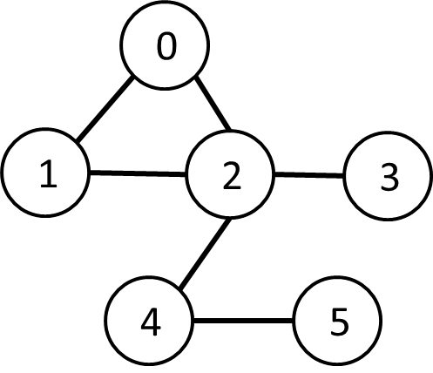
Breadth-First Search
0
Given source vertex S:
Find min. #edges to reach every vertex from S
(Assume source is vertex 0)
1
1
2
2
3
Sequential pseudocode:
let Q be a queue
Q.enqueue(source)
label source as discovered
source.value <- 0
while Q is not empty
v ← Q.dequeue()
for all edges from v to w in G.adjacentEdges(v):
if w is not labeled as discovered
Q.enqueue(w)
label w as discovered, w.value <- v.value + 1

Slide 4
Alternate BFS algorithm
New sequential pseudocode:
Input: Va, Ea, source (graph in “compact adjacency list” format)
Create frontier (F), visited array (X), cost array (C)
F <- (all false)
X <- (all false)
C <- (all infinity)
F[source] <- true
C[source] <- 0
while F is not all false:
for 0 ≤ i < |Va|:
if F[i] is true:
F[i] <- false
X[i] <- true
for Ea[Va[i]] ≤ j < Ea[Va[i+1]]:
if X[j] is false:
C[j] <- C[i] + 1
F[j] <- true
Parallelizable!

Slide 5
GPU-accelerated BFS
CPU-side pseudocode:
Input: Va, Ea, source (graph in “compact adjacency list” format)
Create frontier (F), visited array (X), cost array (C)
F <- (all false)
X <- (all false)
C <- (all infinity)
F[source] <- true
C[source] <- 0
while F is not all false:
call GPU kernel( F, X, C, Va, Ea )
GPU-side kernel pseudocode:
if F[threadId] is true:
F[threadId] <- false
X[threadId] <- true
for Ea[Va[threadId]] ≤ j < Ea[Va[threadId + 1]]:
if X[j] is false:
C[j] <- C[threadId] + 1
F[j] <- true
Can represent boolean values as integers

Slide 6
X-ray CT Reconstruction

Slide 7
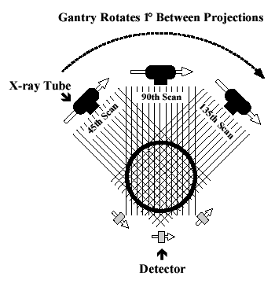
X-ray Computed Tomography (CT)
“Algorithm” (per-slice):
Take *lots* of pictures at different angles
Each “picture” is a 1-D line
Reconstruct the many 1-D pictures into a 2-D image
Harder, more computationally intensive!
3D reconstruction requires multiple slices
http://www.thefullwiki.org/Basic_Physics_of_Nuclear_Medicine/X-Ray_CT_in_Nuclear_Medicine

Slide 8
Mathematical Details
X-ray CT (per-slice) performs a 2D X-ray transform (eq. to 2D Radon transform):
Suppose body density represented by $f(\overset{⃑}{x})$ within 2D slice, $\overset{⃑}{x}=(x,y)$
Assume linear attenuation of radiation
For each line L of radiation measured by detector:
$$I_{detect}=I_{emit}\int_{L}{f}=I_{emit}\int_{\text{ℝ}}{f\left({\overset{⃑}{x}}_{0}+t{\overset{⃑}{θ}}_{L}\right) dt}$$
${\overset{⃑}{θ}}_{L}$: a unit vector in direction of L

Slide 9
Mathematical Details
$$I_{detect}=I_{emit}\int_{L}{f}=I_{emit}\int_{\text{ℝ}}{f\left({\overset{⃑}{x}}_{0}+t{\overset{⃑}{θ}}_{L}\right) dt}$$
Defined as Lebesgue integral – non-oriented
Opposite radiation direction should have same attenuation!
Re-define as:
$$I_{detect}=I_{emit}\int_{−∞}^{∞}{f\left({\overset{⃑}{x}}_{0}+t{\overset{⃑}{θ}}_{L}\right) |dt|}$$

Slide 10
Mathematical Details
For each line L of radiation measured by detector:
$$I_{detect}=I_{emit}\int_{L}{f}=I_{emit}\int_{−∞}^{∞}{f\left({\overset{⃑}{x}}_{0}+t{\overset{⃑}{θ}}_{L}\right) |dt|}$$
Define general X-ray transform (for all lines L in R²):
$$(Rf)\left(L\right)=\int_{−∞}^{∞}{f\left({\overset{⃑}{x}}_{0}+t{\overset{⃑}{θ}}_{L}\right) |dt|}$$
Fractional values of attenuation
${\overset{⃑}{x}}_{0}$ lies along L

Slide 11
Mathematical Details
Define general X-ray transform:
$$(Rf)\left(L\right)=\int_{−∞}^{∞}{f\left({\overset{⃑}{x}}_{0}+t{\overset{⃑}{θ}}_{L}\right) |dt|}$$
Parameterize $\overset{⃑}{θ}=(\cos{θ,\sin{θ}})$
Redefine as:
$$(Rf)\left({\overset{⃑}{x}}_{0}, θ\right)=\int_{−∞}^{∞}{f\left({\overset{⃑}{x}}_{0}+t\overset{⃑}{θ}\right) |dt|}$$
Define for $θ∈[0, 2π)$

Slide 12
Mathematical Details
$$(Rf)\left({\overset{⃑}{x}}_{0}, θ\right)=\int_{−∞}^{∞}{f\left({\overset{⃑}{x}}_{0}+t\overset{⃑}{θ}\right) |dt|}$$
Important properties:
Many ${\overset{⃑}{x}}_{0}$ are redundant!
Symmetry: $Rf\left({\overset{⃑}{x}}_{0}, θ\right)=Rf\left({\overset{⃑}{x}}_{0}, θ+π\right)$
Can define for $θ∈[0, π)$

Slide 13
X-ray Computed Tomography (CT)
Redefined X-ray transform, $θ∈[0, π)$:
$$(Rf)\left({\overset{⃑}{x}}_{0}, θ\right)=\int_{−∞}^{∞}{f\left({\overset{⃑}{x}}_{0}+t\overset{⃑}{θ}\right) |dt|}$$
In reality:
Only defined for some θ!

Slide 14
X-ray CT Reconstruction
Given the results of our scan (the sinogram):
$$(Rf)\left({\overset{⃑}{x}}_{0}, θ\right)=\int_{−∞}^{∞}{f\left({\overset{⃑}{x}}_{0}+t\overset{⃑}{θ}\right) |dt|}$$
Obtain the original data: (“density” of our body)
$$f(x,y)$$
In reality:
This is hard
We only scanned at certain (discrete) values of θ!
Consequence: Perfect reconstruction is impossible!

Slide 15
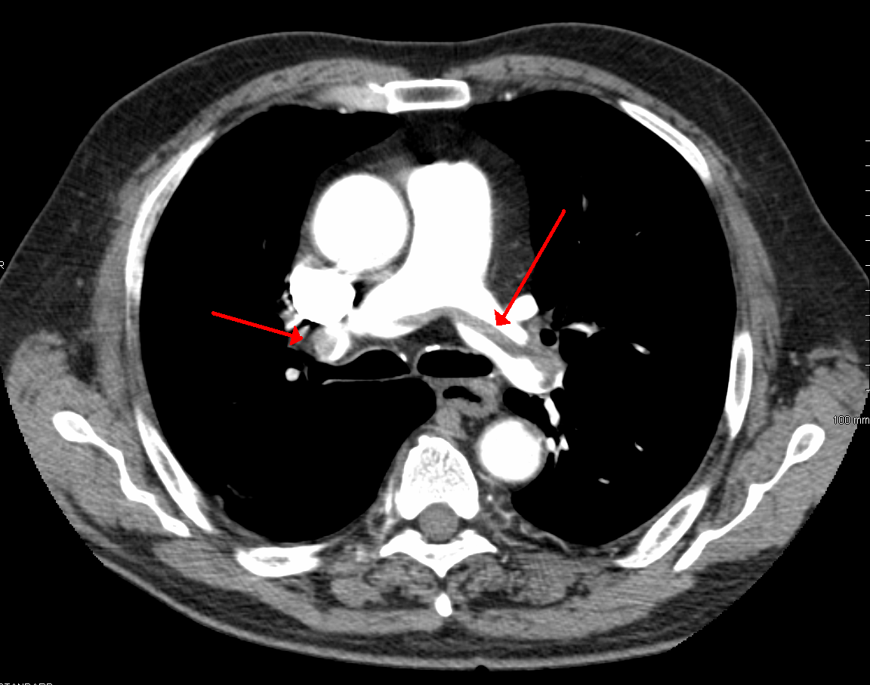
Reconstruction
X-ray detector
…
X-ray emitter

Slide 16
Reconstruction
Different θ’s
X-ray detector
…
X-ray emitter

Slide 17
Reconstruction
Each location on detector: Corresponds to multiple x₀’s
Different θ’s
X-ray detector
…
X-ray emitter

Slide 18
X-ray CT Reconstruction
Given the results of our scan (the sinogram):
$$(Rf)\left({\overset{⃑}{x}}_{0}, θ\right)=\int_{−∞}^{∞}{f\left({\overset{⃑}{x}}_{0}+t\overset{⃑}{θ}\right) |dt|}$$
Obtain the original data: (“density” of our body)
$$f(x,y)$$
In reality:
This is hard
We only scanned at certain (discrete) values of θ!
Consequence: Perfect reconstruction is impossible!

Slide 19
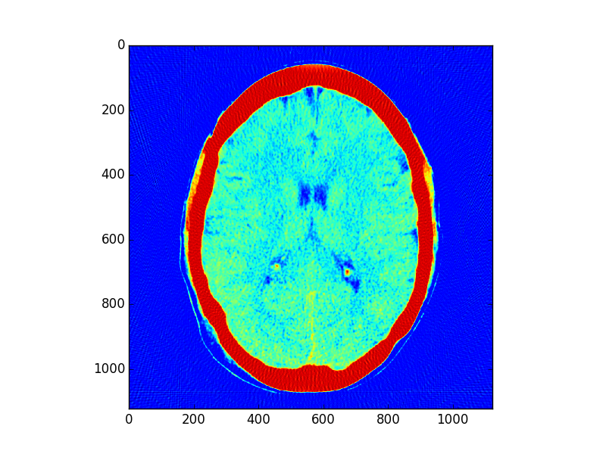
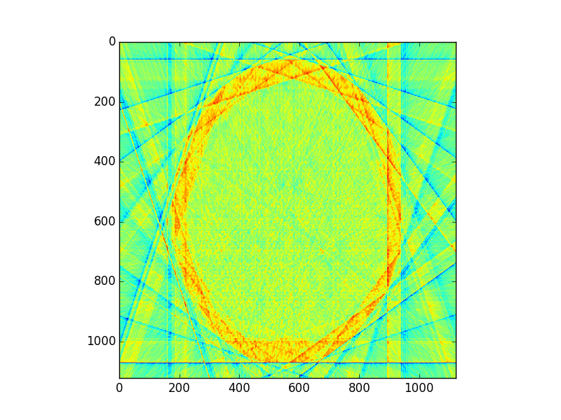
Imperfect Reconstruction
10 angles of imaging
200 angles of imaging

Slide 20
Reconstruction
Simpler algorithm – backprojection
Not quite inverse Radon transform!
Claim: Can reconstruct image as:
$$f_{r}(\overset{⃑}{x}) =\sum_{θ}{(Rf)\left(\overset{⃑}{x}, θ\right)}=\sum_{θ}{\int_{−∞}^{∞}{f\left(\overset{⃑}{x}+t\overset{⃑}{θ}\right) |dt|}}$$
(θ’s where X-rays are taken)
In other words: To reconstruct point, sum measurement along every line passing through that point

Slide 21
Reconstruction
Each location on detector: Corresponds to multiple x₀’s
Different θ’s
X-ray detector
…
X-ray emitter

Slide 22
Geometry Details
For x₀, need to find:
At each θ, which radiation measurement corresponds to the line passing through x₀?

Slide 23
Geometry Details
“The patient”
(slice)
Detector
Emitter

Slide 24
Geometry Details
“The patient”
(slice)
(x₀, y₀)
Detector
θ
Emitter

Slide 25
Geometry Details
Distance from sinogram centerline
d
“The patient”
(slice)
(x₀, y₀)
Detector
θ
Emitter

Slide 26
Geometry Details
Distance from sinogram centerline
d
“The patient”
(slice)
(x₀, y₀)
Detector
Radiation slope:
m = -cos(θ)/sin(θ)
θ
Emitter

Slide 27
Geometry Details
Distance from sinogram centerline
d
Perpendicular slope:
q = -1/m (correction)
(x₀, y₀)
Detector
Radiation slope:
m = -cos(θ)/sin(θ)
θ
θ
Emitter

Slide 28
Geometry Details
Find intersection point (x_{i},y_{i})
Then d² = x_{i}² + y_{i}²
Distance from sinogram centerline
d
Perpendicular slope:
q = -1/m (correction)
(x₀, y₀)
Detector
Radiation slope:
m = -cos(θ)/sin(θ)
θ
d
θ
Emitter

Slide 29
Intersection point
Line 1: (point-slope)
$$\left(y_{i}−y_{0}\right)=m(x_{i}−x_{0})$$
Line 2:
$$y_{i}=qx_{i}$$
Combine and solve:
$$x_{i}=\frac{y_{0}−mx_{0}}{q−m},y_{i}=qx_{i}$$
Corrections

Slide 30
Intersection point
Intersection point:
$$x_{i}=\frac{y_{0}−mx_{0}}{q−m}, y_{i}=qx_{i}$$
Distance from measurement centerline:
$$d=\sqrt{{x_{i}}^{2}+{y_{i}}^{2}}$$
Corrections

Slide 31
Geometry Details
Find intersection point (x_{i},y_{i})
Then d² = x_{i}² + y_{i}²
Distance from sinogram centerline
d
Perpendicular slope:
q = -1/m (correction)
(x₀, y₀)
Detector
Radiation slope:
m = -cos(θ)/sin(θ)
θ
d
θ
Emitter

Slide 32
Sequential pseudocode
$$f_{r}(\overset{⃑}{x})=\sum_{θ}{(Rf)\left(\overset{⃑}{x}, θ\right)}$$
(input: X-ray sinogram):
(allocate output image)
for all y in image:
for all x in image:
for all theta in sinogram:
calculate m from theta
calculate x_i, y_i from m, -1/m
calculate d from x_i, y_i
image[x,y] += sinogram[theta, “distance”]
Clarification: Remember not to confuse geometric x,y with pixel x,y!
(0,0) geometrically is the center pixel of the image, and (0,0) in pixel coordinates is the upper left hand corner. Image is indexed row-wise
Correction/clarification:
d is the distance from the center of the sinogram – remember to center index appropriately
Use –d instead of d as appropriate (when -1/m > 0 and x_i < 0, or if -1/m < 0 and x_i > 0

Slide 33
Sequential pseudocode
$$f_{r}(\overset{⃑}{x})=\sum_{θ}{(Rf)\left(\overset{⃑}{x}, θ\right)}$$
(input: X-ray sinogram):
(allocate output image)
for all y in image:
for all x in image:
for all theta in sinogram:
calculate m from theta
calculate x_i, y_i from m, -1/m
calculate d from x_i, y_i
image[x,y] += sinogram[theta, “distance”]
Parallelizable!
Inside loop depends only on x, y, theta
(corrections/clarification – see slide 37)

Slide 34
Sequential pseudocode
$$f_{r}(\overset{⃑}{x})=\sum_{θ}{(Rf)\left(\overset{⃑}{x}, θ\right)}$$
(input: X-ray sinogram):
(allocate output image)
for all y in image:
for all x in image:
for all theta in sinogram:
calculate m from theta
calculate x_i, y_i from m, -1/m
calculate d from x_i, y_i
image[x,y] += sinogram[theta, “distance”]
For this assignment, only parallelize w/r/to x, y
(provides lots of parallelization already, other issues)
(corrections/clarification – see slide 37)

Slide 35
Cautionary notes
y in an image is opposite of y geometrically!
(Graphics/computing convention)
Edge cases (divide-by-0):
θ = 0:
d = x₀
θ = π/2:
d = y₀

Slide 36
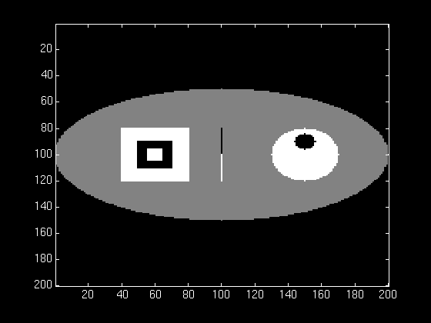
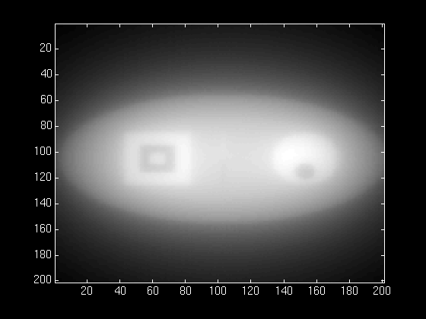
Almost a good reconstruction!
Original
Reconstruction

Slide 37
Almost a good reconstruction!
“Backprojection blur”
Similar to low-pass property of SMA (Week 1)
We need an “anti-blur”! (opposite of Homework 1)

Slide 38
Almost a good reconstruction!
Solution:
A “high-pass filter”
We can get frequency info in parallelizable manner!
(FFT, Week 3)

Slide 39
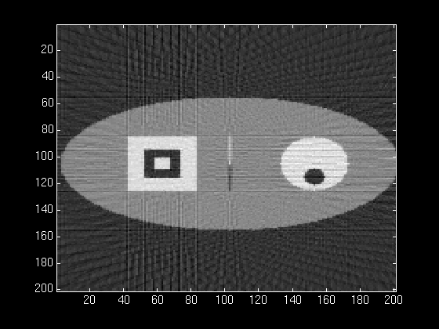
Almost a good reconstruction!
Solution:
A “high-pass filter”
We can get frequency info in parallelizable manner!
(FFT, Week 3)

Slide 40
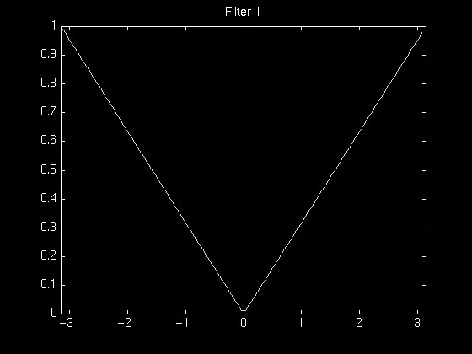
High-pass filtering
Instead of filtering on image (2D HPF):
Filter on sinogram! (1D HPF)
(Equivalent reconstruction by linearity)
Use cuFFT batch feature!
We’ll use a “ramp filter”
Retained amplitude is
linear function of frequency

Slide 41
Almost a good reconstruction!
CPU-side:
(input: X-ray sinogram):
calculate FFT on sinogram using cuFFT
call filterKernel on freq-domain data
Calculate IFFT on freq-domain data
-> get new sinogram
GPU-side:
filterKernel:
Select specific freq-amplitude
based on thread ID
Get new amplitude from
ramp equation

Slide 42
GPU Hardware
Non-coalesced access!
Sinogram 0, index ~d₀
Sinogram 1, index ~d₁
Sinogram 2, index ~d₂
…
…

Slide 43
GPU Hardware
Non-coalesced access!
Sinogram 0, index ~d₀
Sinogram 1, index ~d₁
Sinogram 2, index ~d₂
…
However:
Accesses are 2D spatially local!
…

Slide 44
GPU Hardware
Solution:
Cache sinogram in texture memory!
Read-only (un-modified once we load it)
Ignore coalescing
2D spatial caching!
…

Slide 45
Summary/pseudocode
(input: X-ray sinogram)
Filter sinogram (Slide 46)
Set up 2D texture cache on sinogram (Lecture 10):
Copy to CUDA array (2D)
Set addressing mode (clamp)
Set filter mode (linear, but won’t matter)
Set no normalization
Bind texture to sinogram
Calculate image backprojection (parallelize Slide 39)
Result: 200-250x speedup! (or more)

Slide 46
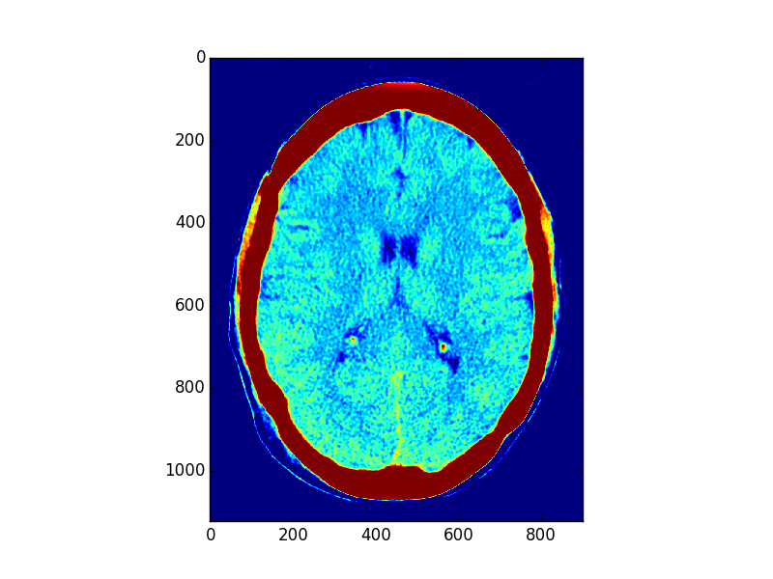
Result: 200-250x speedup! (or more)

Slide 47
Demo
We use two python scripts to prepare the data for the sinogram and to process the output.
preprocess.py
Simulated CT scanner
Forward Radon Transform
postprocess.py
Produces image based on CT Reconstruction

Slide 48
Demo
The “1_input_mpl_falsecolor.png" file is the rendering of the image with false color.

Slide 49
Demo
The "2_input_mpl_grayscale.png" file is the rendering of the image with greyscale.

Slide 50
Demo
The "3_sinogram_as_image.png" file is the sinogram in an image format.
Each column is a line of radiation measurement.

Slide 51
Demo
The "5_recon_output.png" file is the reconstructed image.
The output image of your program should resemble this image.

Slide 52
Demo
10 angles vs 100 angles
More angles allow us to view the body density much more accurately.

Slide 53
Demo

