Slide 1
CS 179: GPU Programming
Lecture 7

Slide 2
Week 3
Goals:
Advanced GPU-accelerable algorithms
CUDA libraries and tools

Slide 3
This Lecture
GPU-accelerable algorithms:
Reduction
Prefix sum
Stream compaction
Sorting (quicksort)

Slide 4
Elementwise Addition
Problem: C[i] = A[i] + B[i]
CPU code:
float *C = malloc(N * sizeof(float));
for (int i = 0; i < N; i++)
C[i] = A[i] + B[i];
GPU code:
// assign device and host memory pointers, and allocate memory in host int thread_index = threadIdx.x + blockIdx.x * blockDim.x;
while (thread_index < N) {
C[thread_index] = A[thread_index] + B[thread_index];
thread_index += blockDim.x * gridDim.x;
}

Slide 5
Reduction Example
Problem: SUM(A[])
CPU code:
float sum = 0.0;
for (int i = 0; i < N; i++)
sum += A[i];
GPU Pseudocode: // assign, allocate, initialize device and host memory pointers // create threads and assign indices for each thread // assign each thread a specific region to get a sum over // wait for all threads to finish running ( __syncthreads; ) // combine all thread sums for final solution

Slide 6
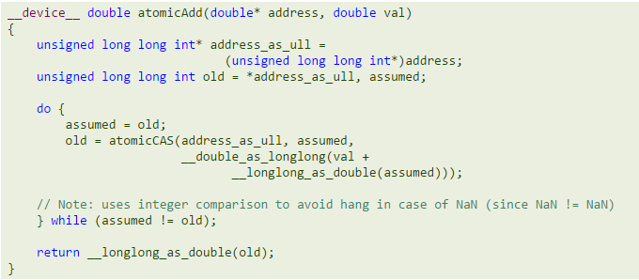
Naïve Reduction
Problem: Sum of Array
Serial Recombination causes speed reduction with GPUs, especially with higher number of threads
GPU must use atomic functions for mutex
atomicCAS
atomicAdd

Slide 7
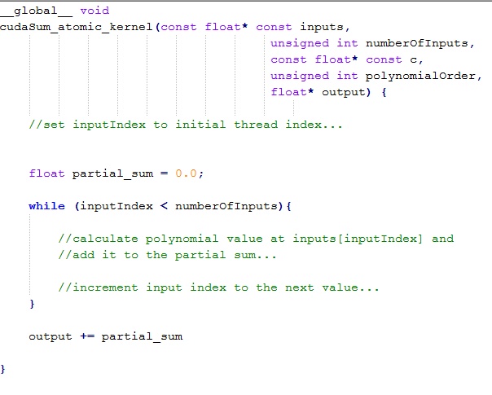
Naive Reduction
Suppose we wished to accumulate our results…

Slide 8
Naive Reduction
Suppose we wished to accumulate our results…
Thread-unsafe!

Slide 9
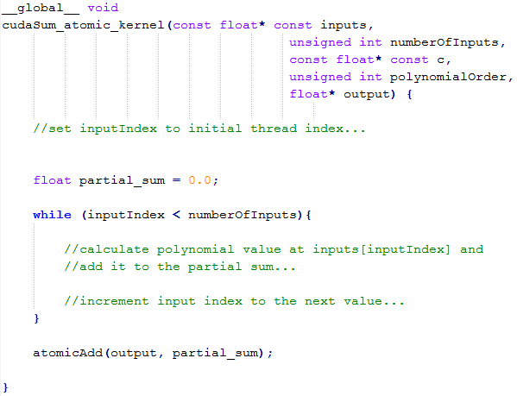
Naive (but correct) Reduction

Slide 10
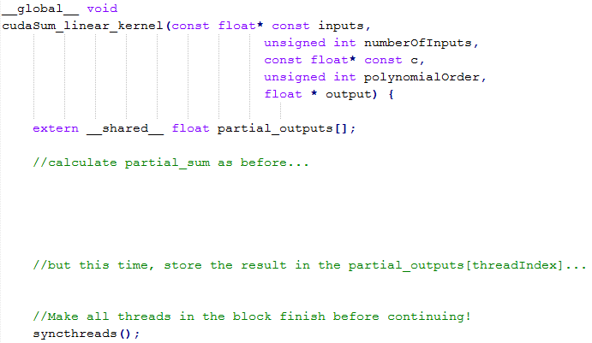
Shared memory accumulation

Slide 11
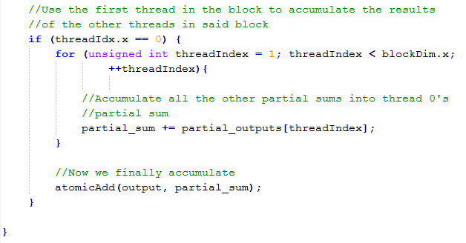
Shared memory accumulation (2)

Slide 12
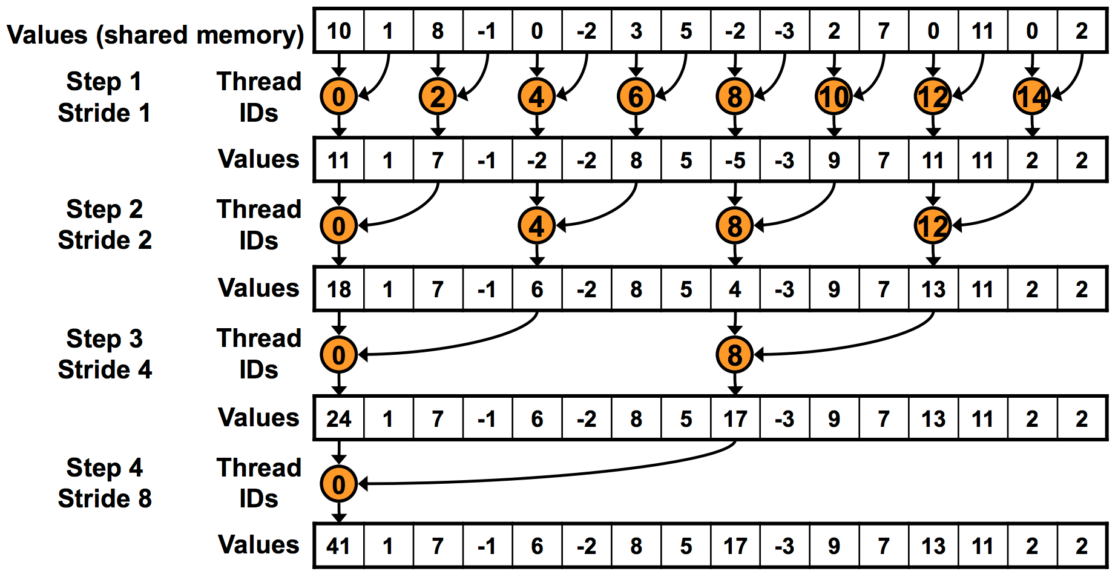
“Binary tree” reduction
One thread atomicAdd’s this to global result

Slide 13
“Binary tree” reduction
Use __syncthreads() before proceeding!

Slide 14
“Binary tree” reduction
Warp Divergence!
Odd threads won’t even execute

Slide 15
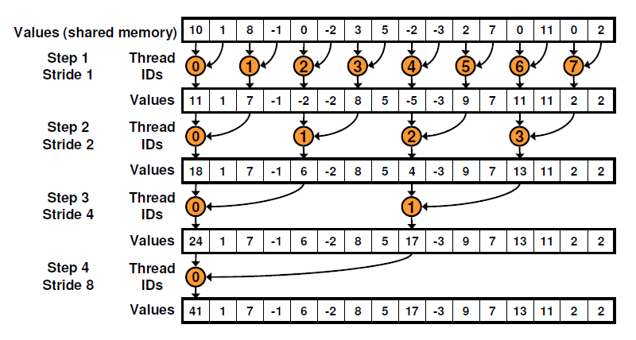
Non-divergent reduction

Slide 16
Non-divergent reduction
Shared Memory Bank Conflicts!
1st iteration: 2-way,
2nd iteration: 4-way (!), …

Slide 17
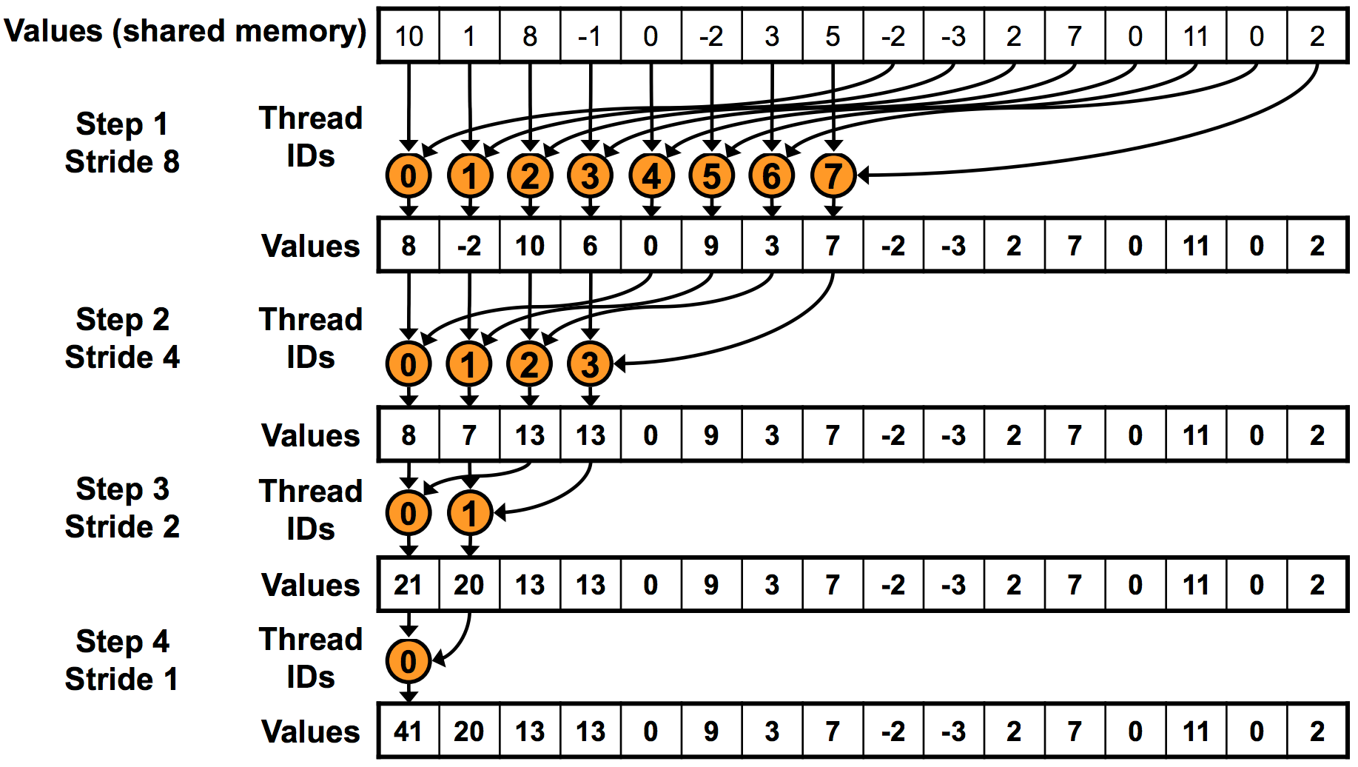
Sequential addressing
Sequential Addressing Automatically Resolves Bank Conflict Problems

Slide 18
Reduction
More improvements possible
“Optimizing Parallel Reduction in CUDA” (Harris)
Code examples!
Moral:
Different type of GPU-accelerized problems
Some are “parallelizable” in a different sense
More hardware considerations in play

Slide 19
Outline
GPU-accelerated:
Reduction
Prefix sum
Stream compaction
Sorting (quicksort)

Slide 20
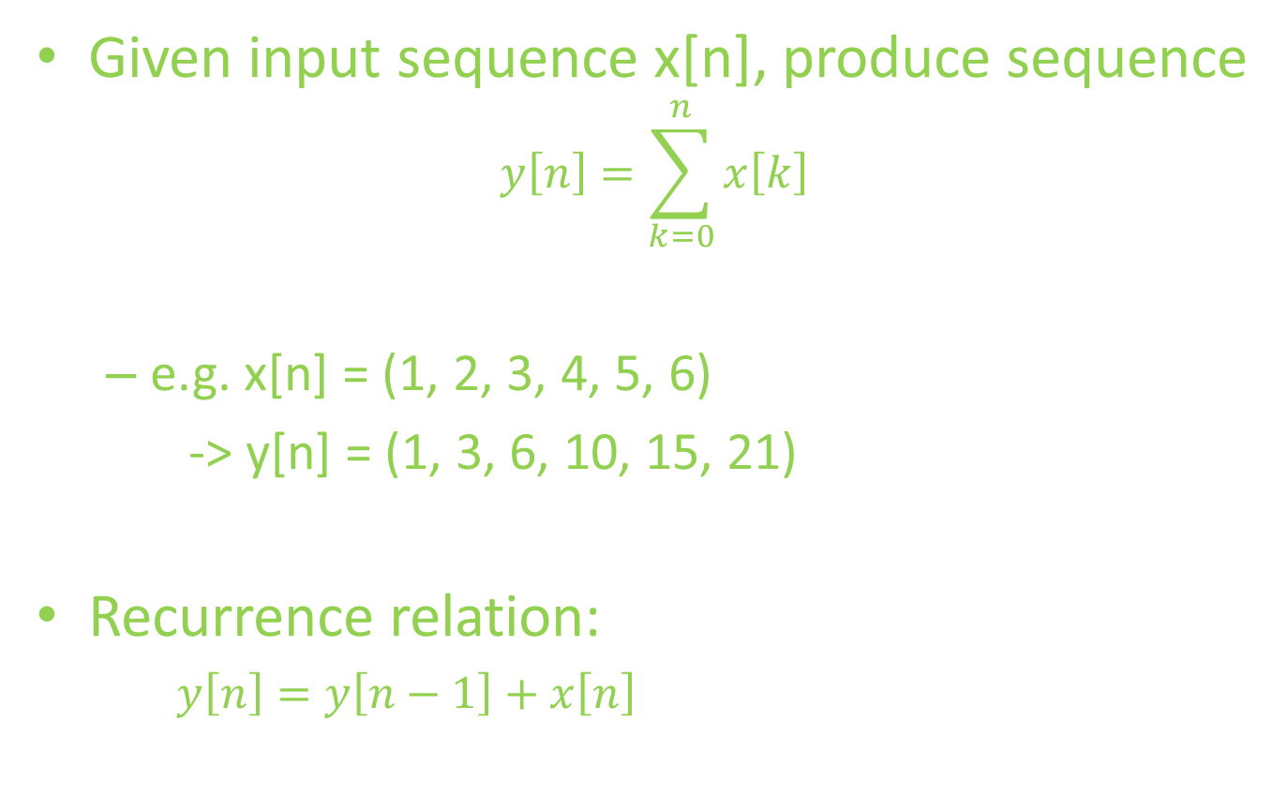
Prefix Sum
Given input sequence x[n], produce sequence
$$y\left[n\right]=\sum_{k=0}^{n}{x\left[k\right]}$$
e.g. x[n] = (1, 2, 3, 4, 5, 6)
-> y[n] = (1, 3, 6, 10, 15, 21)
Recurrence relation:
$y\left[n\right]=y\left[n−1\right]+x\left[n\right]$

Slide 21
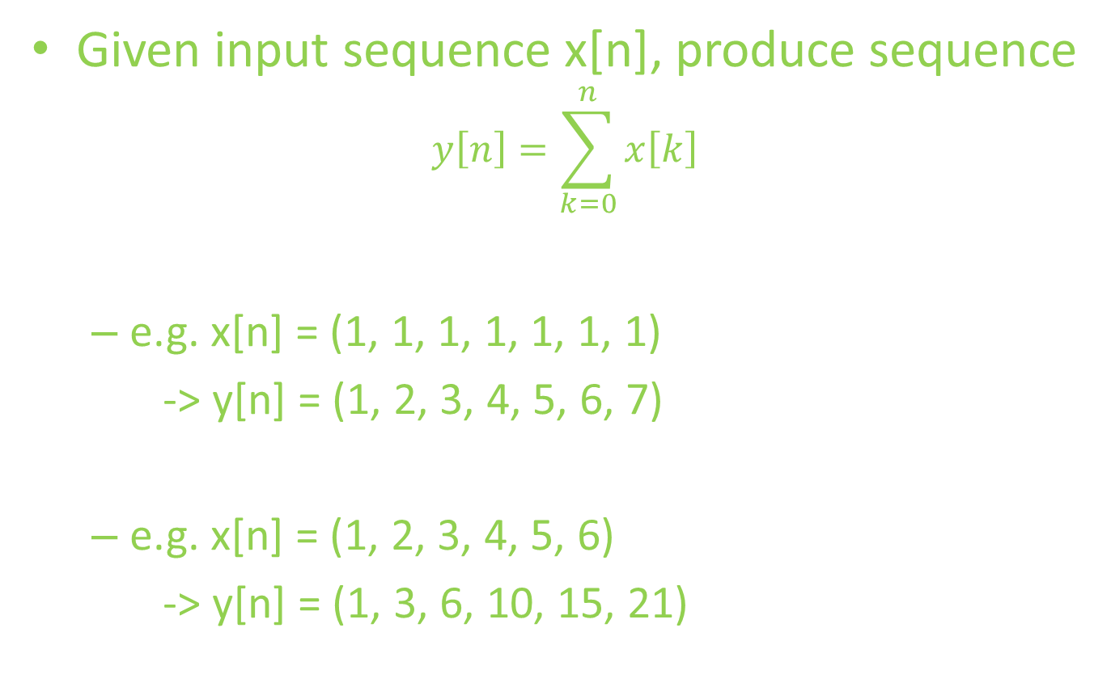
Prefix Sum
Given input sequence x[n], produce sequence
$$y\left[n\right]=\sum_{k=0}^{n}{x\left[k\right]}$$
e.g. x[n] = (1, 1, 1, 1, 1, 1, 1)
-> y[n] = (1, 2, 3, 4, 5, 6, 7)
e.g. x[n] = (1, 2, 3, 4, 5, 6)
-> y[n] = (1, 3, 6, 10, 15, 21)

Slide 22
Prefix Sum
Recurrence relation:
$y\left[n\right]=y\left[n−1\right]+x\left[n\right]$
Is it parallelizable? Is it GPU-accelerable?
Recall:
$y\left[n\right]=x\left[n\right]+x\left[n−1\right]+…+x[n−\left(K−1\right)]$
Easily parallelizable!
$y\left[n\right]=c∙x\left[n\right]+\left(1−c\right)∙y\left[n−1\right]$
Not so much

Slide 23
Prefix Sum
Recurrence relation:
$y\left[n\right]=y\left[n−1\right]+x\left[n\right]$
Is it parallelizable? Is it GPU-accelerable?
Goal:
Parallelize using a “reduction-like” strategy

Slide 24
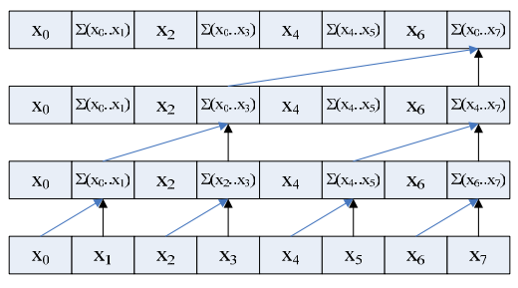
Prefix Sum sample code (up-sweep)
[1, 3, 3, 10, 5, 11, 7, 36]
[1, 3, 3, 10, 5, 11, 7, 26]
[1, 3, 3, 7, 5, 11, 7, 15]
[1, 2, 3, 4, 5, 6, 7, 8]
d = 2
d = 1
d = 0
Original array
for d = 0 to (log₂n) -1 do for all k = 0 to n-1 by 2^{d+1} in parallel do x[k + 2^{d+1} – 1] = x[k + 2^{d} -1] + x[k + 2^{d}]
We want:
[0, 1, 3, 6, 10, 15, 21, 28]
(University of Michigan EECS, http://www.eecs.umich.edu/courses/eecs570/hw/parprefix.pdf

Slide 25
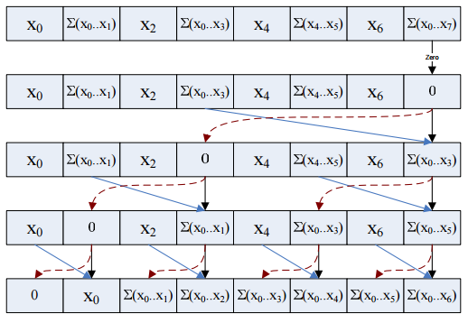
Prefix Sum sample code (down-sweep)
1: x[n – 1] 0 2: for d = log₂ n – 1 down to 0 do 3: for all k = 0 to n – 1 by 2 ^{d} +1 in parallel do 4: t = x[k + 2 ^{d} – 1] 5: x[k + 2 ^{d} – 1] = x[k + 2 ^{d} +1 – 1] 6: x[k + 2 ^{d} +1 – 1] = t + x[k + 2 ^{d} +1 – 1]
[1, 3, 3, 10, 5, 11, 7, 36]
[1, 3, 3, 10, 5, 11, 7, 0]
[1, 3, 3, 0, 5, 11, 7, 10]
[1, 0, 3, 3, 5, 10, 7, 21]
[0, 1, 3, 6, 10, 15, 21, 28]
Original: [1, 2, 3, 4, 5, 6, 7, 8]
x[n-1] = 0 for d = log₂(n) – 1 down to 0 do for all k = 0 to n-1 by 2^{d}+1 in parallel do t = x[k + 2^{d} – 1] x[k + 2^{d} – 1] = x[k + 2^{d}] x[k + 2^{d}] = t + x[k + 2^{d}]
Final result
(University of Michigan EECS, http://www.eecs.umich.edu/courses/eecs570/hw/parprefix.pdf

Slide 26
Prefix Sum (Up-Sweep)
Use __syncthreads() before proceeding!
Original array
(University of Michigan EECS, http://www.eecs.umich.edu/courses/eecs570/hw/parprefix.pdf

Slide 27
Prefix Sum (Down-Sweep)
Use __syncthreads() before proceeding!
Final result
(University of Michigan EECS, http://www.eecs.umich.edu/courses/eecs570/hw/parprefix.pdf

Slide 28
Prefix sum
Bank conflicts galore!
2-way, 4-way, …

Slide 29
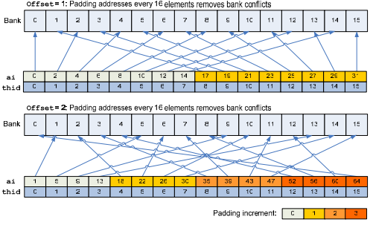
Prefix sum
Bank conflicts!
2-way, 4-way, …
Pad addresses!
(University of Michigan EECS, http://www.eecs.umich.edu/courses/eecs570/hw/parprefix.pdf

Slide 30
Prefix Sum
http://http.developer.nvidia.com/GPUGems3/gpugems3_ch39.html -- See Link for a More In-Depth Explanation of Up-Sweep and Down-Sweep

Slide 31
Outline
GPU-accelerated:
Reduction
Prefix sum
Stream compaction
Sorting (quicksort)

Slide 32
Stream Compaction
Problem:
Given array A, produce subarray of A defined by boolean condition
e.g. given array:
Produce array of numbers > 3
2 | 5 | 1 | 4 | 6 | 3
5 | 4 | 6

Slide 33
Stream Compaction
Given array A:
GPU kernel 1: Evaluate boolean condition,
Array M: 1 if true, 0 if false
GPU kernel 2: Cumulative sum of M (denote S)
GPU kernel 3: At each index,
if M[idx] is 1, store A[idx] in output at position (S[idx] - 1)
2 | 5 | 1 | 4 | 6 | 3
0 | 1 | 0 | 1 | 1 | 0
0 | 1 | 1 | 2 | 3 | 3
5 | 4 | 6

Slide 34
Outline
GPU-accelerated:
Reduction
Prefix sum
Stream compaction
Sorting (quicksort)

Slide 35
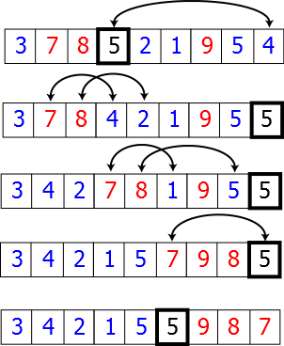
GPU-accelerated quicksort
Quicksort:
Divide-and-conquer algorithm
Partition array along chosen pivot point
Pseudocode:
quicksort(A, lo, hi):
if lo < hi:
p := partition(A, lo, hi)
quicksort(A, lo, p - 1)
quicksort(A, p + 1, hi)
Sequential version

Slide 36
GPU-accelerated partition
Given array A:
Choose pivot (e.g. 3)
Stream compact on condition: ≤ 3
Store pivot
Stream compact on condition: > 3 (store with offset)
2 | 5 | 1 | 4 | 6 | 3
2 | 1
2 | 1 | 3
2 | 1 | 3 | 5 | 4 | 6

Slide 37
GPU acceleration details
Continued partitioning/synchronization on sub-arrays results in sorted array

Slide 38
Final Thoughts
“Less obviously parallelizable” problems
Hardware matters! (synchronization, bank conflicts, …)
Resources:
GPU Gems, Vol. 3, Ch. 39
Highly Recommend Reading This Guide to CUDA Optimization, with a Reduction Example

