Slide 1
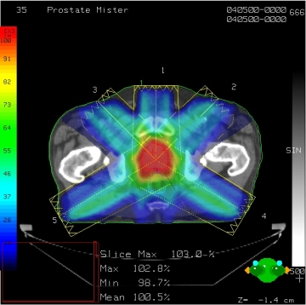
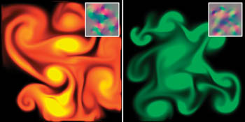
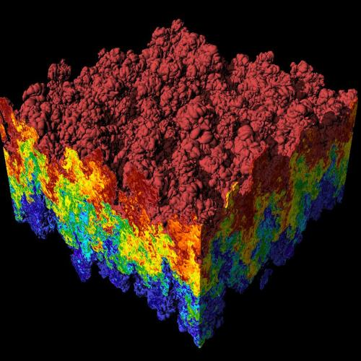
CS 179: GPU Programming
Lecture 19: Projects
Images: http://en.wikipedia.org
http://www.pcper.com
http://northdallasradiationoncology.com/
GPU Gems (Nvidia)
Notes:
1

Slide 2
Projects!
Set 6 is the last set
Independent GPU-based projects for the rest of the term
Deadlines:
Proposal: 11:59 PM, 5/12/16
CPU Demo: 3 PM, 5/20/16
Final Version & Write-Up: 3 PM, 6/3/16
We can't be lenient with these deadlines because this is the end of the year! Please start early!

Slide 3
Proposal
Summary of project (1-3 sentence)
Explanation of project background (1-3 paragraph)
Project details (1-2 paragraphs)
Why is this challenging? Has it been done before? What tricky things are you going to have to figure out? How does using a GPU help solve this problem?
Project goals (1 paragraph)
Week by week timeline
Must match our deadlines

Slide 4
CPU Demo
Must have a working CPU Demo by 05/20/2016
Your Demo must having all the parts of your project outlined in your proposal tested and analyzed
Code that will be parallelized in the final version should be implemented in a serial fashion for now (e.g. for loops instead of CUDA kernels)
GPU code is easily interchangeable with CPU code as long as the algorithm is parallelizable. Point is to have all of the pieces built so that you can easily put them together for the final version
Make sure any code that won't be turned into GPU code is easily scalable
^^More on this later

Slide 5
Final Version & Write-Up
Your final project should be submitted with comprehensive readme outlining everything we need to know about the program. This document should be clear and concise.
A sufficient readme should have all of the following:
Installation/Usage instructions
Explanation of what the program does
Expected results
Analysis of performance

Slide 6
Resources
There will be in-class office hours on Friday during weeks 7, 8, and 9. These will be in addition to normal office hours. Please utilize these office hours for getting feedback and help with projects.

Slide 7
Demos!

Slide 8
Next Time...
Last lecture! From now on, only in-class office hours on Fridays
Last lecture will be on project design concepts and tools
This will hopefully make your lives easier
In depth description of demo projects:
Orbit simulation
Raytracer
Collision Physics
OpenGL

