Slide 1
CS 179: GPU Computing
Lecture 16: Simulations and Randomness
Notes:
Resume – remarks:
Welcome back
Storytelling/motivational purposes
Introducing

Slide 2
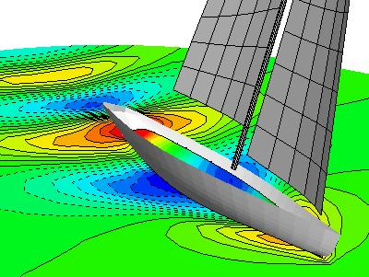
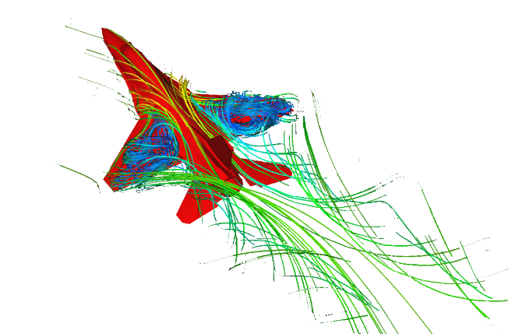
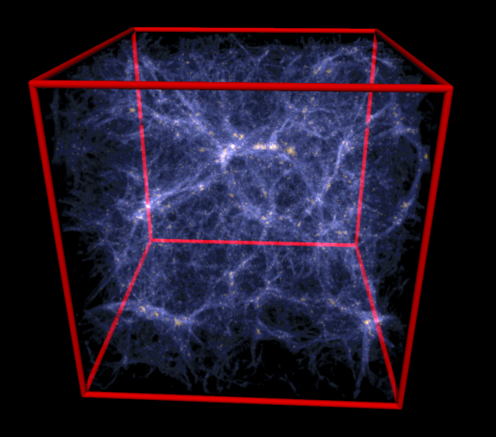
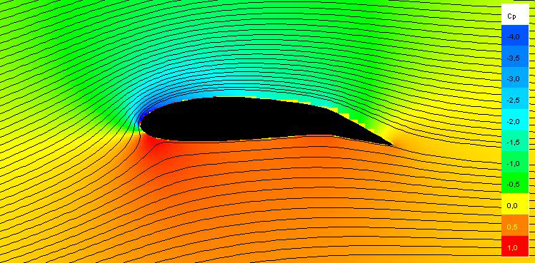
Simulations
Exa Corporation, http://www.exa.com/images/f16.png
South Bay Simulations, http://www.panix.com/~brosen/graphics/iacc.400.jpg
Flysurfer Kiteboarding, http://www.flysurfer.com/wp-content/blogs.dir/3/files/gallery/research-and-development/zwischenablage07.jpg
Max-Planck Institut, http://www.mpa-garching.mpg.de/gadget/hydrosims/

Slide 3
Simulations
But what if your problem is hard to solve? e.g.
EM radiation attenuation
Estimating complex probability distributions
Complicated ODEs, PDEs
(e.g. option pricing in last lecture)
Geometric problems w/o closed-form solutions
Volume of complicated shapes

Slide 4
Simulations
Potential solution: Monte Carlo methods
Run simulation with randomly chosen inputs
(Possibly according to some distribution)
Do it again… and again… and again…
Aggregate results

Slide 5
Monte Carlo example
Estimating the value of π

Slide 6
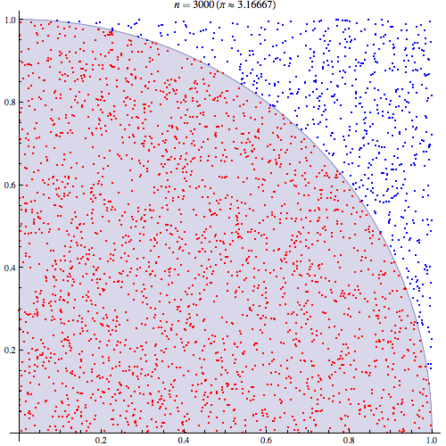
Monte Carlo example
Estimating the value of π
Quarter-circle of radius r:
Area = (πr²)/4
Enclosing square:
Area = r²
Fraction of area: π/4
"Pi 30K" by CaitlinJo - Own workThis mathematical image was created with Mathematica. Licensed under CC BY 3.0 via Wikimedia Commons - http://commons.wikimedia.org/wiki/File:Pi_30K.gif#/media/File:Pi_30K.gif

Slide 7
Monte Carlo example
Estimating the value of π
Quarter-circle of radius r:
Area = (πr²)/4
Enclosing square:
Area = r²
Fraction of area: π/4 ≈ 0.79
“Solution”: Randomly generate lots of points, calculate fraction within circle
Answer should be pretty close!
"Pi 30K" by CaitlinJo - Own workThis mathematical image was created with Mathematica. Licensed under CC BY 3.0 via Wikimedia Commons - http://commons.wikimedia.org/wiki/File:Pi_30K.gif#/media/File:Pi_30K.gif

Slide 8
Monte Carlo example
Pseudocode:
(simulate on N points)
(assume r = 1)
points_in_circle = 0
for i = 0,…,N-1:
randomly pick point (x,y) from
uniform distribution in [0,1]²
if (x,y) is in circle:
points_in_circle++
return (points_in_circle / N) * 4
"Pi 30K" by CaitlinJo - Own workThis mathematical image was created with Mathematica. Licensed under CC BY 3.0 via Wikimedia Commons - http://commons.wikimedia.org/wiki/File:Pi_30K.gif#/media/File:Pi_30K.gif

Slide 9
Monte Carlo example
Pseudocode:
(simulate on N points)
(assume r = 1)
points_in_circle = 0
for i = 0,…,N-1:
randomly pick point (x,y) from
uniform distribution in [0,1]²
if x^2 + y^2 < 1:
points_in_circle++
return (points_in_circle / N) * 4
"Pi 30K" by CaitlinJo - Own workThis mathematical image was created with Mathematica. Licensed under CC BY 3.0 via Wikimedia Commons - http://commons.wikimedia.org/wiki/File:Pi_30K.gif#/media/File:Pi_30K.gif

Slide 10
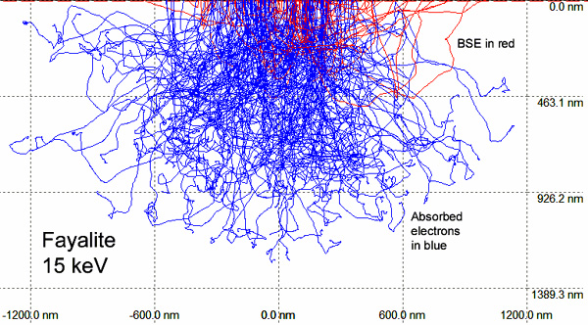
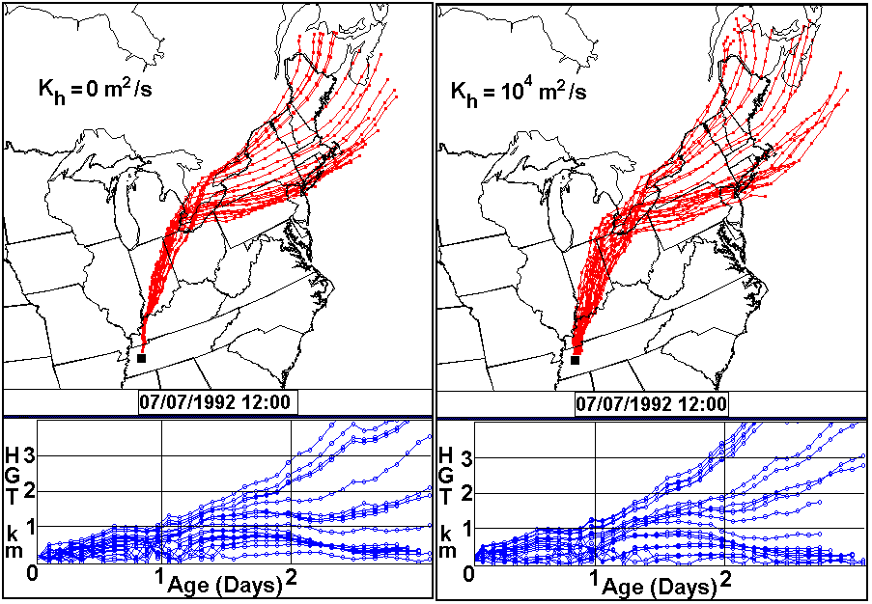
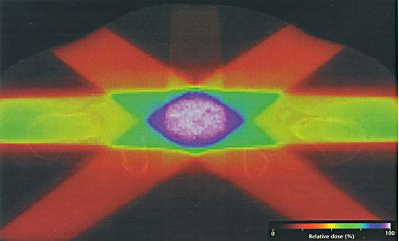
Monte Carlo simulations
Planetary Materials Microanalysis Facility, , Northern Arizona University, http://www4.nau.edu/microanalysis/microprobe-sem/Images/Monte_Carlo.jpg
Center for Air Pollution Impact & Trend Analysis, Washington University in St. Louis, http://www4.nau.edu/microanalysis/microprobe-sem/Images/Monte_Carlo.jpg
http://www.cancernetwork.com/sites/default/files/cn_import/n0011bf1.jpg

Slide 11
General Monte Carlo method
Pseudocode:
for (number of trials):
randomly pick value from a probability distribution
perform deterministic computation on inputs
(aggregate results)

Slide 12
General Monte Carlo method
Why it works:
Law of large numbers!

Slide 13
General Monte Carlo method
Pseudocode:
for (number of trials):
randomly pick value from a probability distribution
perform deterministic computation on inputs
(aggregate results)
Can we parallelize this?

Slide 14
General Monte Carlo method
Pseudocode:
for (number of trials):
randomly pick value from a probability distribution
perform deterministic computation on inputs
(aggregate results)
Can we parallelize this?
Trials are independent

Slide 15
General Monte Carlo method
Pseudocode:
for (number of trials):
randomly pick value from a probability distribution
perform deterministic computation on inputs
(aggregate results)
Can we parallelize this?
Trials are independent
Usually so
(e.g. with reduction)

Slide 16
General Monte Carlo method
Pseudocode:
for (number of trials):
randomly pick value from a probability distribution
perform deterministic computation on inputs
(aggregate results)
Can we parallelize this?
What about this?
Trials are independent
Usually so
(e.g. with reduction)

Slide 17
Parallelized Random Number Generation

Slide 18
Early Credits
Algorithm and presentation based on:
“Parallel Random Numbers: As Easy as 1, 2, 3”
(Salmon, Moraes, Dror, Shaw) at D. E. Shaw Research
Developed for biomolecular simulations on Anton (massively parallel ASIC-based supercomputer)
Also applicable to CPUs, GPUs

Slide 19
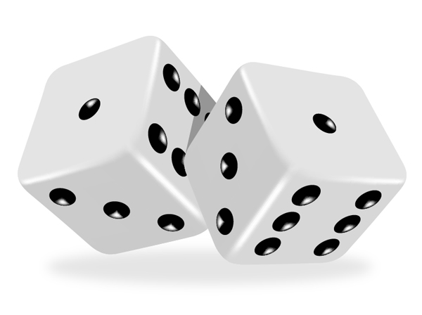
Random Number Generation
Generating random data computationally is hard
Computers are deterministic!
https://cdn.tutsplus.com/vector/uploads/legacy/tuts/165_Shiny_Dice/27.jpg

Slide 20
Random Number Generation
Two methods:
Hardware random number generator
aka TRNG (“True” RNG)
Uses data collected from environment (thermal, optical, etc)
Very slow!
Pseudorandom number generator (PRNG)
Algorithm that produces “random-looking” numbers
Faster – limited by computational power

Slide 21
Demonstration

Slide 22
Random Number Generation
PRNG algorithm should be:
High-quality
Produce “good” random data
Fast
(In its own right)
Parallelizable!
Can we do it?
(Assume selection from uniform distribution)

Slide 23
A Very Basic PRNG
“Linear congruential generator” (LCG)
e.g. C’s rand()
General formula:
$$X_{n+1}=\left(aX_{n}+c\right) \text{mod} m$$
X₀ is the “seed” (e.g. system time)
//from glibc
int32_t val = state[0];
val = ((state[0] * 1103515245) + 12345)
& 0x7fffffff;
state[0] = val;
*result = val;

Slide 24
A Very Basic PRNG
“Linear congruential generator” (LCG)
e.g. C’s rand()
General formula:
$$X_{n+1}=\left(aX_{n}+c\right) \text{mod} m$$
//from glibc
int32_t val = state[0];
val = ((state[0] * 1103515245) + 12345)
& 0x7fffffff;
state[0] = val;
*result = val;
Non-parallelizable recurrence relation!

Slide 25
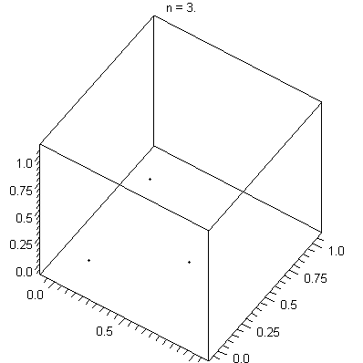
Linear congruential generators
$$X_{n+1}=\left(aX_{n}+c\right) \text{mod} m$$
Not high quality!
Clearly non-uniform
Fast to compute
Not parallelizable!
"Lcg 3d". Licensed under CC BY-SA 3.0 via Wikimedia Commons - http://commons.wikimedia.org/wiki/File:Lcg_3d.gif#/media/File:Lcg_3d.gif

Slide 26
Measures of RNG quality
Impossible to prove a sequence is “random”
Possible tests:
Frequency
Periodicity - do the values repeat too early?
Linear dependence
…

Slide 27
PRNG Parallelizability
Many PRNGs (like the LCG) have a non-parallelizable appearance:
$$X_{n+1}={f(X}_{n})$$
(Better chance of good data when):
All $X_{i}$ in some large state space
Complicated function f

Slide 28
PRNG Parallelizability
Possible “approach” to GPU parallelization:
Assign a PRNG to each thread!
Initialize with e.g. different X₀
Thread 0 produces sequence $X_{n+1,0}={ f(X}_{n,0})$
Thread 1 produces sequence $X_{n+1,1}={ f(X}_{n,1})$
…

Slide 29
PRNG Parallelizability
Possible “approach” to GPU parallelization:
Assign a PRNG to each thread!
Initialize with e.g. different X₀
Thread 0 produces sequence $X_{n+1,0}={ f(X}_{n,0})$
Thread 1 produces sequence $X_{n+1,1}={ f(X}_{n,1})$
…
In practice, often cannot get high quality
Repeated values, lack of good, enumerable parameters

Slide 30
PRNG Parallelizability
Instead of:
$$X_{n+1}={f(X}_{n})$$
Suppose we had:
$$X_{n+1}=b\left(n\right)$$
This is parallelizable! (Without our previous “trick”)
Is this possible?

Slide 31
More General PRNG
“Keyed” PRNG given by:
Transition function: $f: S→S$
Output function: $g:K×S→U$
S: Internal (hidden) state space
U: Output space
K: “Key space”
Can “seed” output behavior without relying on X₀ alone – useful for scientific reproducibility!

Slide 32
More General PRNG
“Keyed” PRNG given by:
Transition function: $f: S→S$
Output function: $g:K×S→U$
S: Internal (hidden) state space
U: Output space
K: “Key space”
Can “seed” output behavior without relying on X₀ alone – useful for scientific reproducibility!
If S has J times more bits than U, can produce J outputs per transition.
Assume J = 1 in this lecture

Slide 33
More General PRNG
“Keyed” PRNG given by:
Transition function: $f: S→S$
Output function: $g:K×S→U$
“Trivial” example: LCG $X_{n+1}=\left(aX_{n}+c\right) \text{mod} m$
$f\left(X_{n}\right)=aX_{n}+c$
$g\left(X_{n}\right)=X_{n}$
S is (for example) the space of 32-bit integers
U = S
K is “trivial” (no keys used)

Slide 34
More General PRNG
“Keyed” PRNG given by:
Transition function: $f: S→S$
Output function: $g:K×S→U$
“Trivial” example: LCG $X_{n+1}=\left(aX_{n}+c\right) \text{mod} m$
$f\left(X_{n}\right)=aX_{n}+c$
$g\left(X_{n}\right)=X_{n}$
f is more complicated than g!

Slide 35
More General PRNG
“Keyed” PRNG given by:
Transition function: $f: S→S$
Output function: $g:K×S→U$
General theme: f is complicated, g is simple
What if we flipped that?

Slide 36
More General PRNG
“Keyed” PRNG given by:
Transition function: $f: S→S$
Output function: $g:K×S→U$
General theme: f is complicated, g is simple
What if we flipped that?
What if f were so simple that it could be evaluated explicity?

Slide 37
More General PRNG
i.e. what if we had:
Simple transition function (p-bit integer state space):
$$f\left(s\right)=(s+1) \text{mod} 2^{p}$$
This is just a counter! Can expand into explicit formula
$$f\left(n\right)=(n+n_{0}) \text{mod} 2^{p}$$
These form counter-based PRNGs
Complicated output function g
Would this work?

Slide 38
More General PRNG
i.e. what if we had:
Simple transition function f
Complicated output function g(k, n)
Should be bijective w/r/to n
Guarantees period of 2^{p}
Shouldn’t be too difficult to compute

Slide 39
Bijective Functions
Cryptographic block ciphers!
AES (Advanced Encryption Standard), Threefish, …
Must be bijective!
(Otherwise messages can’t be encrypted/decrypted)

Slide 40
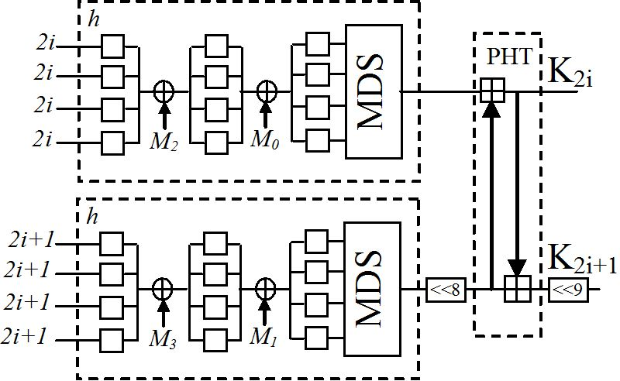
AES-128 Algorithm
1) Key Expansion
Determine all keys k from initial cipher key k_{B}
Used to strengthen weak keys
Sohaib Majzoub and Hassan Diab, Reconfigurable Systems for Cryptography and Multimedia Applications, http://www.intechopen.com/source/html/38442/media/image19_w.jpg

Slide 41
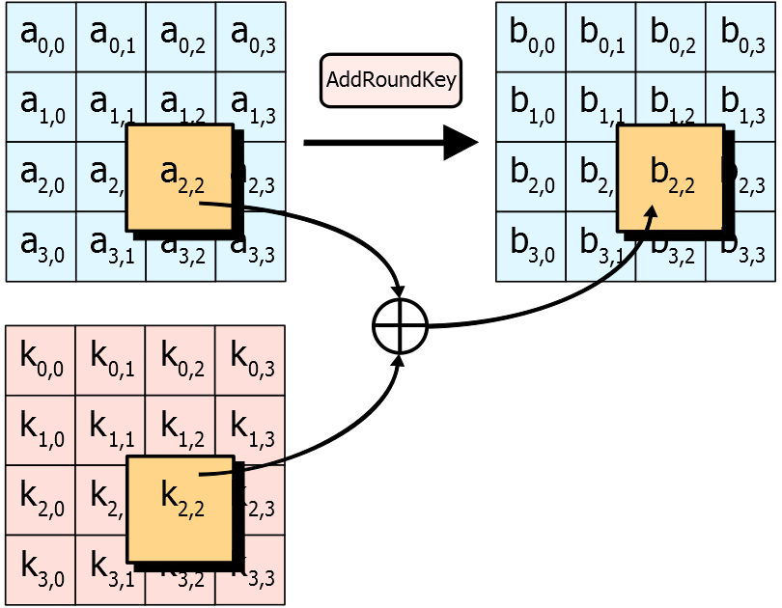
AES-128 Algorithm
2) Add round key
Bitwise XOR state s with key k₀
By User:Matt Crypto - Own work. Licensed under Public Domain via Wikimedia Commons - http://commons.wikimedia.org/wiki/File:AES-AddRoundKey.svg#/media/File:AES-AddRoundKey.svg

Slide 42
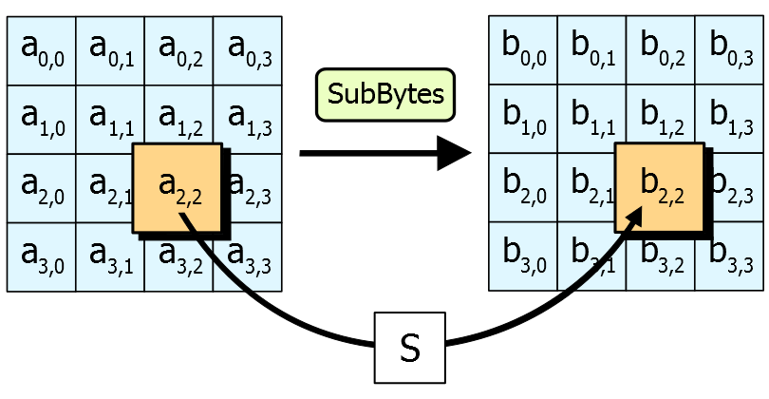
AES-128 Algorithm
3) For each round… (10 rounds total)
a) Substitute bytes
Use lookup table to switch positions
By User:Matt Crypto - Own work. Licensed under Public Domain via Wikimedia Commons - http://commons.wikimedia.org/wiki/File:AES-AddRoundKey.svg#/media/File:AES-AddRoundKey.svg

Slide 43
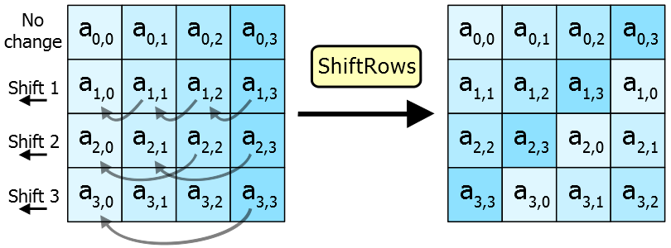
AES-128 Algorithm
3) For each round…
b) Shift rows
By User:Matt Crypto - Own work. Licensed under Public Domain via Wikimedia Commons - http://commons.wikimedia.org/wiki/File:AES-AddRoundKey.svg#/media/File:AES-AddRoundKey.svg

Slide 44
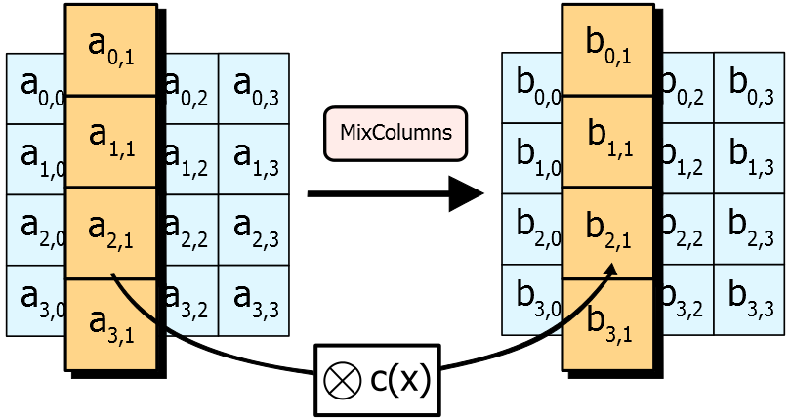
AES-128 Algorithm
3) For each round…
c) Mix columns
Multiply by constant matrix
By User:Matt Crypto - Own work. Licensed under Public Domain via Wikimedia Commons - http://commons.wikimedia.org/wiki/File:AES-AddRoundKey.svg#/media/File:AES-AddRoundKey.svg

Slide 45
AES-128 Algorithm
3) For each round…
d) Add round key (as before)
By User:Matt Crypto - Own work. Licensed under Public Domain via Wikimedia Commons - http://commons.wikimedia.org/wiki/File:AES-AddRoundKey.svg#/media/File:AES-AddRoundKey.svg

Slide 46
AES-128 Algorithm
4) Final round
Do everything in normal round except mix columns

Slide 47
AES-128 Algorithm
Summary:
1) Expand keys
2) Add round key
3) For each round (10 rounds total)
Substitute bytes
Shift rows
Mix columns
Add round key
4) Final round:
(do everything except mix columns)

Slide 48
Algorithmic Improvements
We have a good PRNG!
Simple transition function f
Counter
Complicated output function g(k, n)
AES-128

Slide 49
Algorithmic Improvements
We have a good PRNG!
Simple transition function f
Counter
Complicated output function g(k, n)
AES-128
High quality!
Passes Crush test suite (more on that later)
Parallelizable!
f and g only depend on k, n !
Sort of slow to compute
AES is sort of slow without special instructions (which GPUs don’t have)

Slide 50
Algorithmic Improvements
Can we “make AES go faster”?
AES is a cryptographic algorithm, but we’re using it for PRNG
Can we change the algorithm for our purposes?

Slide 51
AES-128 Algorithm
Summary:
1) Expand keys
2) Add round key
3) For each round (10 rounds total)
Substitute bytes
Shift rows
Mix columns
Add round key
4) Final round:
(do everything except mix columns)

Slide 52
AES-128 Algorithm
Purpose of this step is to hide key from attacker using chosen plaintext.
Not relevant here.
Summary:
1) Expand keys
2) Add round key
3) For each round (10 rounds total)
Substitute bytes
Shift rows
Mix columns
Add round key
4) Final round:
(do everything except mix columns)

Slide 53
AES-128 Algorithm
Purpose of this step is to hide key from attacker using chosen plaintext.
Not relevant here.
Summary:
1) Expand keys
2) Add round key
3) For each round (10 rounds total)
Substitute bytes
Shift rows
Mix columns
Add round key
4) Final round:
(do everything except mix columns)
Do we really need this many rounds?
Other changes?

Slide 54
Key Schedule Change
Old key schedule:
The first n bytes of the expanded key are simply the encryption key.
The rcon iteration value i is set to 1
Until we have b bytes of expanded key, we do the following to generate n more bytes of expanded key:
We do the following to create 4 bytes of expanded key:
We create a 4-byte temporary variable, t
We assign the value of the previous four bytes in the expanded key to t
We perform the key schedule core (see above) on t, with i as the rcon iteration value
We increment i by 1
We exclusive-OR t with the four-byte block n bytes before the new expanded key. This becomes the next 4 bytes in the expanded key
We then do the following three times to create the next twelve bytes of expanded key:
We assign the value of the previous 4 bytes in the expanded key to t
We exclusive-OR t with the four-byte block n bytes before the new expanded key. This becomes the next 4 bytes in the expanded key
If we are processing a 256-bit key, we do the following to generate the next 4 bytes of expanded key:
We assign the value of the previous 4 bytes in the expanded key to t
We run each of the 4 bytes in t through Rijndael's S-box
We exclusive-OR t with the 4-byte block n bytes before the new expanded key. This becomes the next 4 bytes in the expanded key.
New key schedule:
k₀ = k_{B}
k_{i+1} = k_{i} + constant
e.g. golden ratio
Copied from Wikipedia (Rijndael Key Schedule)

Slide 55
AES-128 Algorithm
Summary:
1) Expand keys using simplified algorithm
2) Add round key
3) For each round (10 5 rounds total)
Substitute bytes
Shift rows
Mix columns
Add round key
4) Final round:
(do everything except mix columns)
Other simplifications possible!

Slide 56
Algorithmic Improvements
We have a good PRNG!
Simple transition function f
Counter
Complicated output function g(k, n)
Modified AES-128 (known as ARS-5)
High quality!
Passes Crush test suite (more on that later)
Parallelizable!
f and g only depend on k, n !
Moderately faster to compute

Slide 57
Even faster parallel PRNGs
Use a different g, e.g.
Threefish cipher
Optimized for PRNG – known as “Threefry”
“Philox”
(see paper for details)
202 GB/s on GTX580!
Fastest known PRNG in existence

Slide 58
General Monte Carlo method
Pseudocode:
for (number of trials):
randomly pick value from a probability distribution
perform deterministic computation on inputs
(aggregate results)
Can we parallelize this?
What about this?
Trials are independent
Usually so
(e.g. with reduction)

Slide 59
General Monte Carlo method
Pseudocode:
for (number of trials):
randomly pick value from a probability distribution
perform deterministic computation on inputs
(aggregate results)
Can we parallelize this?
Yes!
Part of cuRAND
Yes!
Trials are independent
Usually so
(e.g. with reduction)

Slide 60
Summary
Monte Carlo methods
Very useful in scientific simulations
Parallelizable because of…
Parallelized random number generation
Another story of “parallel algorithm analysis”

Slide 61
Credits (again)
Parallel RNG algorithm and presentation based on:
“Parallel Random Numbers: As Easy as 1, 2, 3”
(Salmon, Moraes, Dror, Shaw) at D. E. Shaw Research

