Slide 1
CS 179 Lecture 14
Pipeline parallelism and Multi–GPU Programming

Slide 2
Last time
HD 0
 | kernel 0
 |  | DH 0
HD 1
 | kernel 1
 |  | DH 1
HD 2
 | kernel 2
HD 0
HD 1 | kernel 0
HD 2 | kernel 1 | DH 0
HD 3 | kernel 2 | DH 1
HD 4 | kernel 3 | DH 2
HD 5 | kernel 4 | DH 3
HD 6 | kernel 5 | DH 4
HD 7 | kernel 6 | DH 5
streams

Slide 3
Today
Pipeline parallelism
Programming multiple GPUs
General theme of week:
Using all of your computational resources in parallel.
Notes:
been parallelizing solely within the GPU, but there are also other higher-level types of parallelism to consider

Slide 4
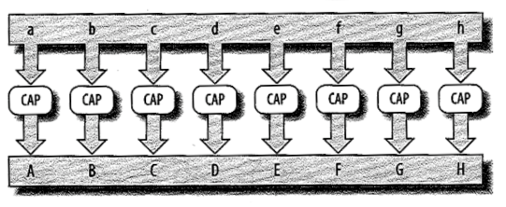
Converting all characters in an array to upper-case:
No dependencies
Data Parallelism (figures from James Reinders)
Notes:
This is what we’ve been doing with CUDA. SIMD model
All threads do the same computation. Computations are independent.

Slide 5
Task Parallelism
Notes:
Threads compute different independent tasks.
Not normally what we do on GPU, but something we could do if we’re careful to avoid thread divergence.

Slide 6
Parallelizing over one iteration
Pipeline Parallelism
Notes:
Quite different from previous forms of parallelism.
One computation, but we break it up into multiple parts. Each thread handles one part of computation.
Useful to parallelize things that don’t seem easily parallelizable (but does require multiple stages of computation).
Requires low-overhead queues (producer-consumer problem from CS 24).
This is what we’ve been talking about with CUDA streams and asynchronous functions.

Slide 7
Pipeline parallelism on GPU
while (1) {
cudaMemcpy(d_in, h_in, input_size, cudaMemcpyHostToDevice);
kernel<<<grid, block>>>(d_input, d_output);
cudaMemcpy(h_out, d_out, output_size, cudaMemcpyDeviceToHost);
}
3 stage pipeline:
Host to Device
Kernel
Device to Host

Slide 8
Stage 0 | Stage 1 | Stage 2
HD 0
HD 1 | kernel 0
HD 2 | kernel 1 | DH 0
HD 3 | kernel 2 | DH 1
HD 4 | kernel 3 | DH 2
HD 5 | kernel 4 | DH 3
time
Stage computed by: | HD copy engine | SM’s | DH copy engine
Pipeline parallelism in action
Notes:
Note we have a separate piece of hardware for each stage of the pipeline.
Could run multiple kernels concurrently, but no real advantage because they are still sharing hardware.

Slide 9
Pipeline analysis
What are the latency and throughput of a pipeline?
(Hint: Analyze with with respect to latency and throughput of each stage of pipeline)

Slide 10
Pipeline analysis
Stage throughput = 1 / (stage latency)
Pipeline throughput = minimum of stage throughputs
Pipeline latency = sum of stage latencies
All of this assumes a stage can handle one packet of data at a time.

Slide 11
Pipeline throughput analysis
Pipeline throughput
= minimum of stage throughputs
= minimum of (1 / stage latency)
= 1 / (maximum stage latency)
Equal because we assume each stage can only handle one packet of data at a time…

Slide 12
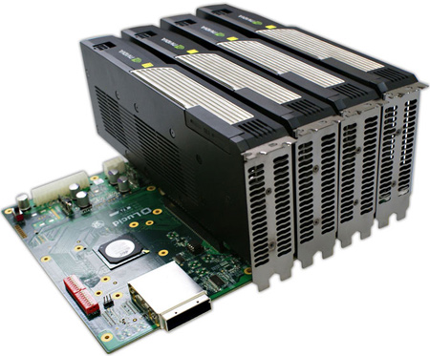
Multiple GPUs
Can put multiple GPUs in a single computer.
CUDA provides interfaces to dispatch work to more than 1 GPU.
haru has 3x GTX 570

Slide 13
Simple interface
cudaGetDeviceCount -
how many CUDA capable GPUs?
cudaSetDevice(int i) -
execute future commands on GPU i.
NVIDIA refers to multiple GPUs as “peers”

Slide 14
Data movement
Thanks to unified virtual addressing, you can just use cudaMemcpy with cudaMemcpyDefault to move data between GPUs.
Actually possible to DMA to one GPU from another and skip the host entirely.
Memcpy breaks concurrency on both GPUs.

Slide 15
Data access
Depending on hardware and motherboard layout, peers can have ability to directly access each other’s memory over PCI-E.
cudaDeviceCanAccessPeer tells if access is possible
cudaDeviceEnablePeerAccess enables peer access.

Slide 16
Peer access example
Peer access is asymmetric
// allow device 0 to access device 1 memory
cudaSetDevice(0);
cudaDeviceEnablePeerAccess(1, 0);
// allow device 1 to access device 0 memory
cudaSetDevice(1);
cudaDeviceEnablePeerAccess(0, 0);
Notes:
Second argument to cudaDeviceEnablePeerAccess is a flag that must be 0 as of right now

Slide 17
Peer access use cases & alternative
Peer access use cases are similar to using pinned host memory (both involve all accesses going over PCI-E).
Simpler alternative: use managed memory! Also accessible on host, cudaMallocManaged
Notes:
Could imagine pipeline parallelism between GPUs where you want to use peer access for streaming purposes

Slide 18
GPU/GPU synchronization
Problem:
synchronize 2 GPUs without synchronizing full system (all GPUs + CPU)
Solution:
cudaStreamWaitEvent. Record an event one 1 GPU and have the other GPUs stream synchronize with it (but not with CPU).

Slide 19
Driving multiple GPUs
2 common options:
single threaded process
one thread per GPU

Slide 20
How many threads?
Single thread / process
Pros:
simple
Cons:
constantly have to call cudaSetDevice
One thread / GPU
Pros:
call cudaSetDevice once per thread
plays nice with MPI
can use multiple CPU cores for computation
Cons:
complex

Slide 21
cuBLAS-XT
NVIDIA’s cuBLAS-XT(Basic Linear Algebra Subprograms) library takes advantage of the sort of full system parallelism we’ve been talking about.
Input: arbitrarily sized matrices in host memory
Output: matrix product in host memory
Programming multiple GPUs is almost like programming a distributed system. Want to minimize communication.
Worth exploring for course projects

Slide 22
GPUs across multiple machines
More or less the same as doing scientific computation on a cluster without GPUs.
MPI commonly used. MPI is a standard API for communicating data between distributed processed.
For some networking hardware (such as Infiniband), it’s possible to DMA data straight from network adapter to GPU. This is expensive territory!
Notes:
Speaking of distributed systems/cluster

Slide 23
Conclusion
Pipeline parallelism is a great way to think about utilizing all available hardware.
Multiple GPUs can increase throughput through either data or pipeline parallelism.
Both parallelizing and distributing of algorithms requires careful thought about dependencies (or equivalently synchronization and communication).

