Slide 1
CS 179: GPU Computing
Lecture 2: more basics
Notes:
Resume – remarks:
Welcome back
Storytelling/motivational purposes
Introducing

Slide 2
Recap
Can use GPU to solve highly parallelizable problems
Straightforward extension to C++
Separate CUDA code into .cu and .cuh files and compile with nvcc to create object files (.o files)
Looked at the a[] + b[] -> c[] example

Slide 3
Recap
If you forgot everything, just make sure you understand that CUDA is simply an extension of other bits of code you write!!!!
Evident in .cu/.cuh vs .cpp/.hpp distinction
.cu/.cuh is compiled by nvcc to produce a .o file
.cpp/.hpp is compiled by g++ and the .o file from the CUDA code is simply linked in using a "#include xxx.cuh" call
No different from how you link in .o files from normal C++ code

Slide 4
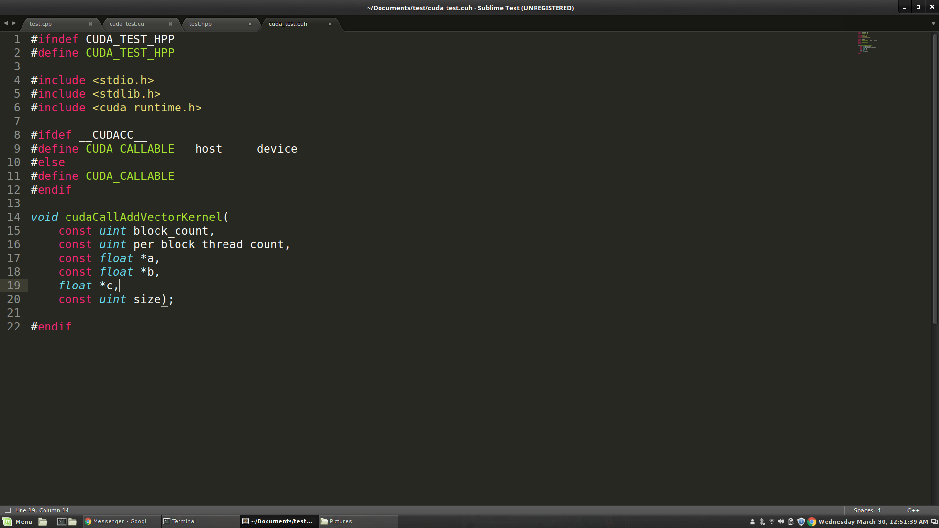
.cu/.cuh vs .cpp/.hpp

Slide 5
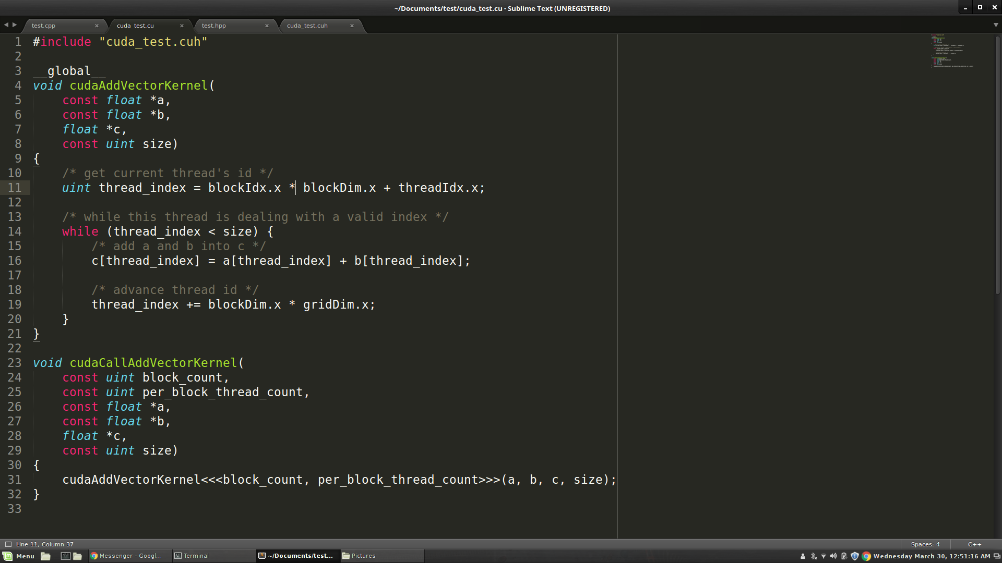
.cu/.cuh vs .cpp/.hpp

Slide 6
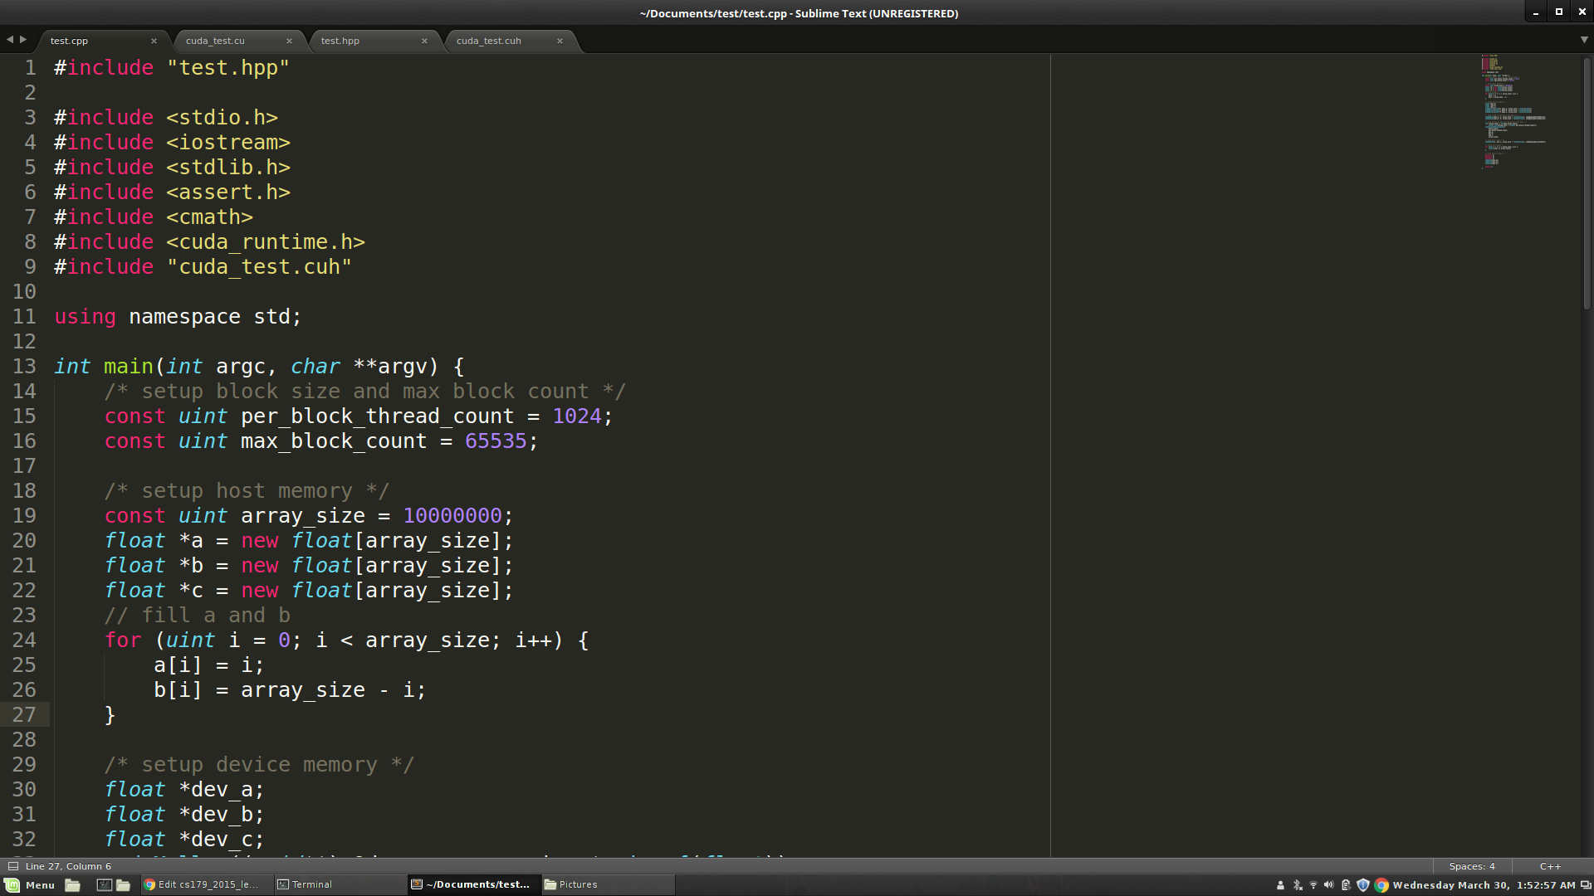
.cu/.cuh vs .cpp/.hpp

Slide 7
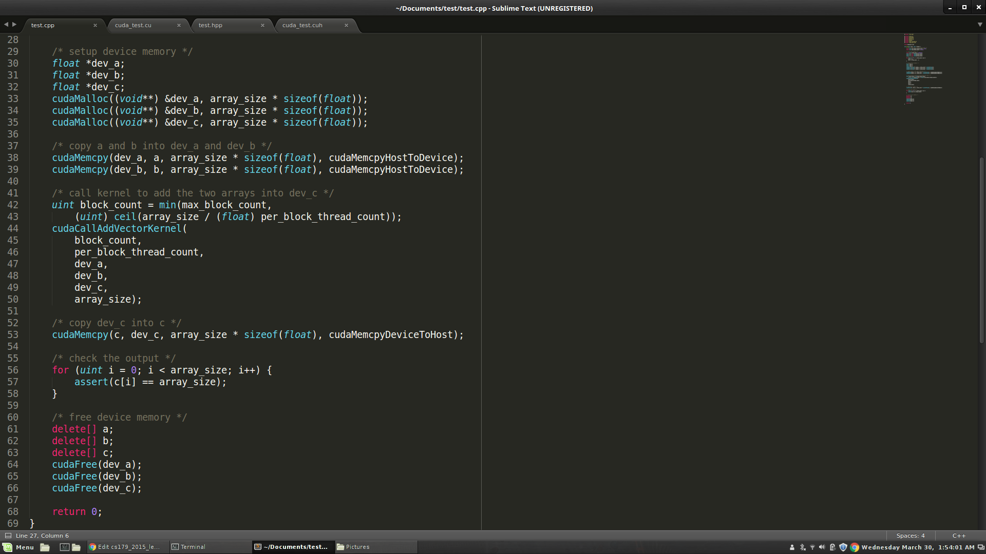
.cu/.cuh vs .cpp/.hpp

Slide 8
Thread Organization
We will now look at how threads are organized and used in GPUs
Keywords you MUST know to code in CUDA:
Thread
Block
Grid
Keywords you MUST know to code WELL in CUDA:
(Streaming) Multiprocessor
Warp
Warp Divergence

Slide 9
Inside a GPU
The black Xs are just crossing out things you don’t have to think about just yet. You'll learn about them later

Slide 10
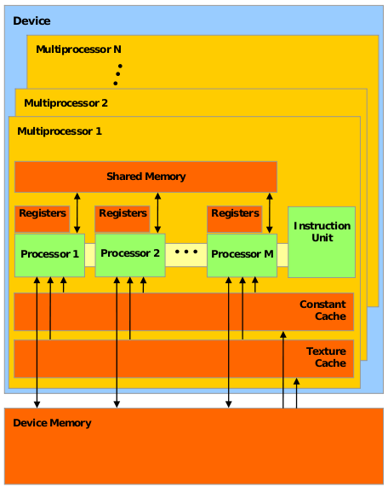
Inside a GPU
Think of Device Memory (we will also refer to it as Global Memory) as a RAM for your GPU
Faster than getting memory from the actual RAM but still can be faster
Will come back to this in future lectures
GPUs have many Streaming Multiprocessors (SMs)
Each SM has multiple processors but only one instruction unit
Groups of processors must run the exact same set of instructions at any given time with in a single SM

Slide 11
Inside a GPU
When a kernel (the thing you define in .cu files) is called, the task is divided up into threads
Each thread handles a small portion of the given task
The threads are divided into a Grid of Blocks
Both Grids and Blocks are 3 dimensional
e.g.
dim3 dimBlock(8, 8, 8);
dim3 dimGrid(100, 100, 1);
Kernel<<<dimGrid, dimBlock>>>(…);
However, we'll often only work with 1 dimensional grids and blocks
e.g. Kernel<<<block_count, block_size>>>(…);

Slide 12
Inside a GPU
Maximum number of threads per block count is usually 512 or 1024 depending on the machine
Maximum number of blocks per grid is usually 65535
If you go over either of these numbers your GPU will just give up or output garbage data
Much of GPU programming is dealing with this kind of hardware limitations! Get used to it
This limitation also means that your Kernel must compensate for the fact that you may not have enough threads to individually allocate to your data points
Will show how to do this later (this lecture)

Slide 13
Inside a GPU
Each block is assigned to an SM
Inside the SM, the block is divided into Warps of threads
Warps consist of 32 threads
All 32 threads MUST run the exact same set of instructions at the same time
Due to the fact that there is only one instruction unit
Warps are run concurrently in an SM
If your Kernel tries to have threads do different things in a single warp (using if statements for example), the two tasks will be run sequentially
Called Warp Divergence (NOT GOOD)

Slide 14
Inside a GPU (fun hardware info)
In Fermi Architecture (i.e. GPUs with Compute Capability 2.x), each SM has 32 cores
e.g. GTX 400, 500 series
32 cores is not what makes each warp have 32 threads. Previous architecture also had 32 threads per warp but had less than 32 cores per SM
Halo.cms.caltech.edu has 3 GTX 570s
This course will cover CC 2.x

Slide 15
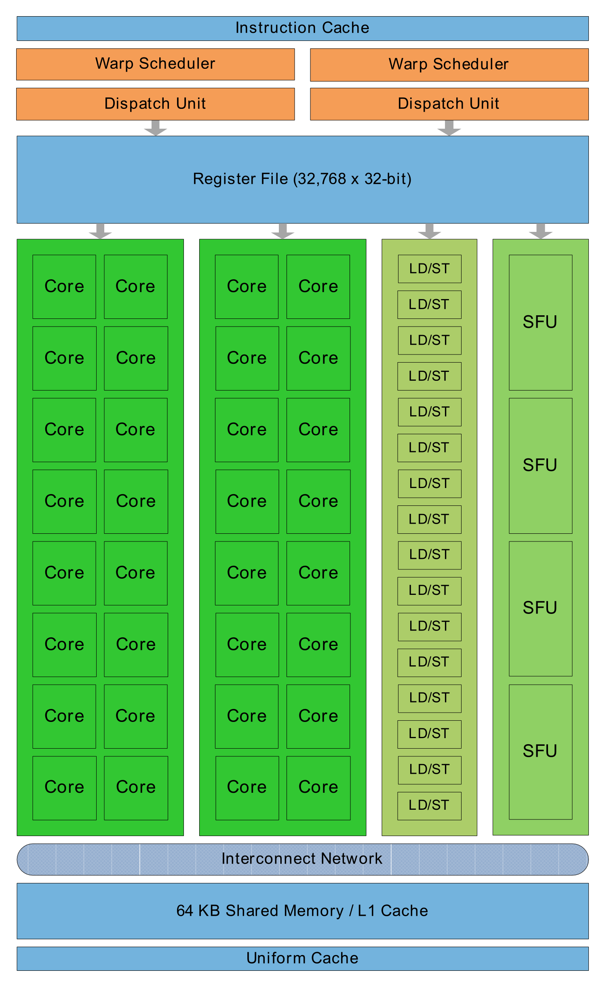
Streaming Multiprocessor

Slide 16
A[] + B[] -> C[] (again)

Slide 17
A[] + B[] -> C[] (again)

Slide 18
A[] + B[] -> C[] (again)

Slide 19
Questions so far?

Slide 20
Stuff that will be useful later

Slide 21
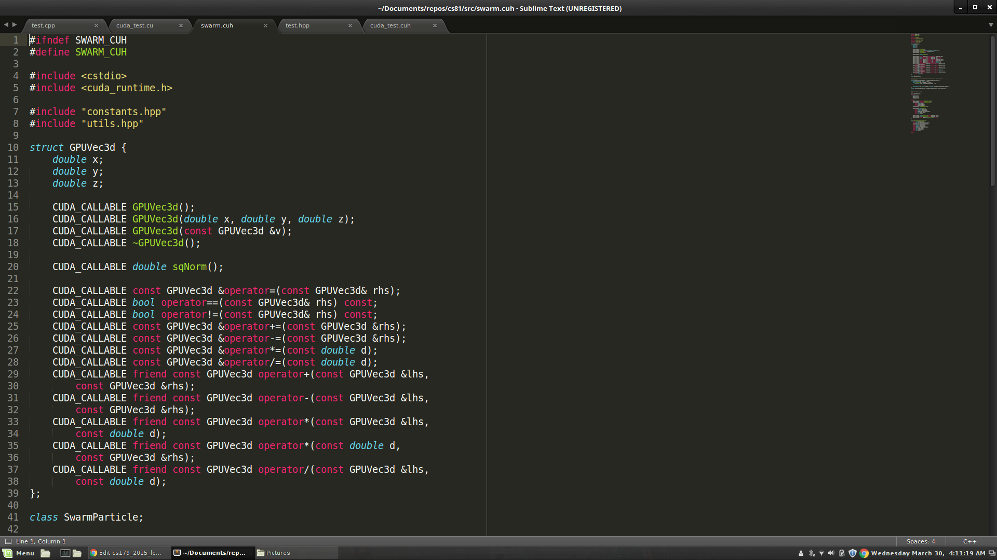
Stuff that will be useful later

Slide 22
Stuff that will be useful later

Slide 23
Next Time...
Global Memory access is not that fast
Tends to be the bottleneck in many GPU programs
Especially true if done stupidly
We'll look at what "stupidly" means
Optimize memory access by utilizing hardware specific memory access patterns
Optimize memory access by utilizing different caches that come with the GPU

