Slide 1
Recitation 2
CS179: GPU PROGRAMMING
GPU Memory
Synchronization
Instruction-level parallelism
Latency hiding
Matrix Transpose

Slide 2
Main requirements for Gpu performance
Sufficient parallelism
Latency hiding and occupancy
Instruction-level parallelism
Coherent execution within warps of thread
Efficient memory usage
Coalesced memory access for global memory
Shared memory and bank conflicts

Slide 3
Latency hiding
Idea: have enough warps to keep the GPU busy during the waiting time.
Notes:
Number of threads (instructions) needed to hide latency depends on
Arithmetic instruction latency
Number of instructions that can be issued in one clock time
Warp scheduler and dispatcher

Slide 4
Loop Unrolling and ILP
for (i = 0; i < 10; i++) {
output[i] = a[i] + b[i];
}
Reduce loop overhead
Increase parallelism when each iteration of the loop is independent
Can increase register usage
output[0] = a[0] + b[0];
output[1] = a[1] + b[1];
output[2] = a[2] + b[2];
…

Slide 5
Synchronization
__syncthreads()
Synchronizes all threads in a block
Warps are already synchronized! (Can reduce __syncthreads() calls)
Atomic{Add, Sub, Exch, Min, Max, Inc, Dec, CAS,
And, Or, Xor}
Works in global and shared memory

Slide 6
Synchronization Advice
Do more cheap things and fewer expensive things!
Example: computing sum of list of numbers
Naive:
each thread atomically increments each number to accumulator in global memory
Smarter solution:
Each thread computes its own sum in register
Use shared memory to sum across a block (Next week: Reduction)
Each block does a single atomic increment in global memory

Slide 7
Lab 2
Part 1: Conceptual questions
Latency hiding
Thread divergence
Coalesced memory access
Bank conflicts and instruction dependencies
Part 2: Matrix Transpose Optimization
Naïve matrix transpose (given to you)
Shared memory matrix transpose
Optimal matrix transpose
Need to comment on all non-coalesced memory accesses and bank conflicts in provided kernel code

Slide 8
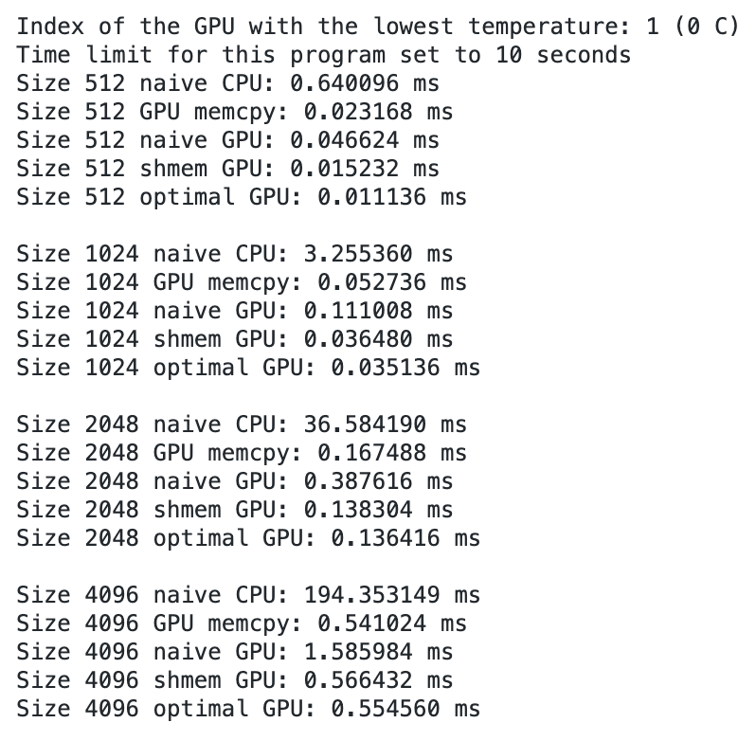
Matrix Transpose
An interesting IO problem, because you have a stride 1 access and a stride n access. Not a trivial access pattern like “blur_v” from Lab 1.
The example output compares performance among CPU implementation and different GPU implementations.

Slide 9
Matrix transpose
__global__
void naiveTransposeKernel(const float *input, float *output, int n) {
// launched with (64, 16) block size and (n / 64, n / 64) grid size
// each block transposes a 64x64 block
const int i = threadIdx.x + 64 * blockIdx.x;
int j = 4 * threadIdx.y + 64 * blockIdx.y;
const int end_j = j + 4;
for (; j < end_j; j++) {
output[j + n * i] = input[i + n * j];
}
}
Notes:
What variable determines the warp?
Which access (there are only 2, read and write) are non-coalesced?
How many cache lines does the write touch? (32)

Slide 10
Shared memory matrix transpose
Idea to avoid non-coalesced accesses:
Load from global memory with stride 1
Store into shared memory with stride x
__syncthreads()
Load from shared memory with stride y
Store to global memory with stride 1
Need to choose values of x and y to perform the transpose
Notes:
x=64, y=1 works. Gives a huge bank conflict but coalesced accesses.

Slide 11
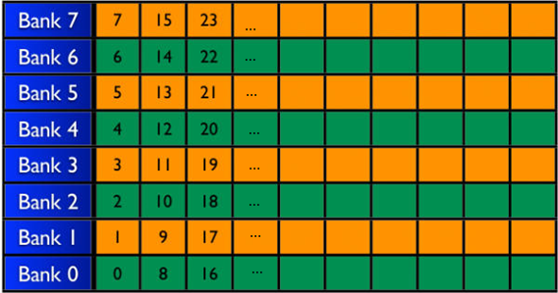
Example of a shared memory cache
Let’s populate shared memory with random integers. Here’s what the first 8 of 32 banks look like:

Slide 12
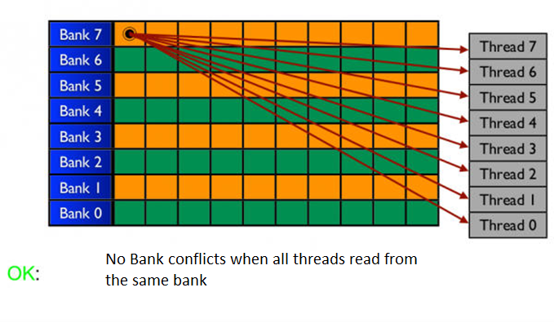
Example of a shared memory cache

Slide 13
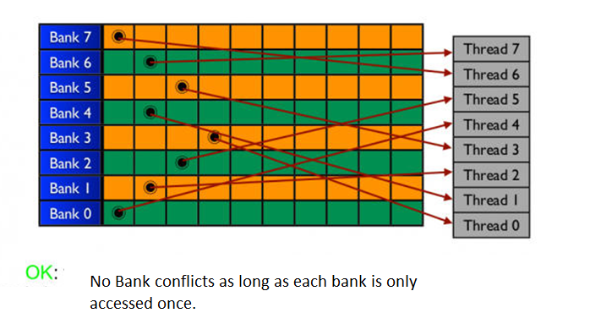
Example of a shared memory cache

Slide 14
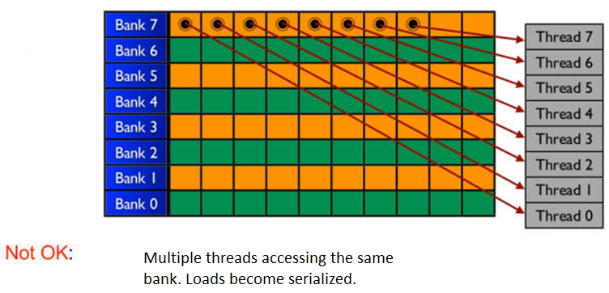
Example of a shared memory cache

Slide 15
Avoiding bank conflicts
You can choose x and y to avoid bank conflicts.
Remember that there are 32 banks and the GPU runs threads in batches of 32 (called warps).
A stride n access to shared memory avoids bank conflicts
iff gcd(n, 32) == 1.

Slide 16
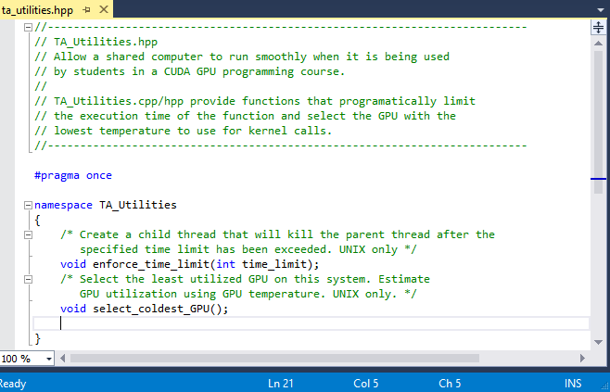
ta_utils.cpp
DO NOT DELETE THIS CODE!
Included in the UNIX version of this set
Should minimize lag or infinite waits on GPU function calls.
Please leave these functions in the code if you are using Titan/Haru/Maki
Namespace TA_Utilities

