Slide 1
CS 179: Lecture 16
Model Complexity, Regularization, and Convolutional Nets

Slide 2
Last Time
Intro to cuDNN
Deep neural nets using cuBLAS and cuDNN

Slide 3
Today
Building a better model for image classification
Overfitting and regularization
Convolutional neural nets

Slide 4
Model Complexity
Consider a class of models $f\left(x;w\right)$
A function $f$ of an input $x$ with parameters $w$
For now, let’s just consider $x∈ℝ$ ($1$D input) as a toy example
Polynomial regression fits a polynomial of degree $d$ to our input, i.e. $f\left(x;w\right)=w_{0}+w_{1}x+w_{2}x^{2}+…+w_{d}x^{d}$
Intuitively, a higher degree polynomial is a more complex model function than a lower degree polynomial

Slide 5
Intuition: Taylor Series
More formally, one model class is more complex than another if it contains more functions
If we already know the function $g$ that we want to approximate, we can use Taylor polynomials
For many functions $g$, we have $g\left(x\right)=\sum_{k=0}^{∞}{w_{k}x^{k}}$
One way to approximate is as $g\left(x\right)≈\sum_{k=0}^{d}{w_{k}x^{k}}$
Higher degree polynomial gives a better approximation?

Slide 6
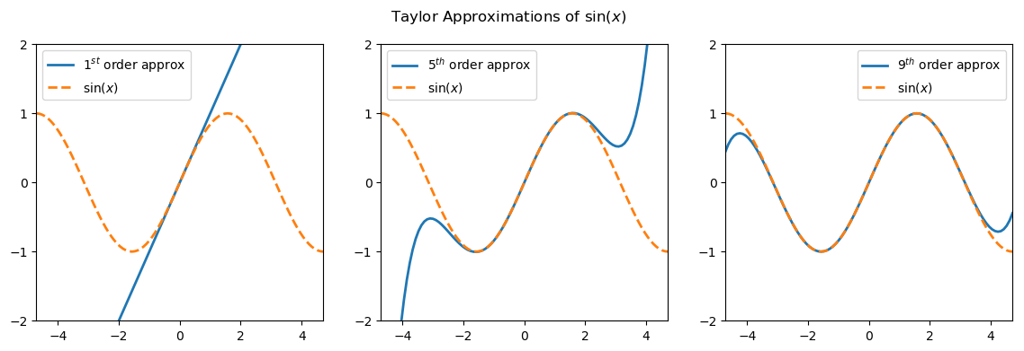
Intuition: Taylor Series
Taylor expansions of $sin⁡(x)$ about $0$ for $d=1,5,9$

Slide 7
Least Squares Fitting
Generally, we don’t know the true function a priori
Instead, we approximate it with a model function $f\left(x;w\right)$
Rather than Taylor coefficients, we really want parameters $w^{⋆}$ that minimize some loss function $J\left(w\right)$ on a dataset ${\left\{\left(x^{\left(i\right)},y^{\left(i\right)}\right)\right\}}_{i=1}^{N}$, e.g. mean squared error:
$$w^{⋆}=\underset{w}{argmin}{J(w)}=\underset{w}{argmin}{\frac{1}{N}\sum_{i=1}^{N}{{\left(y^{\left(i\right)}−f\left(x^{\left(i\right)};w\right)\right)}^{2}}}$$

Slide 8
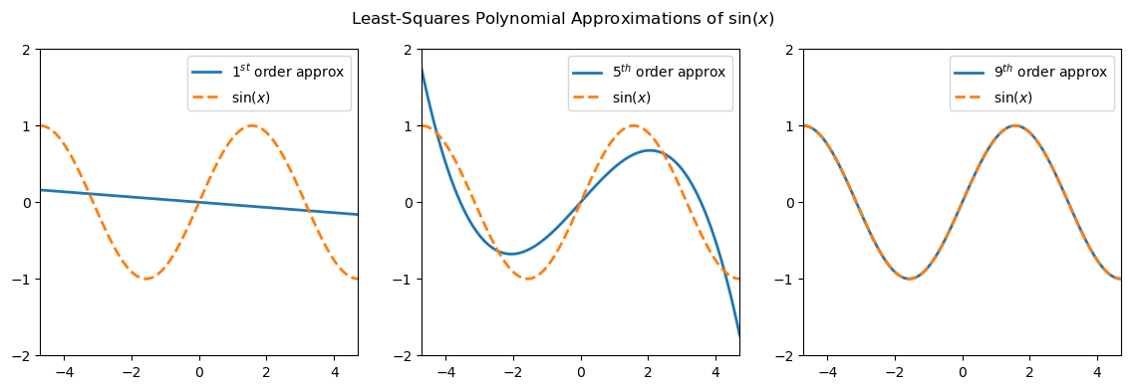
Least Squares Fitting
Least squares polynomial fits of $sin⁡(x)$ for $d=1,5,9$

Slide 9
Why should you care?
So far, it seems like you should always prefer the more complex model, right?
That’s because these toy examples assume
We have a LOT of data
Our data is noiseless
Our model function behaves well between our data points
In the real world, these assumptions are almost always false!

Slide 10
Underfitting & Overfitting
Fitting polynomials to noisy data from the orange function
Notes:
Fun fact: huge bumps are called “shark fins” in graphics
Note: add note on the case where the x’s are drawn from some known true function, but there’s overfitting anyways

Slide 11
Underfitting & Overfitting
Goal: learn a model that generalizes well to unseen test data
Underfitting: model is too simple to learn any meaningful patterns in the data – high training error and high test error
Overfitting: model is so complex that it doesn’t generalize well to unseen data because it pays too much attention to the training data – low training error but high test error

Slide 12
Underfitting & Overfitting
Underfitting is easy to deal with – try using a more complex model class because it is more expressive
Complexity is roughly the “size” of the function space encoded by a model class (the set of all functions the class can represent)
Expressiveness is how well that model class can approximate the functions we are interested in
If a more complex model class overfits, can we reduce its complexity while retaining its expressiveness?

Slide 13
Regularization
If we make certain structural assumptions about the model we want to learn, we can do just this!
These assumptions are called regularizers
Most commonly, we minimize an augmented loss function
$$\tilde{J}\left(w\right)=J\left(w\right)+λR\left(w\right)$$
$J\left(w\right)$ is the original loss function, $λ$ is the regularization strength, and $R\left(w\right)$ is a regularization term

Slide 14
$ℓ_{2}$ Weight Decay
In $ℓ_{2}$ weight decay regularization, $R\left(w\right)=w^{T}w=\sum_{k=1}^{d}{w_{k}^{2}}$
Minimizing $\tilde{J}\left(w\right)=J\left(w\right)+λw^{T}w$
Balances the goals of minimizing the loss $J\left(w\right)$ and finding a set of weights $w$ that are small in magnitude
High $λ$ means we care more about small weights, while low $λ$ means we care more about a low (un-augmented) loss
Intuitively, small weights $w$ → smoother function (no huge oscillations like the 9th degree polynomial we overfit)

Slide 15
$ℓ_{2}$ Weight Decay
Regularizing a degree 9 polynomial fit with $ℓ_{2}$ weight decay

Slide 16
Returning to Neural Nets
All of the intuition we’ve built for polynomials is also valid for neural nets!
The complexity of a deep neural net is related (roughly) to the number of learned parameters and the number of layers
More complex neural nets, i.e. deeper (more layers) and/or wider (more hidden units) are much more likely to overfit to the training data.

Slide 17
Returning to Neural Nets
$ℓ_{2}$ weight decay helps us learn smoother neural nets by encouraging learned weights to be smaller.
To incorporate $ℓ_{2}$ weight decay, just do stochastic gradient descent on the augmented loss function
$$\tilde{J}\left(W^{\left(1\right)},…,W^{\left(L\right)}\right)=J\left(W^{\left(1\right)},…,W^{\left(L\right)}\right)+λ\sum_{i,j,ℓ}{{W_{ij}^{\left(ℓ\right)}}^{2}}$$
$$∇_{W^{\left(ℓ\right)}}\left[\tilde{J}\right]=∇_{W^{\left(ℓ\right)}}\left[J\right]+2λW^{\left(ℓ\right)}$$

Slide 18
Neural Nets and Image Data
Let’s now consider the special case of doing machine learning on image data with neural nets
As we’ve studied them so far, neural nets model relationships between every single pair of pixels
However, in any image, the color and intensity of neighboring pixels are much more strongly correlated than those of faraway pixels, i.e. images have local structure

Slide 19
Neural Nets and Image Data
Images are also translation invariant
A face is still a face, regardless of whether it’s in the top left of an image or the bottom right
Can we encode these assumptions of local structure into a neural network as a regularizer?
If we could, we would get models that learned something about our data set as a collection of images.

Slide 20
Recap: Convolutions
Consider a $c$-by-$h$-by-$w$ convolutional kernel or filter array $K$ and a $C$-by-$H$-by-$W$ array representing an image $X$
The convolution (technically cross-correlation) $Z=K⊗X$ is
$$Z\left[i,j,k\right]=\sum_{ℓ=0}^{c−1}{\sum_{m=0}^{h−1}{\sum_{n=0}^{w−1}{K[ℓ,m, n] X\left[i+ℓ, j+m,k+n\right]}}}$$
There are multiple ways to deal with boundary conditions; for now, ignore any indices that are out of bounds
Notes:
A convolution would have minus signs where the cross-correlation has plus signs

Slide 21
Recap: Convolutions ($c=1$)
http://machinelearninguru.com/computer_vision/basics/convolution/convolution_layer.html

Slide 22
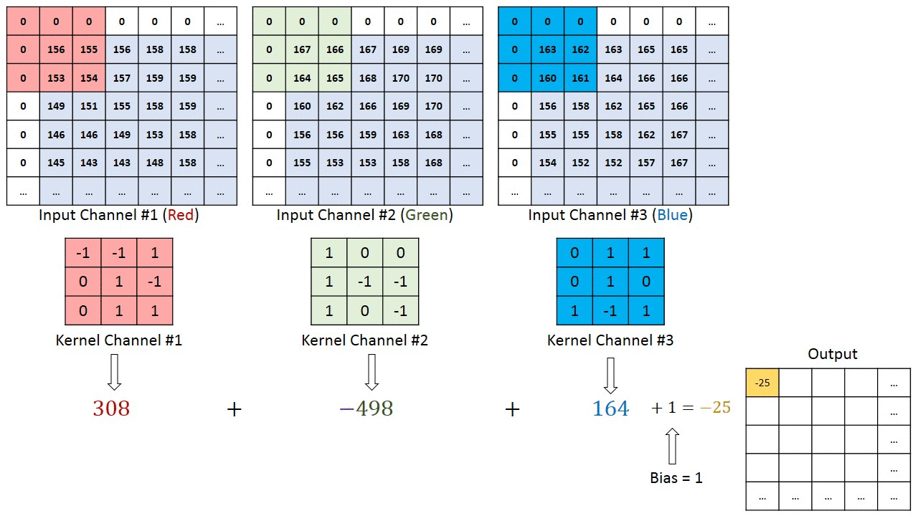
Recap: Convolutions ($c=3$)
Same source as last figure

Slide 23
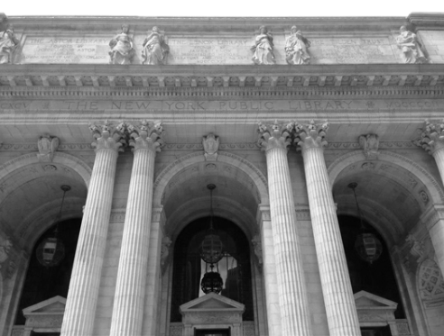
Example Convolutions With ReLU
$$\left[\begin{aligned}0 \\ 0 \\ 0\end{aligned} \begin{aligned}0 \\ 1 \\ 0\end{aligned} \begin{aligned}0 \\ 0 \\ 0\end{aligned}\right]$$

Slide 24
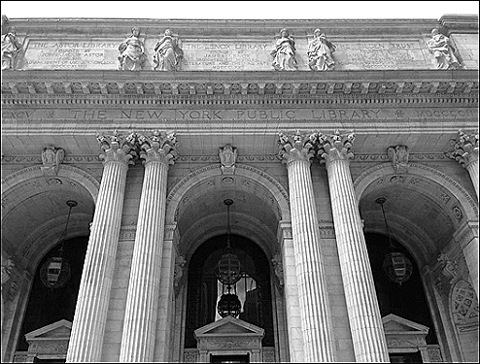
Example Convolutions With ReLU
$$\left[\begin{aligned}0 \\ −1 \\ 0\end{aligned} \begin{aligned}−1 \\ 5 \\ −1\end{aligned} \begin{aligned}0 \\ −1 \\ 0\end{aligned}\right]$$

Slide 25
Example Convolutions With ReLU
$$\frac{1}{16}\left[\begin{aligned}1 \\ 2 \\ 1\end{aligned} \begin{aligned}2 \\ 4 \\ 2\end{aligned} \begin{aligned}1 \\ 2 \\ 1\end{aligned}\right]$$

Slide 26
Example Convolutions With ReLU
$$\frac{1}{256}\left[\begin{aligned}1 \\ 4 \\ 6 \\ 4 \\ 1\end{aligned} \begin{aligned}4 \\ 16 \\ 24 \\ 16 \\ 4\end{aligned} \begin{aligned}6 \\ 24 \\ 36 \\ 24 \\ 6\end{aligned} \begin{aligned}4 \\ 16 \\ 24 \\ 16 \\ 4\end{aligned} \begin{aligned}1 \\ 4 \\ 6 \\ 4 \\ 1\end{aligned}\right]$$

Slide 27
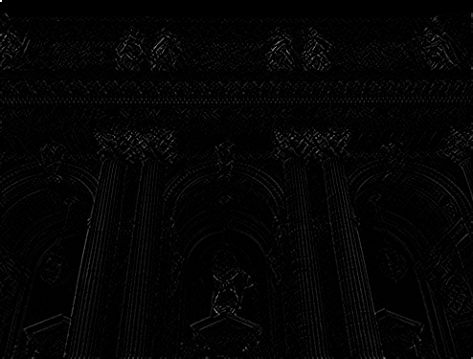
Example Convolutions With ReLU
$$\left[\begin{aligned}1 \\ 0 \\ −1\end{aligned} \begin{aligned}0 \\ 0 \\ 0\end{aligned} \begin{aligned}−1 \\ 0 \\ 1\end{aligned}\right]$$

Slide 28
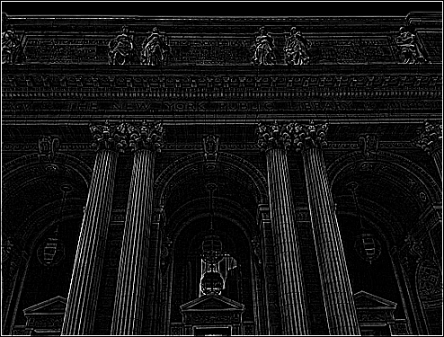
Example Convolutions With ReLU
$$\left[\begin{aligned}−1 \\ −1 \\ −1\end{aligned} \begin{aligned}−1 \\ 8 \\ −1\end{aligned} \begin{aligned}−1 \\ −1 \\ −1\end{aligned}\right]$$

Slide 29
Advantages of Convolution
By sliding the kernel along the image, we can extract the image’s local structure!
Large objects (by blurring)
Sharp edges and outlines
Since each output pixel of the convolution is highly local, the whole process is also translation invariant!
Convolution is a linear operation, like matrix multiplication

Slide 30
Convolutional Neural Nets
So far, the main downside of convolutions is that the coefficients of the kernels seem like magic numbers ☹
But if we fit a $1$D quadratic regression and get the model $f\left(x\right)=0.382x^{2}−15.4x+7$, then aren’t the coefficients $0.382$, $−15.4$, and $7$ just magic numbers too?
Idea: learn convolutional kernels instead of matrices to extract something meaningful from our image data, and then feed that into a dense neural network (with matrices)

Slide 31
Convolutional Neural Nets
We can do this by creating a new kind of layer, and adding it to the front (closer to the input) of our neural network
In the forward pass, we convolve our input $X^{\left(ℓ−1\right)}$ with a learned kernel $K^{\left(ℓ\right)}$, add a scalar bias $b^{\left(ℓ\right)}$ to every element of $Z^{\left(ℓ\right)}$, and apply a nonlinearity $θ$ to obtain our output $X^{\left(ℓ\right)}$
$$Z^{\left(ℓ\right)}=K^{\left(ℓ\right)}⊗X^{\left(ℓ−1\right)}+b^{\left(ℓ\right)}$$
$$X^{\left(ℓ\right)}=θ\left(Z^{\left(ℓ\right)}\right)$$

Slide 32
Convolutional Neural Nets
Note that we will actually be attempting to learn multiple (specifically $c_{ℓ}$) kernels of shape $c_{ℓ−1}×h_{ℓ}×w_{ℓ}$ per layer $ℓ$!
$c_{ℓ−1}$ is the number of channels in input $X^{\left(ℓ−1\right)}$, so convolving any individual kernel with $X^{\left(ℓ−1\right)}$ will yield $1$ output channel
The output $X^{\left(ℓ\right)}$ is the result of all $c_{ℓ}$ of these convolutions stacked on top of each other ($1$ output channel per kernel)
If input $X^{\left(ℓ−1\right)}$ has shape $c_{ℓ−1}×H_{ℓ}×W_{ℓ}$, then output $X^{\left(ℓ\right)}$ will have shape $c_{ℓ}×\left(H_{ℓ}−h_{ℓ}+1\right)×(W_{ℓ}−w_{ℓ}+1)$

Slide 33
Convolutional Neural Nets
We then feed the output $X^{\left(ℓ\right)}$ into the next layer as its input
If the next layer is a dense layer, we will re-shape $X^{\left(ℓ\right)}$ into a vector (instead of a multi-dimensional array)
If the next layer is also convolutional, we can pass $X^{\left(ℓ\right)}$ as is
To actually learn good kernels that stage well with the layers we feed them into, we can just use the backpropagation algorithm to do stochastic gradient descent!

Slide 34
Convolutional Backprop
Assume that we have $Δ^{\left(ℓ\right)}=∇_{X^{\left(ℓ\right)}}[J]$ (the gradient with respect to the input of the next layer, which is also the output of this layer)
By the chain rule, for each kernel $K^{\left(ℓ\right)}$ at this layer $ℓ$,
$$\frac{∂J}{∂K_{ijk}^{\left(ℓ\right)}}=\sum_{a=1}^{c_{ℓ}}{\sum_{b=1}^{w_{ℓ}}{\sum_{c=1}^{h_{ℓ}}{\frac{∂J}{∂Z_{abc}^{\left(ℓ\right)}}\frac{∂Z_{abc}^{\left(ℓ\right)}}{∂K_{ijk}^{\left(ℓ\right)}}}}}$$

Slide 35
Convolutional Backprop
By the chain rule (again)
$$\frac{∂J}{∂Z_{abc}^{\left(ℓ\right)}}=\frac{∂J}{∂X_{abc}^{\left(ℓ\right)}}\frac{∂X_{abc}^{\left(ℓ\right)}}{∂Z_{abc}^{\left(ℓ\right)}}=Δ_{abc}^{\left(ℓ\right)}θ^{′}\left(Z_{abc}^{\left(ℓ\right)}\right)$$
This gives us $∇_{Z^{\left(ℓ\right)}}\left[J\right]$, the gradient with respect to the output of the convolution
We can find this with cudnnActivationBackward() (see Lecture 15) ☺

Slide 36
Convolutional Backprop
If you give cuDNN the
Gradient with respect to the convolved output $∇_{Z^{\left(ℓ\right)}}\left[J\right]$
Input to the convolution $X^{\left(ℓ−1\right)}$
cuDNN can compute each $∇_{K^{\left(ℓ\right)}}\left[J\right]$, the gradient of the loss with respect to each kernel $K^{\left(ℓ\right)}$ (Lecture 17) ☺
With the $∇_{K^{\left(ℓ\right)}}\left[J\right]$’s computed, we can do gradient descent!

Slide 37
Convolutional Backprop
All that remains is for us to find the gradient with respect to the input to this layer $Δ^{\left(ℓ−1\right)}= ∇_{X^{\left(ℓ−1\right)}}\left[J\right]$
This is also the gradient with respect to the output of the next layer, and will be used to continue doing backpropagation.
Again, cuDNN has a function for it (Lecture 17)
You need to provide it the kernels $K^{\left(ℓ\right)}$ and the gradient with respect to the output $Δ^{\left(ℓ\right)}=∇_{X^{\left(ℓ\right)}}\left[J\right]$ (like a dense neural net)

Slide 38
Pooling Layers
After each convolutional layer, it is common to add a pooling layer to down-sample the input
Most commonly, one would take every non-overlapping $n×n$ window of a convolved output, and replace each window with a single pixel whose intensity is either
The maximum intensity found in that $n×n$ window
The mean intensity of the pixels in that $n×n$ window

Slide 39
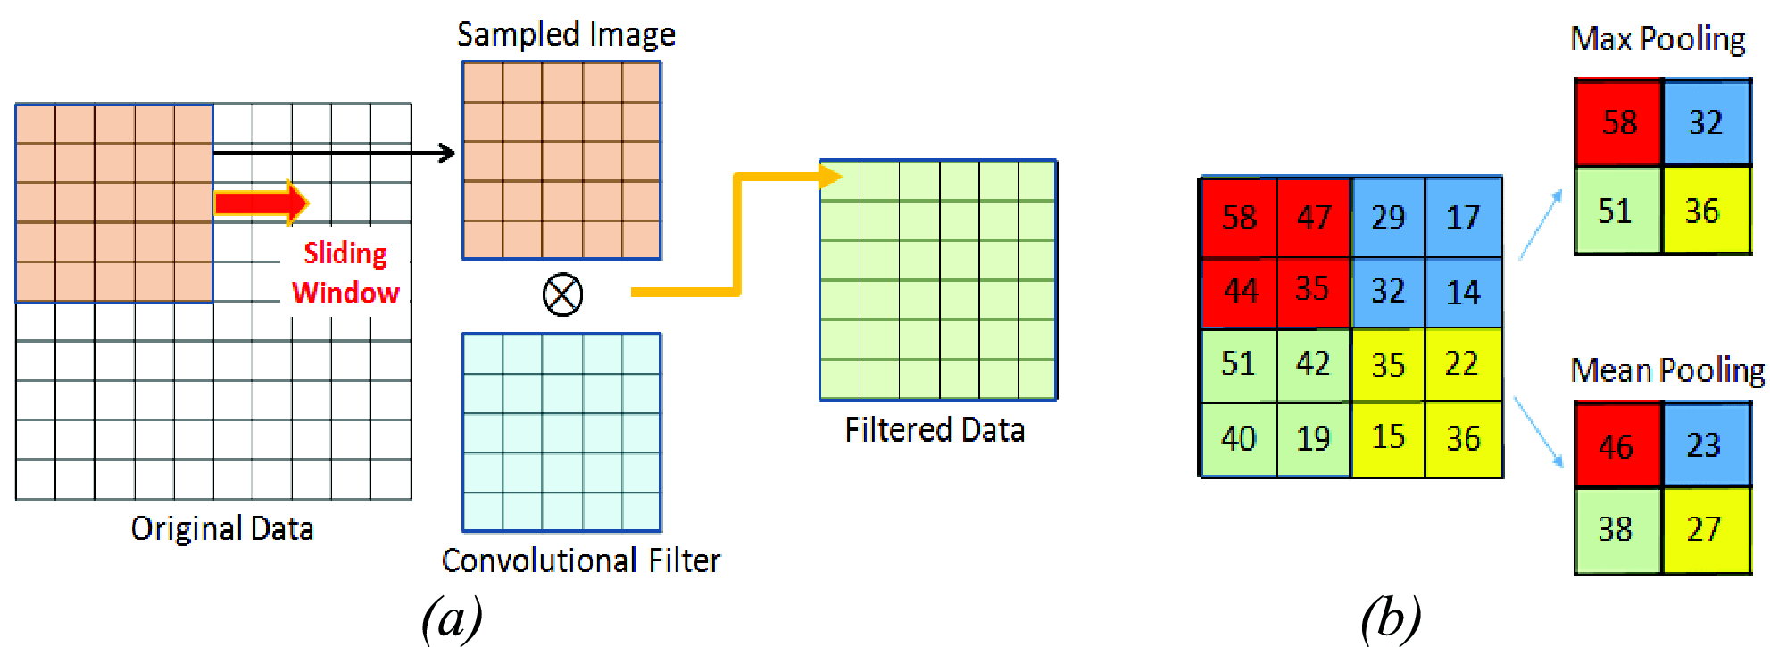
Example of $2×2$ Pooling
http://ieeexplore.ieee.org/document/7590035/all-figures

Slide 40
Pooling Layers
Motivation: convolution compresses the amount of information in the image spatially
Blur → nearby pixels are more similar
Edge → “important” pixels are brighter than their surroundings
Why not use that compression to reduce dimensionality?
Forward and backwards propagation for pooling layers are fairly straightforward, and cuDNN can do both (Lecture 17)

Slide 41
Why Bother?
Consider the MNIST dataset of handwritten digits
Each image is $28×28$ pixels → $784$ input dimensions, and it can be one of $10$ output classes
A neural net with $1$ dense hidden layer with 200 units and an dense output layer with $10$ units will have $200×\left(784+1\right)+10×\left(200+1\right)=159,010$ parameters
We’re modeling relationships between every pair of pixels; most of the relationships we learn probably aren’t meaningful

Slide 42
Conv Nets are Better
Let’s instead consider the following convolutional net:
Layer 1: Twenty $(1×5×5)$ kernels
Layer 2: $2×2$ pooling
Layer 3: Five $(20×3×3)$ kernels
Layer 4: $2×2$ pooling
Layer 5: Dense layer with $10$ output units

Slide 43
Conv Nets are Better
Input shape $(1×28×28)$ (MNIST image)
Twenty $(1×5×5)$ kernels
$20×\left(\left(1×5×5\right)+1\right)=520$ parameters
Output shape $(20×24×24)$
$2×2$ pooling
Output shape $(20×12×12)$

Slide 44
Conv Nets are Better
Input shape $(20×12×12)$ (conv $1$ + pool $1$)
Five $(20×3×3)$ kernels
$5×\left(\left(20×3×3\right)+1\right)=905$ parameters
Output shape $(5×10×10)$
$2×2$ pooling
Output shape $(5×5×5)$

Slide 45
Conv Nets are Better
Input shape $(5×5×5)$ (conv $2$ + pool $2$)
Flatten into a $125$-dimensional vector
Dense layer with $50$ hidden units
$10×\left(125+1\right)=1260$ parameters
Output is a $10$-dimensional vector

Slide 46
Conv Nets are Better
This gives us a total of $520+905+1260=2685$ parameters, far fewer than the dense net’s $159,010$
However, with far fewer parameters, this model
Learns something more meaningful about image structure
Achieves a significantly better accuracy on unseen data
We’ve effectively regularized the neural net to perform well on image data! HW6: implement it and see for yourself.
Notes:
Show a demo of conv net vs linear classifier

