Slide 1
CS 179: GPU Computing
Recitation 2: Synchronization, Shared memory, Matrix Transpose

Slide 2
Synchronization
Ideal case for parallelism:
no resources shared between threads
no communication between threads
Many algorithms that require just a little bit of resource sharing can still be accelerated by massive parallelism of GPU
Notes:
Shared resources and communication between threads are really kind of the same thing.

Slide 3
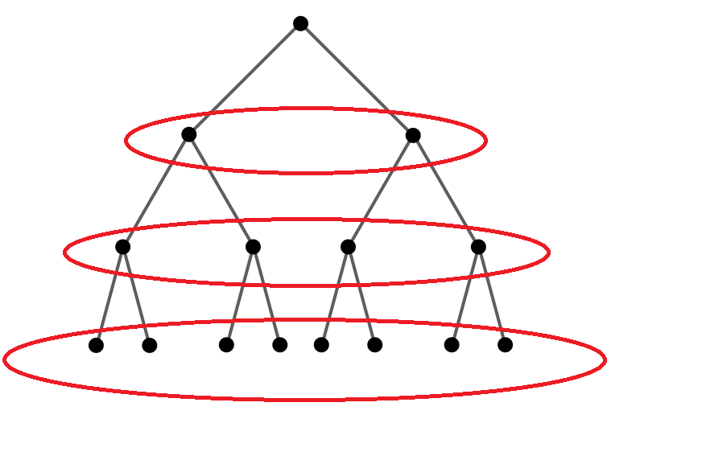
Examples needing synchronization
Parallel BFS
Summing a list of numbers
Loading data into a GPU’s shared memory
Notes:
For the first example, I’m assuming a thread with touch elements in shared memory that were loaded by another thread.
We can’t start processing until we know all threads have finished loading their data into shared memory.
When summing a list of numbers, multiple threads/blocks all need to write to a single memory address. Need some synchronization.
dining philosophers

Slide 4
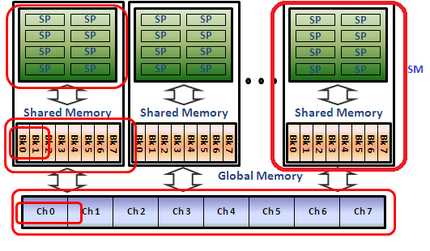
__syncthreads()
__syncthreads() synchronizes all threads in a block.
Remember that shared memory is per block. Every block that is launched will have to allocate shared memory for its own itself on its resident SM.
This __synchthreads() call is very useful for kernels using shared memory.

Slide 5
Atomic instructions: motivation
Two threads try to increment variable x=42 concurrently. Final value should be 44.
Possible execution order:
thread 0 load x (=42) into register r0
thread 1 load x (=42) into register r1
thread 0 increment r0 to 43
thread 1 increment r1 to 43
thread 0 store r0 (=43) into x
thread 1 store r1 (=43) into x
Actual final value of x: 43
:(

Slide 6
Atomic instructions
An atomic instruction executes as a single unit, cannot be interrupted.
Serializes access
Notes:
named because an atom is the “smallest unit” even though this isn’t really true.
atomic adds solve the problem of the previous slide

Slide 7
Atomic instructions on CUDA
atomic{Add, Sub, Exch, Min, Max, Inc, Dec, CAS,
And, Or, Xor}
Syntax: atomicAdd(float *address, float val)
Work in both global and shared memory!

Slide 8
(Synchronization) budget advice
Do more cheap things and fewer expensive things!
Example: computing sum of list of numbers
Naive:
each thread atomically increments each number to accumulator in global memory
Notes:
Can anyone think of a better solution?

Slide 9
Sum example
Smarter solution:
each thread computes its own sum in register
use warp shuffle (next slide) to compute sum over warp
each warp does a single atomic increment to accumulator in global memory
Reduce number of atomic instructions by a factor of 32 (warp size)
Notes:
Optionally could compute sum over full block in shared memory, but shared memory increments are not much faster than global (before Maxwell), so I don’t know if this would have better performance.

Slide 10
Warp-synchronous programming
What if I only need to synchronize between all threads in a warp?
Warps are already synchronized!
Can reduce __syncthreads() calls
Notes:
Why is “synchronizing between threads in a warp” silly?

Slide 11
Warp shuffle
Read value of register from another thread in warp.
int __shfl(int var, int srcLane, int width=warpSize)
Extremely useful to compute sum of values across a warp.
First available on Kepler (no Fermi, only CC >= 3.0)

Slide 12
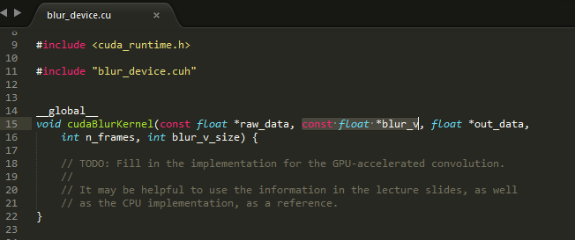
Quick Aside: blur_v from Lab 1
Shared memory is great place to put blur_v.
blur_v is relatively small and easily fits in shared memory.
Every thread reads from blur_v
Stride 0 access. No bank conflicts when i > GAUSSIAN_SIZE (majority of threads)

Slide 13
Lab 2
Questions on latency hiding, thread divergence, coalesced memory access, bank conflicts, instruction dependencies
What you actually have to do: Need to comment on all non-coalesced memory accesses and bank conflicts in provided kernel code. Lastly, improve the matrix transpose kernel by using cache and memory optimizations.

Slide 14
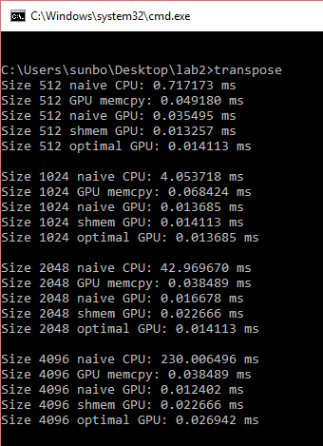
Matrix Transpose
An interesting IO problem, because you have a stride 1 access and a stride n access. Not a trivial access pattern like “blur_v” from Lab 1.
Transpose is just a fancy memcpy, so memcpy provides a great performance target.
Note: This example output is for a clean project without the shmem and optimal kernels completed. Your final output should show a decline in kernel time for the different kernels.

Slide 15
Matrix Transpose
__global__
void naiveTransposeKernel(const float *input, float *output, int n) {
// launched with (64, 16) block size and (n / 64, n / 64) grid size
// each block transposes a 64x64 block
const int i = threadIdx.x + 64 * blockIdx.x;
int j = 4 * threadIdx.y + 64 * blockIdx.y;
const int end_j = j + 4;
for (; j < end_j; j++) {
output[j + n * i] = input[i + n * j];
}
}
Notes:
What variable determines the warp?
Which access (there are only 2, read and write) are non-coalesced?
How many cache lines does the write touch? (32)

Slide 16
Shared memory & matrix transpose
Idea to avoid non-coalesced accesses:
Load from global memory with stride 1
Store into shared memory with stride x
__syncthreads()
Load from shared memory with stride y
Store to global memory with stride 1
Choose values of x and y perform the transpose.
Notes:
x=64, y=1 works. Gives a huge bank conflict but coalesced accesses.

Slide 17
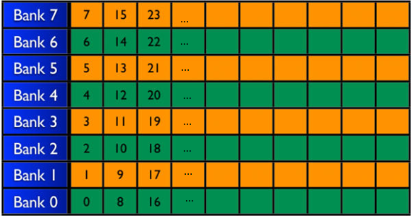
Bank Conflicts
Example of an SM’s shared memory cache
Let’s populate shared memory with random integers. Here’s what the first 8 of 32 banks look like:

Slide 18
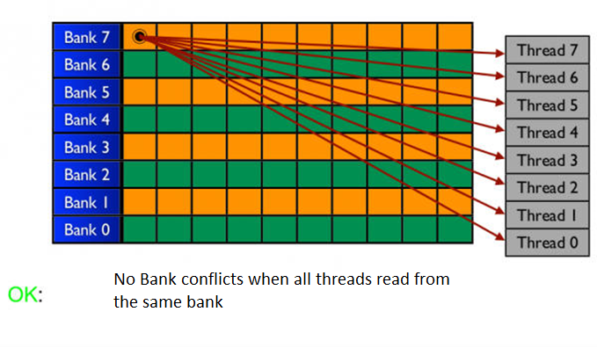
Bank Conflicts
Example of an SM’s shared memory cache

Slide 19
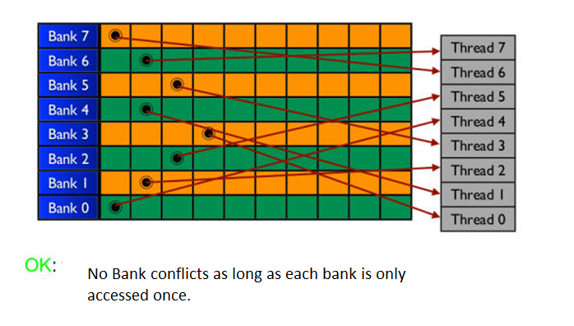
Bank Conflicts
Example of an SM’s shared memory cache

Slide 20
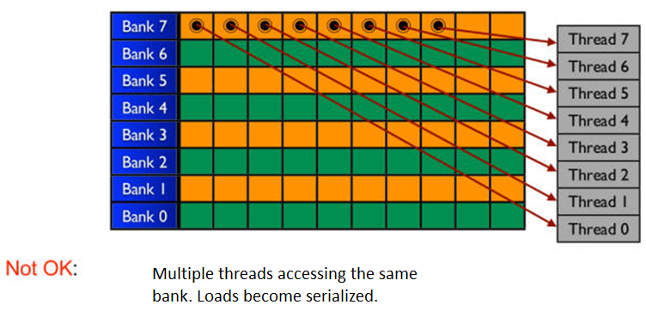
Bank Conflicts
Example of an SM’s shared memory cache

Slide 21
Avoiding bank conflicts
You can choose x and y to avoid bank conflicts.
Remember that there are 32 banks and the GPU runs threads in batches of 32 (called warps).
A stride n access to shared memory avoids bank conflicts
iff gcd(n, 32) == 1.

Slide 22
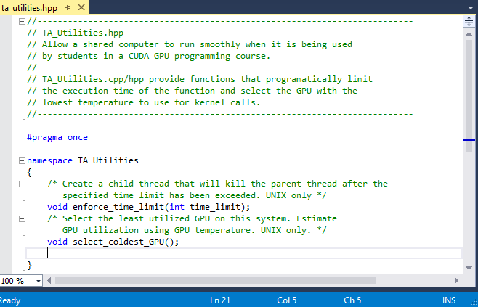
ta_utils.cpp
Included in the UNIX version of this set
Should minimize lag or infinite waits on GPU function calls.
Please leave these functions in the code if you are using Haru
Namespace TA_Utilities

