Slide 1
CS 179 Lecture 13
Host-Device Data Transfer

Slide 2
Moving data is slow
So far we’ve only considered performance when the data is already on the GPU
This neglects the slowest part of GPU programming: getting data on and off of GPU
Notes:
Everything we’ve talked about so far assumes data is on GPU.

Slide 3
Moving data is important
Intelligently moving data allows processing data larger than GPU global memory (~6GB)
Absolutely critical for real-time or streaming applications (common in computer vision, data analytics, control systems)

Slide 4
VRAM
Max VRAM on a GPU (Nvidia Maxwell): 12 GB
Max RAM on a CPU (Xeon E7): 1536 GB
VRAM is soldered directly onto the graphics card, allowing the VRAM modules to sit closely to the GPU, allowing quicker transfer between VRAM and GPU, increasing graphics performance. Secondly, sockets and circuits most likely would cause GPU prices to go up.
The next generation of Nviida GPUs (Pascal) will supposedly feature 32 GB of memory in the top of the line versions.

Slide 5
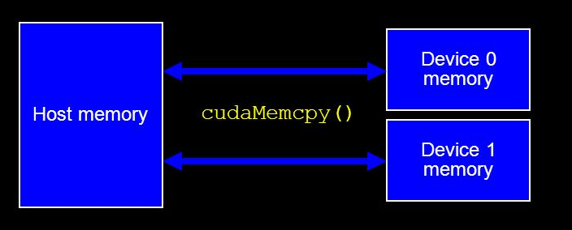
Matrix transpose: another look
Time(%) Time Calls Avg Name
49.35% 29.581ms 1 29.581ms [CUDA memcpy DtoH]
47.48% 28.462ms 1 28.462ms [CUDA memcpy HtoD]
3.17% 1.9000ms 1 1.9000ms naiveTransposeKernel
Only 3% of time spent in kernel! 97% of time spent moving data onto and off GPU! Copying between host and GPU is SLOW.

Slide 6
Lecture Outline
IO strategy
CUDA streams
CUDA events
How it all works: virtual memory, command buffers
Pinned host memory
Managed memory

Slide 7
A common pattern
while (1) {
cudaMemcpy(d_input, h_input, input_size)
kernel<<<grid, block>>>(d_input, d_output)
cudaMemcpy(output, d_output, output_size)
}
Throughput limited by IO!
How can we hide the latency?

Slide 8
Dreams & Reality
Reality
time
Dreams
HD 0
 | kernel 0
 |  | DH 0
HD 1
 | kernel 1
 |  | DH 1
HD 2
 | kernel 2
HD 0
HD 1 | kernel 0
HD 2 | kernel 1 | DH 0
HD 3 | kernel 2 | DH 1
HD 4 | kernel 3 | DH 2
HD 5 | kernel 4 | DH 3
HD 6 | kernel 5 | DH 4
HD 7 | kernel 6 | DH 5
Notes:
HD = host -> device
DH = device -> host
What to do we need to make the dream happen?

Slide 9
Turning dreams into reality
What do we need to make the dream happen?
hardware to run 2 transfers and 1 kernel in parallel
2 input buffers
2 output buffers
asynchronous memcpy & kernel invocation
easy, up to programmer

Slide 10
Latency hiding checklist
Hardware:
maximum of 4, 16, or 32 concurrent kernels (depending on hardware) on CC >= 2.0
1 device→host copy engine
1 host→device copy engine
(2 copy engines only on newer hardware, some hardware has single copy engine shared for both directions)

Slide 11
Asynchrony
An asynchronous function returns as soon is it called.
There is generally an interface to check if the function is done and to wait for completion.
Kernel launches are asynchronous.
cudaMemcpy is not.

Slide 12
cudaMemcpyAsync
Convenient asynchronous memcpy! Similar arguments to normal cudaMemcpy.
while (1) {
cudaMemcpyAsync(d_in, h_in, in_size)
kernel<<<grid, block>>>(d_in, d_out)
cudaMemcpyAsync(out, d_out, out_size)
}
Can anyone think of any issues with this code?

Slide 13
CUDA Streams
In previous example, need cudaMemcpyAsync to finish before kernel starts. Luckily, CUDA already does this.
Streams let us enforce ordering of operations and express dependencies.
Useful blog post describing streams
Notes:
Streams are how we deal with asynchronous behavior.
Dependencies such as copy must finish before kernel can start.

Slide 14
The null / default stream
When stream is not specified, operation only starts after all other GPU operations have finished.
CPU code can run concurrently with default stream.
Notes:
Only 1 NULL stream operation runs on GPU at a time

Slide 15
Stream example
cudaStream_t s[2];
cudaStreamCreate(&s[0]); cudaStreamCreate(&s[1]);
for (int i = 0; i < 2; i++) {
kernel<<<grid, block, shmem, s[i]>(d_outs[i], d_ins[i]);
cudaMemcpyAsync(h_outs[i], d_outs[i], size, dir, s[i]);
}
for (int i = 0; i < 2; i++) {
cudaStreamSynchronize(s[i]);
cudaStreamDestroy(s[i]);
}
kernels run in parallel!
Notes:
dir is direction, cudaMemcpyHostToDevice, etc.

Slide 16
CUDA events
Streams synchronize the GPU (but can synchronize CPU/GPU with cudaStreamSynchronize)
Events are simpler way to enforce CPU/GPU synchronization.
Also useful for timing!

Slide 17
Events example
#define START_TIMER() { \
gpuErrChk(cudaEventCreate(&start)); \
gpuErrChk(cudaEventCreate(&stop)); \
gpuErrChk(cudaEventRecord(start)); \
}
#define STOP_RECORD_TIMER(name) { \
gpuErrChk(cudaEventRecord(stop)); \
gpuErrChk(cudaEventSynchronize(stop)); \
gpuErrChk(cudaEventElapsedTime(&name, start, stop)); \
gpuErrChk(cudaEventDestroy(start)); \
gpuErrChk(cudaEventDestroy(stop)); \
}

Slide 18
Events methods
cudaEventRecord - records that an event has occurred. Recording happens not at time of call but after all preceding operations on GPU have finished
cudaEventSynchronize - CPU waits for event to be recorded
cudaEventElapsedTime - compute time between recording of events

Slide 19
Other stream/event methods
cudaStreamAddCallback <- Add host function to stream
cudaStreamQuery <- check if stream completed
cudaEventQuery <- check if event completed
cudaDeviceSynchronize <- Wait on all streams
Can also parameterize event recording to happen only after all preceding operations complete in a given stream (rather than in all streams)
Notes:
addCallback allows lets host code run after all preceding items in stream have finished
streamWaitEvent causes a stream to pause until an event is recorded
DeviceSynchronize waits on all scheduled GPU operations to end

Slide 20
CPU/GPU communication
How exactly do the CPU and GPU communicate?
Notes:
how does a kernel get issued?
how can they talk about memory addresses?

Slide 21
Virtual Memory
Could give a week of lectures on virtual memory…
Key idea: The memory addresses used in programs do not correspond to physical locations in memory. A program deals solely in virtual addresses. There is a table that maps (process id, address) to physical address.
Notes:
Extremely important topic in systems, a beautiful idea.

Slide 22
What does virtual memory give us?
Each process can act like it is the only process running. The same virtual address in different processes can point to different physical addresses (and values).
Each process can use more than the total system memory. Store pages of data on disc if there is no room in physical memory.
Operating system can move pages around physical memory and disc as needed.

Slide 23
Unified Virtual Addressing
On 64-bit OS with GPU of CC >= 2.0, GPU pointers live in disjoint address space from CPU. Makes it possible to figure out which memory an address lives on at runtime.
NVIDIA calls it unified virtual addressing (UVA)
cudaMemcpy(dst, src, size, cudaMemcpyDefault), no need to specify cudaMemcpyHostToDevice or etc.

Slide 24
Unified Virtual Addressing/Memory
You can think of unified memory as “smart pinned memory”. Driver is allowed to cache memory on host or any GPU.
Available on CC >= 3.0
cudaMallocManaged/
cudaFree

Slide 25
Virtual memory and GPU
To move data from CPU to GPU, the GPU must access data on host. GPU is given virtual address.
2 options:
for each word, have the CPU look up physical address and then perform copy. Discontiguous physical memory. slow!
tell the OS to keep a page at a fixed location (pinning). Directly access physical memory on host from GPU (direct memory access a.k.a. DMA). fast!

Slide 26
Memcpy
cudaMemcpy(Async):
Pin a host buffer in the driver.
Copy data from user array into pinned buffer.
Copy data from pinned buffer to GPU.

Slide 27
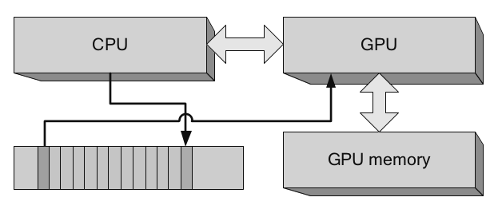
Commands communicated by circular buffer.
Host writes, device reads.
pinned host memory
Command buffers (diagram courtesy of CUDA Handbook)
Notes:
circular buffer

Slide 28
Taking advantage of pinning
cudaMallocHost allocates pinned memory on the host.
cudaFreeHost to free.
Advantages:
can dereference pointer to pinned host buffers on device! Lots of PCI-Express (PCI-E) traffic :(
cudaMemcpy is considerably faster when copying to/from pinned host memory.

Slide 29
Pinned host memory use cases
self-referential data structures that are not easy to copy (such as a linked list)
deliver output as soon as possible (rather than waiting for kernel completion and memcpy)
Must synchronize and wait for kernel to finish before accessing kernel result on host.

Slide 30
Disadvantages of pinning
Pinned pages limit freedom of OS memory management.
cudaMallocHost will fail (due to no memory available) long before malloc.
Coalesced accesses are extra important while accessing pinned host memory.
Potentially tricky concurrency issues.

