Slide 1
CS 179: GPU Programming
Lecture 20: Cross-system communication

Slide 2

The Wave Equation
$$\frac{∂}{∂t}\frac{y_{x,t+1}−y_{x,t}}{∆t}=c^{2}\frac{∂}{∂x}\frac{y_{x+1,t}−y_{x,t}}{∆x}$$
→
$$\frac{{(y}_{x,t+1}−y_{x,t})−{(y}_{x,t}−y_{x,t−1})}{{(∆t)}^{2}}=c^{2}\frac{{(y}_{x+1,t}−y_{x,t})−{(y}_{x,t}−y_{x−1,t})}{{(∆x)}^{2}}$$
→
$$y_{x,t+1}=2y_{x,t}−y_{x,t−1}+{\left(\frac{c∆t}{∆x}\right)}^{2}{(y}_{x+1,t}−2y_{x,t}+y_{x−1,t})$$

Slide 3
Multiple GPU Solution
Big idea: Divide our data array between n GPUs!

Slide 4
Multiple GPU Solution
Problem if we’re at the boundary of a process!
$$y_{x,t+1}=2y_{x,t}−y_{x,t−1}+{\left(\frac{c∆t}{∆x}\right)}^{2}{(y}_{x+1,t}−2y_{x,t}+y_{x−1,t})$$
t+1
t
t-1
x
Where do we get $y_{x−1,t}$? (It’s outside our process!)

Slide 5
Multiple GPU Solution
Communication can be expensive!
Expensive to communicate every timestep to send 1 value!
Better solution: Send some m values every m timesteps!

Slide 6
Possible Implementation
Send “current” data (current at time of communication)
Proc0
Proc1
Proc2

Slide 7
Possible Implementation
Then send “old” data
Proc0
Proc1
Proc2

Slide 8
Multiple GPU Solution
(More details next lecture)
General idea – suppose we’re on GPU r in 0…(N-1):
If we’re not GPU N-1:
Send data to process r+1
Receive data from process r+1
If we’re not GPU 0:
Send data to process r-1
Receive data from process r-1
Wait on requests

Slide 9
Multiple GPU Solution
GPUs on same system:
Use CUDA-supplied functions (cudaMemcpyPeer, etc.)
GPUs on different systems:
Need cross-system, inter-process communication…

Slide 10
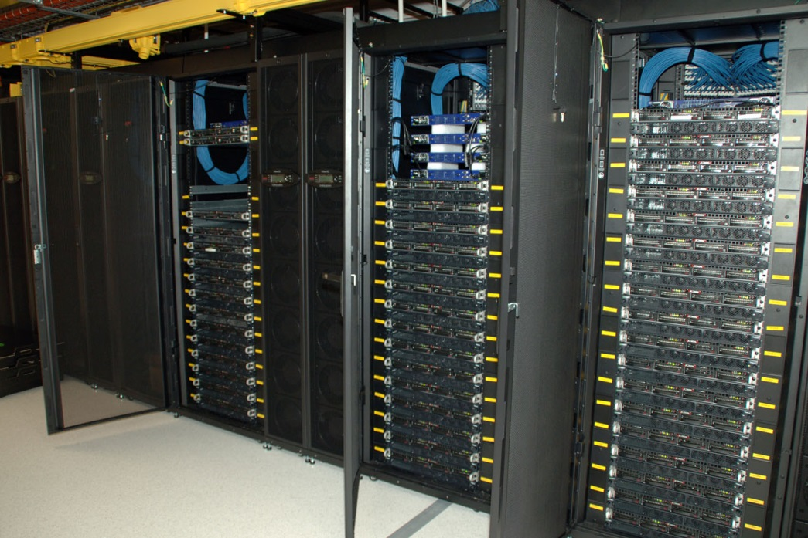
Supercomputers
Often have:
Many different systems
Few GPUs/system
GPU cluster, CSIRO

Slide 11
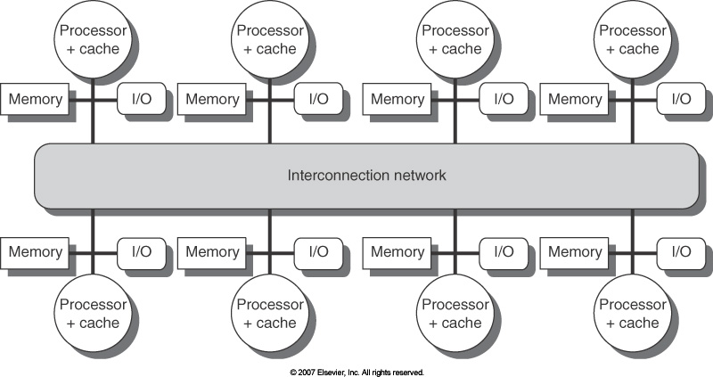
Distributed System
A collection of computers
Each computer has its own local memory!
Communication over a network
Communication suddenly becomes harder! (and slower!)
GPUs can’t be trivially used between computers

Slide 12
Message Passing Interface (MPI)
A standard for message-passing
Multiple implementations exist
Standard functions that allow easy communication of data between processes
Non-networked systems:
Equivalent to memcpy on local system

Slide 13
MPI Functions
There are seven basic functions:
MPI_Init initialize MPI environment
MPI_Finalize terminate MPI environment
MPI_Comm_size how many processes we have running
MPI_Comm_rank the ID of our process
MPI_Isend send data (nonblocking)
MPI_Irecv receive data (nonblocking)
MPI_Wait wait for request to complete

Slide 14
MPI Functions
Some additional functions:
MPI_Barrier wait for all processes to reach a certain point
MPI_Bcast send data to all other processes
MPI_Reduce receive data from all processes and
reduce to a value
MPI_Send send data (blocking)
MPI_Recv receive data (blocking)

Slide 15
Blocking vs. Non-blocking
MPI_Isend and MPI_Irecv are asynchronous (non-blocking)
Calling these functions returns immediately
Operation may not be finished!
Should use MPI_Wait to make sure operations are completed
Special “request” objects for tracking status
MPI_Send and MPI_Recv are synchronous (blocking)
Functions don’t return until operation is complete
Can cause deadlock!
(we won’t focus on these)

Slide 16
MPI Functions - Wait
int MPI_Wait(MPI_Request *request, MPI_Status *status)
Takes in…
A “request” object corresponding to a previous operation
Indicates what we’re waiting on
A “status” object
Basically, information about incoming data

Slide 17
MPI Functions - Reduce
int MPI_Reduce(const void *sendbuf, void *recvbuf, int count, MPI_Datatype datatype, MPI_Op op, int root, MPI_Comm comm)
Takes in…
A “send buffer” (data obtained from every process)
A “receive buffer” (where our final result will be placed)
Number of elements in send buffer
Can reduce element-wise array -> array
Type of data (MPI label, as before)
…

Slide 18
MPI Functions - Reduce
int MPI_Reduce(const void *sendbuf, void *recvbuf, int count, MPI_Datatype datatype, MPI_Op op, int root, MPI_Comm comm)
Takes in… (continued)
Reducing operation (special MPI labels, e.g. MPI_SUM, MPI_MIN)
ID of process that obtains result
MPI communication object (as before)

Slide 19
MPI Example
int main(int argc, char **argv) {
int rank, numprocs;
MPI_Status status;
MPI_Request request;
MPI_Init(&argc,&argv);
MPI_Comm_size(MPI_COMM_WORLD,&numprocs);
MPI_Comm_rank(MPI_COMM_WORLD,&rank);
int tag=1234;
int source=0;
int destination=1;
int count=1;
int send_buffer;
int recv_buffer;
if(rank == source){
send_buffer=5678;
MPI_Isend(&send_buffer,count,MPI_INT,destination,tag, MPI_COMM_WORLD,&request);
}
if(rank == destination){
MPI_Irecv(&recv_buffer,count,MPI_INT,source,tag, MPI_COMM_WORLD,&request);
}
MPI_Wait(&request,&status);
if(rank == source){
printf("processor %d sent %d\n",rank,recv_buffer);
}
if(rank == destination){
printf("processor %d got %d\n",rank,recv_buffer);
}
MPI_Finalize();
return 0;
}
Two processes
Sends a number from process 0 to process 1
Note: Both processes are running this code!

Slide 20
Wave Equation – Simple Solution
Can do this with MPI_Irecv, MPI_Isend, MPI_Wait:
Suppose process has rank r:
If we’re not the rightmost process:
Send data to process r+1
Receive data from process r+1
If we’re not the leftmost process:
Send data to process r-1
Receive data from process r-1
Wait on requests

Slide 21
Wave Equation – Simple Solution
Boundary conditions:
Use MPI_Comm_rank and MPI_Comm_size
Rank 0 process will set leftmost condition
Rank (size-1) process will set rightmost condition

Slide 22
Simple Solution – Problems
Communication can be expensive!
Expensive to communicate every timestep to send 1 value!
Better solution: Send some m values every m timesteps!
Tradeoff between redundant computations and reduced network/communication overhead
Network (MPI) case worse than the multi-GPU case!

