Slide 1
CS 179: GPU Programming
Lecture 11 / Homework 4

Slide 2
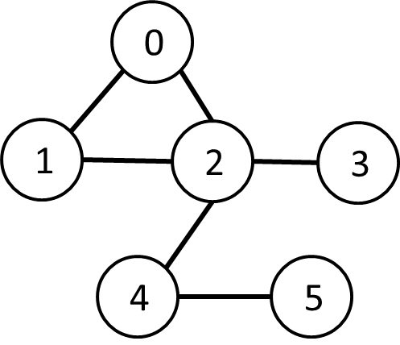
Breadth-First Search
0
Given source vertex S:
Find min. #edges to reach every vertex from S
(Assume source is vertex 0)
1
1
2
2
3
Sequential pseudocode:
let Q be a queue
Q.enqueue(source)
label source as discovered
source.value <- 0
while Q is not empty
v ← Q.dequeue()
for all edges from v to w in G.adjacentEdges(v):
if w is not labeled as discovered
Q.enqueue(w)
label w as discovered, w.value <- v.value + 1

Slide 3
Alternate BFS algorithm
New sequential pseudocode:
Input: Va, Ea, source (graph in “compact adjacency list” format)
Create frontier (F), visited array (X), cost array (C)
F <- (all false)
X <- (all false)
C <- (all infinity)
F[source] <- true
C[source] <- 0
while F is not all false:
for 0 ≤ i < |Va|:
if F[i] is true:
F[i] <- false
X[i] <- true
for Ea[Va[i]] ≤ j < Ea[Va[i+1]]:
if X[j] is false:
C[j] <- C[i] + 1
F[j] <- true
Parallelizable!

Slide 4
GPU-accelerated BFS
CPU-side pseudocode:
Input: Va, Ea, source (graph in “compact adjacency list” format)
Create frontier (F), visited array (X), cost array (C)
F <- (all false)
X <- (all false)
C <- (all infinity)
F[source] <- true
C[source] <- 0
while F is not all false:
call GPU kernel( F, X, C, Va, Ea )
GPU-side kernel pseudocode:
if F[threadId] is true:
F[threadId] <- false
X[threadId] <- true
for Ea[Va[threadId]] ≤ j < Ea[Va[threadId + 1]]:
if X[j] is false:
C[j] <- C[threadId] + 1
F[j] <- true
Can represent boolean values as integers

Slide 5
Texture Memory (and co-stars)
Another type of memory system, featuring:
Spatially-cached read-only access
Avoid coalescing worries
Interpolation
(Other) fixed-function capabilities
Graphics interoperability

Slide 6
X-ray CT Reconstruction

Slide 7
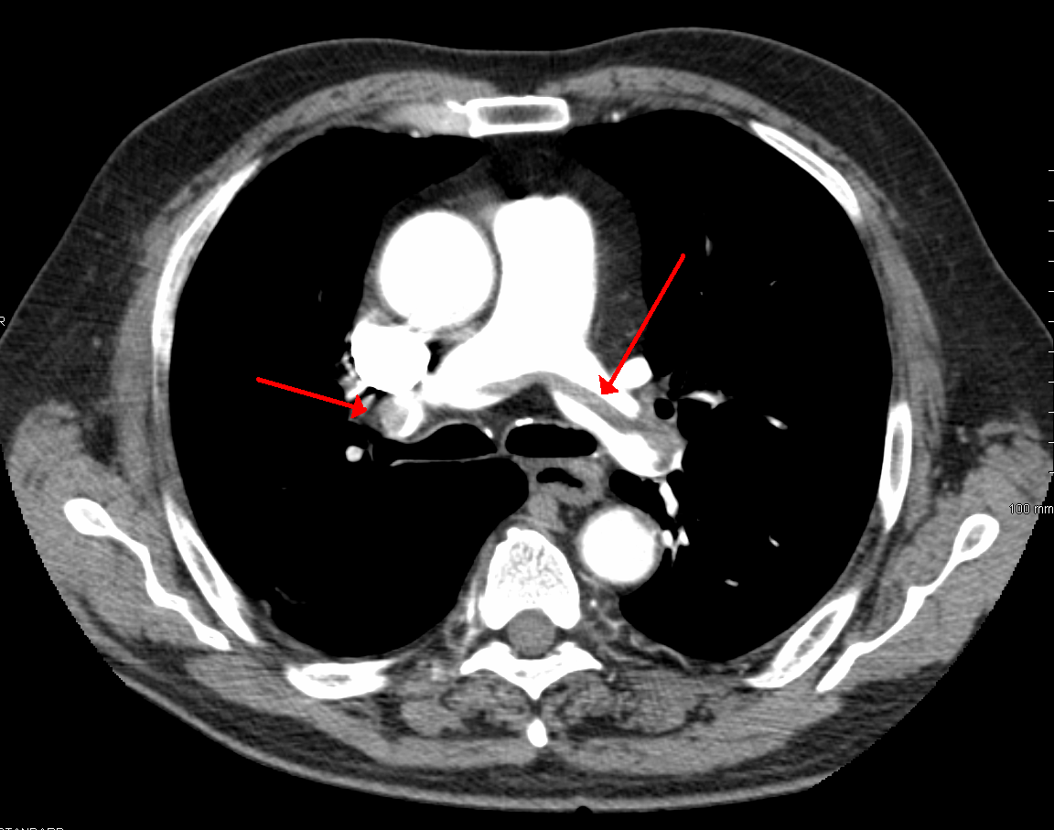
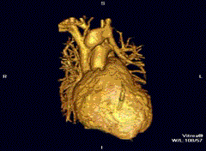
Medical Imaging
See inside people!
Critically important in medicine today
"SaddlePE" by James Heilman, MD - Own work. Licensed under CC BY-SA 3.0 via Wikimedia Commons - http://commons.wikimedia.org/wiki/File:SaddlePE.PNG#/media/File:SaddlePE.PNG
"PAPVR". Licensed under CC BY 3.0 via Wikipedia - http://en.wikipedia.org/wiki/File:PAPVR.gif#/media/File:PAPVR.gif

Slide 8
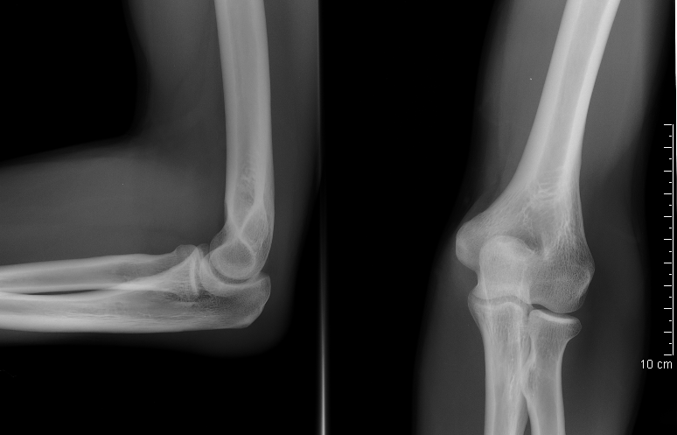
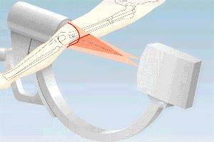
X-ray imaging (Radiography)
“Algorithm”:
Generate electromagnetic radiation
Measure radiation at the “camera”
Certain tissues are more “opaque” to X-rays
Like photography!
"Coude fp" by MB - Collection personnelle. Licensed under CC BY-SA 2.5 via Wikimedia Commons - http://commons.wikimedia.org/wiki/File:Coude_fp.PNG#/media/File:Coude_fp.PNG
http://www.imaginis.com/xray/how-does-x-ray-imaginig-work

Slide 9
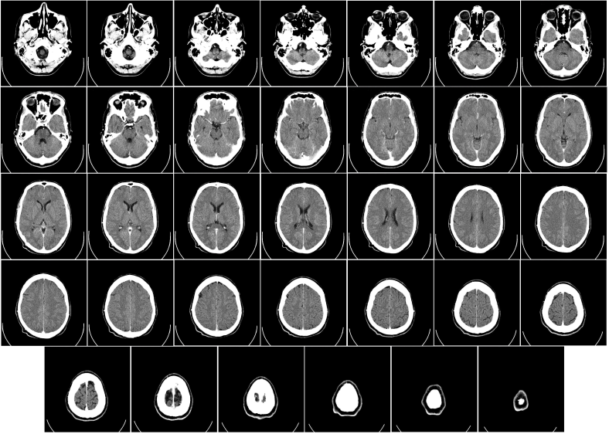
Radiography limitations
Generates 2D image of 3D body
What if we want a “slice” of 3D body?
Goal: 3D reconstruction! (from multiple slices)
vs.
"Coude fp" by MB - Collection personnelle. Licensed under CC BY-SA 2.5 via Wikimedia Commons - http://commons.wikimedia.org/wiki/File:Coude_fp.PNG#/media/File:Coude_fp.PNG
"Computed tomography of human brain - large" by Department of Radiology, Uppsala University Hospital. Uploaded by Mikael Häggström. - Radiology, Uppsala University Hospital. Brain supplied by Mikael Häggström. It was taken Mars 23, 2007. Licensed under CC0 via Wikimedia Commons - http://commons.wikimedia.org/wiki/File:Computed_tomography_of_human_brain_-_large.png#/media/File:Computed_tomography_of_human_brain_-_large.png

Slide 10
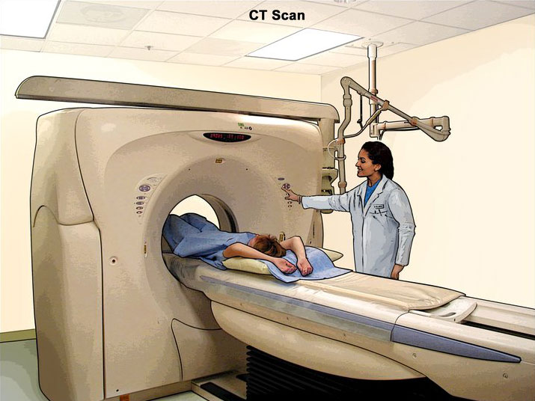
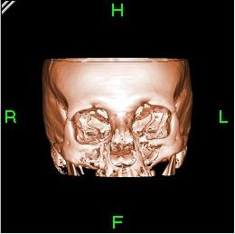
X-ray Computed Tomography (CT)
http://www.cancer.gov/
"Bonereconstruction" by Original uploader was Zgyorfi at en.wikipedia - Transferred from en.wikipedia; transferred to Commons by User:Common Good using CommonsHelper.. Licensed under CC BY-SA 3.0 via Wikimedia Commons - http://commons.wikimedia.org/wiki/File:Bonereconstruction.jpg#/media/File:Bonereconstruction.jpg

Slide 11
X-ray Computed Tomography (CT)
Generate 2D “slice” using 3D imaging
New imaging possibilities!
Reconstruction less straightforward

Slide 12
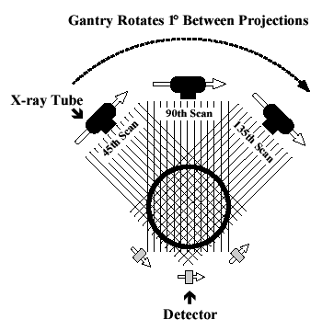
X-ray Computed Tomography (CT)
“Algorithm” (per-slice):
Take *lots* of pictures at different angles
Each “picture” is a 1-D line
Reconstruct the many 1-D pictures into a 2-D image
Harder, more computationally intensive!
3D reconstruction requires multiple slices
http://www.thefullwiki.org/Basic_Physics_of_Nuclear_Medicine/X-Ray_CT_in_Nuclear_Medicine

Slide 13
Mathematical Details
X-ray CT (per-slice) performs a 2D X-ray transform (eq. to 2D Radon transform):
Suppose body density represented by $f(\overset{⃑}{x})$ within 2D slice, $\overset{⃑}{x}=(x,y)$
Assume linear attenuation of radiation
For each line L of radiation measured by detector:
$$I_{detect}=I_{emit}\int_{L}{f}=I_{emit}\int_{\text{ℝ}}{f\left({\overset{⃑}{x}}_{0}+t{\overset{⃑}{θ}}_{L}\right) dt}$$
${\overset{⃑}{θ}}_{L}$: a unit vector in direction of L

Slide 14
Mathematical Details
$$I_{detect}=I_{emit}\int_{L}{f}=I_{emit}\int_{\text{ℝ}}{f\left({\overset{⃑}{x}}_{0}+t{\overset{⃑}{θ}}_{L}\right) dt}$$
Defined as Lebesgue integral – non-oriented
Opposite radiation direction should have same attenuation!
Re-define as:
$$I_{detect}=I_{emit}\int_{−∞}^{∞}{f\left({\overset{⃑}{x}}_{0}+t{\overset{⃑}{θ}}_{L}\right) |dt|}$$

Slide 15
Mathematical Details
For each line L of radiation measured by detector:
$$I_{detect}=I_{emit}\int_{L}{f}=I_{emit}\int_{−∞}^{∞}{f\left({\overset{⃑}{x}}_{0}+t{\overset{⃑}{θ}}_{L}\right) |dt|}$$
Define general X-ray transform (for all lines L in R²):
$$(Rf)\left(L\right)=\int_{−∞}^{∞}{f\left({\overset{⃑}{x}}_{0}+t{\overset{⃑}{θ}}_{L}\right) |dt|}$$
Fractional values of attenuation
${\overset{⃑}{x}}_{0}$ lies along L

Slide 16
Mathematical Details
Define general X-ray transform:
$$(Rf)\left(L\right)=\int_{−∞}^{∞}{f\left({\overset{⃑}{x}}_{0}+t{\overset{⃑}{θ}}_{L}\right) |dt|}$$
Parameterize $\overset{⃑}{θ}=(\cos{θ,\sin{θ}})$
Redefine as:
$$(Rf)\left({\overset{⃑}{x}}_{0}, θ\right)=\int_{−∞}^{∞}{f\left({\overset{⃑}{x}}_{0}+t\overset{⃑}{θ}\right) |dt|}$$
Define for $θ∈[0, 2π)$

Slide 17
Mathematical Details
$$(Rf)\left({\overset{⃑}{x}}_{0}, θ\right)=\int_{−∞}^{∞}{f\left({\overset{⃑}{x}}_{0}+t\overset{⃑}{θ}\right) |dt|}$$
Important properties:
Many ${\overset{⃑}{x}}_{0}$ are redundant!
Symmetry: $Rf\left({\overset{⃑}{x}}_{0}, θ\right)=Rf\left({\overset{⃑}{x}}_{0}, θ+π\right)$
Can define for $θ∈[0, π)$

Slide 18
X-ray Computed Tomography (CT)
Redefined X-ray transform, $θ∈[0, π)$:
$$(Rf)\left({\overset{⃑}{x}}_{0}, θ\right)=\int_{−∞}^{∞}{f\left({\overset{⃑}{x}}_{0}+t\overset{⃑}{θ}\right) |dt|}$$
In reality:
Only defined for some θ!

Slide 19
X-ray CT Reconstruction
Given the results of our scan (the sinogram):
$$(Rf)\left({\overset{⃑}{x}}_{0}, θ\right)=\int_{−∞}^{∞}{f\left({\overset{⃑}{x}}_{0}+t\overset{⃑}{θ}\right) |dt|}$$
Obtain the original data: (“density” of our body)
$$f(x,y)$$
In reality:
This is hard
We only scanned at certain (discrete) values of θ!
Consequence: Perfect reconstruction is impossible!

Slide 20
Reconstruction
X-ray detector
…
X-ray emitter

Slide 21
Reconstruction
Different θ’s
X-ray detector
…
X-ray emitter

Slide 22
Reconstruction
Each location on detector: Corresponds to multiple x₀’s
Different θ’s
X-ray detector
…
X-ray emitter

Slide 23
X-ray CT Reconstruction
Given the results of our scan (the sinogram):
$$(Rf)\left({\overset{⃑}{x}}_{0}, θ\right)=\int_{−∞}^{∞}{f\left({\overset{⃑}{x}}_{0}+t\overset{⃑}{θ}\right) |dt|}$$
Obtain the original data: (“density” of our body)
$$f(x,y)$$
In reality:
This is hard
We only scanned at certain (discrete) values of θ!
Consequence: Perfect reconstruction is impossible!

Slide 24
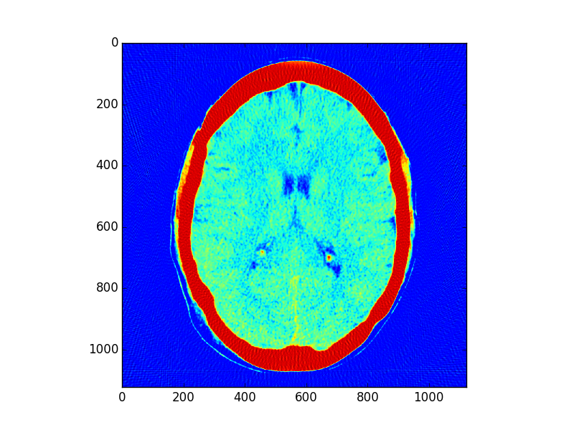
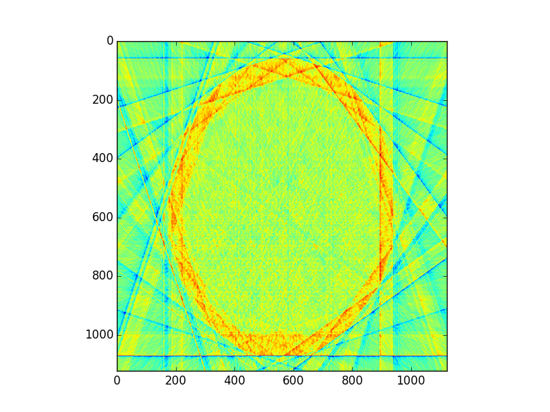
Imperfect Reconstruction
10 angles of imaging
200 angles of imaging

Slide 25
Reconstruction
Simpler algorithm – backprojection
Not quite inverse Radon transform!
Claim: Can reconstruct image as:
$$f_{r}(\overset{⃑}{x}) =\sum_{θ}{(Rf)\left(\overset{⃑}{x}, θ\right)}=\sum_{θ}{\int_{−∞}^{∞}{f\left(\overset{⃑}{x}+t\overset{⃑}{θ}\right) |dt|}}$$
(θ’s where X-rays are taken)
In other words: To reconstruct point, sum measurement along every line passing through that point

Slide 26
Reconstruction
Each location on detector: Corresponds to multiple x₀’s
Different θ’s
X-ray detector
…
X-ray emitter

Slide 27
Geometry Details
For x₀, need to find:
At each θ, which radiation measurement corresponds to the line passing through x₀?

Slide 28
Geometry Details
“The patient”
(slice)
Detector
Emitter

Slide 29
Geometry Details
“The patient”
(slice)
(x₀, y₀)
Detector
θ
Emitter

Slide 30
Geometry Details
Distance from sinogram centerline
d
“The patient”
(slice)
(x₀, y₀)
Detector
θ
Emitter

Slide 31
Geometry Details
Distance from sinogram centerline
d
“The patient”
(slice)
(x₀, y₀)
Detector
Radiation slope:
m = -cos(θ)/sin(θ)
θ
Emitter

Slide 32
Geometry Details
Distance from sinogram centerline
d
Perpendicular slope:
q = -1/m (correction)
(x₀, y₀)
Detector
Radiation slope:
m = -cos(θ)/sin(θ)
θ
θ
Emitter

Slide 33
Geometry Details
Find intersection point (x_{i},y_{i})
Then d² = x_{i}² + y_{i}²
Distance from sinogram centerline
d
Perpendicular slope:
q = -1/m (correction)
(x₀, y₀)
Detector
Radiation slope:
m = -cos(θ)/sin(θ)
θ
d
θ
Emitter

Slide 34
Intersection point
Line 1: (point-slope)
$$\left(y_{i}−y_{0}\right)=m(x_{i}−x_{0})$$
Line 2:
$$y_{i}=qx_{i}$$
Combine and solve:
$$x_{i}=\frac{y_{0}−mx_{0}}{q−m},y_{i}=qx_{i}$$
Corrections

Slide 35
Intersection point
Intersection point:
$$x_{i}=\frac{y_{0}−mx_{0}}{q−m}, y_{i}=qx_{i}$$
Distance from measurement centerline:
$$d=\sqrt{{x_{i}}^{2}+{y_{i}}^{2}}$$
Corrections

Slide 36
Geometry Details
Find intersection point (x_{i},y_{i})
Then d² = x_{i}² + y_{i}²
Distance from sinogram centerline
d
Perpendicular slope:
q = -1/m (correction)
(x₀, y₀)
Detector
Radiation slope:
m = -cos(θ)/sin(θ)
θ
d
θ
Emitter

Slide 37
Sequential pseudocode
$$f_{r}(\overset{⃑}{x})=\sum_{θ}{(Rf)\left(\overset{⃑}{x}, θ\right)}$$
(input: X-ray sinogram):
(allocate output image)
for all y in image:
for all x in image:
for all theta in sinogram:
calculate m from theta
calculate x_i, y_i from m, -1/m
calculate d from x_i, y_i
image[x,y] += sinogram[theta, “distance”]
Clarification: Remember not to confuse geometric x,y with pixel x,y!
(0,0) geometrically is the center pixel of the image, and (0,0) in pixel coordinates is the upper left hand corner. Image is indexed row-wise
Correction/clarification:
d is the distance from the center of the sinogram – remember to center index appropriately
Use –d instead of d as appropriate (when -1/m > 0 and x_i < 0, or if -1/m < 0 and x_i > 0

Slide 38
Sequential pseudocode
$$f_{r}(\overset{⃑}{x})=\sum_{θ}{(Rf)\left(\overset{⃑}{x}, θ\right)}$$
(input: X-ray sinogram):
(allocate output image)
for all y in image:
for all x in image:
for all theta in sinogram:
calculate m from theta
calculate x_i, y_i from m, -1/m
calculate d from x_i, y_i
image[x,y] += sinogram[theta, “distance”]
Parallelizable!
Inside loop depends only on x, y, theta
(corrections/clarification – see slide 37)

Slide 39
Sequential pseudocode
$$f_{r}(\overset{⃑}{x})=\sum_{θ}{(Rf)\left(\overset{⃑}{x}, θ\right)}$$
(input: X-ray sinogram):
(allocate output image)
for all y in image:
for all x in image:
for all theta in sinogram:
calculate m from theta
calculate x_i, y_i from m, -1/m
calculate d from x_i, y_i
image[x,y] += sinogram[theta, “distance”]
For this assignment, only parallelize w/r/to x, y
(provides lots of parallelization already, other issues)
(corrections/clarification – see slide 37)

Slide 40
Cautionary notes
y in an image is opposite of y geometrically!
(Graphics/computing convention)
Edge cases (divide-by-0):
θ = 0:
d = x₀
θ = π/2:
d = y₀

Slide 41
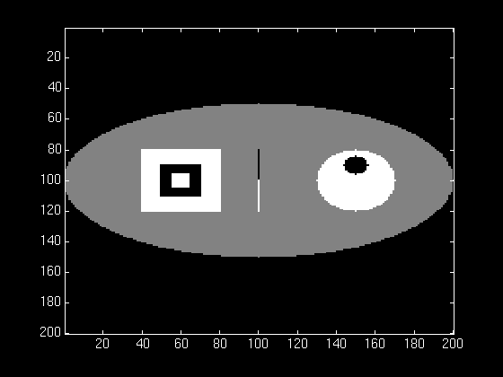
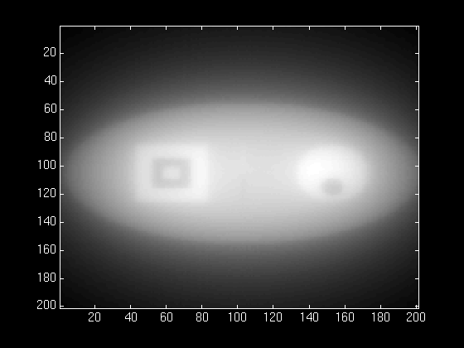
Almost a good reconstruction!
Original
Reconstruction

Slide 42
Almost a good reconstruction!
“Backprojection blur”
Similar to low-pass property of SMA (Week 1)
We need an “anti-blur”! (opposite of Homework 1)

Slide 43
Almost a good reconstruction!
Solution:
A “high-pass filter”
We can get frequency info in parallelizable manner!
(FFT, Week 3)

Slide 44
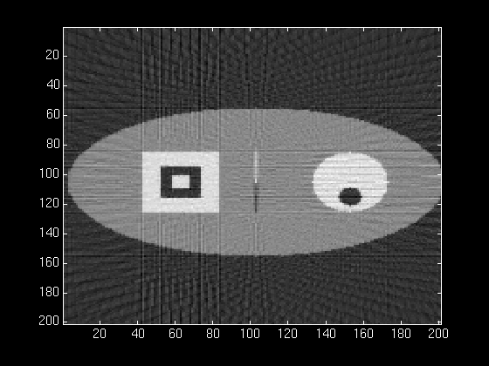
Almost a good reconstruction!
Solution:
A “high-pass filter”
We can get frequency info in parallelizable manner!
(FFT, Week 3)

Slide 45
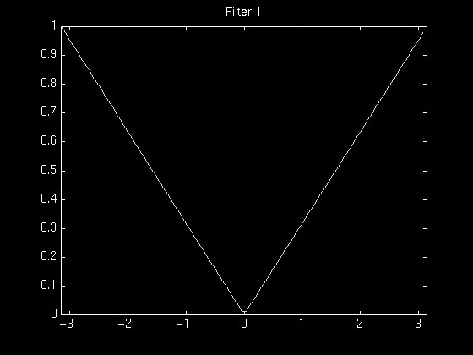
High-pass filtering
Instead of filtering on image (2D HPF):
Filter on sinogram! (1D HPF)
(Equivalent reconstruction by linearity)
Use cuFFT batch feature!
We’ll use a “ramp filter”
Retained amplitude is
linear function of frequency

Slide 46
Almost a good reconstruction!
CPU-side:
(input: X-ray sinogram):
calculate FFT on sinogram using cuFFT
call filterKernel on freq-domain data
Calculate IFFT on freq-domain data
-> get new sinogram
GPU-side:
filterKernel:
Select specific freq-amplitude
based on thread ID
Get new amplitude from
ramp equation

Slide 47
GPU Hardware
Non-coalesced access!
Sinogram 0, index ~d₀
Sinogram 1, index ~d₁
Sinogram 2, index ~d₂
…
…

Slide 48
GPU Hardware
Non-coalesced access!
Sinogram 0, index ~d₀
Sinogram 1, index ~d₁
Sinogram 2, index ~d₂
…
However:
Accesses are 2D spatially local!
…

Slide 49
GPU Hardware
Solution:
Cache sinogram in texture memory!
Read-only (un-modified once we load it)
Ignore coalescing
2D spatial caching!
…

Slide 50
Summary/pseudocode
(input: X-ray sinogram)
Filter sinogram (Slide 46)
Set up 2D texture cache on sinogram (Lecture 10):
Copy to CUDA array (2D)
Set addressing mode (clamp)
Set filter mode (linear, but won’t matter)
Set no normalization
Bind texture to sinogram
Calculate image backprojection (parallelize Slide 39)
Result: 200-250x speedup! (or more)

Slide 51
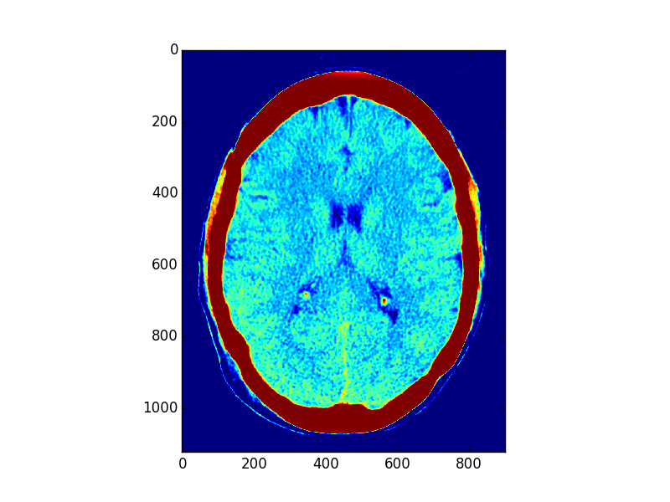
Result: 200-250x speedup! (or more)

Slide 52
Admin
This topic is harder than before!
Lots of information
I may have missed something
If there’s anything unclear, let us know
I can (and likely will) make additional slides/explanatory materials

Slide 53
Admin
C/CUDA code should work on all machines
Pre/post-processing:
Python scripts preprocess.py, postprocess.py
(To run Python scripts: “python <script>.py”)
Either:
Use haru
Install python, (optionally pip) -> numpy, scipy, matplotlib, scikit-image

Slide 54
Resources
Imaging methods:
X-Ray CT in Nuclear Medicine
CT Image Reconstruction (Peters, at AAPM)
Elements of Modern Signal Processing (Candes, at Stanford)
Proof that our algorithm works!

