Slide 1
CS 179 Project Ideas

Slide 2
Proposal Guidelines
1-3 sentence summary of project
team members (pair or solo)
Hoping to do 3 week or 5 week?
1-3 paragraph explanation of project with background
Why is this challenging? Has it been done before? What tricky things are you going to have to figure out? 1-2 paragraphs
What are the deliverables? Goals? 1 paragraph
Week by week timeline: What are you going to do each week?

Slide 3
Available CUDA libraries
cuBLAS: dense linear algebra
cuSPARSE: sparse linear algebra
cuRAND: random numbers, good for MCMC simulations
cuFFT: Fast Fourier Transform
cuSOLVER: dense and sparse factorization and system solvers
cuDNN: common operations for deep neural nets
Might be useful for project planning to to check out what they provide!

Slide 4
16 bit matrix multiplication
Some applications (such as deep neural nets) don’t need 32 bits of precision.
16 bit advantages: speed up matrix multiply due to less IO, fit twice as much data in GPU memory
If you create a fast implementation, there’s a good chance the deep learning community will use it a lot!
Notes:
Talk to Eric for

Slide 5
Cryptocurrency
Find some cryptocurrency with an proof of work algorithm that hasn’t been optimized to death, and then optimize it to death
An interesting read on the topic

Slide 6
Randomized Matrix Factorizations
Can quickly approximate SVD, QR decomposition, etc using randomized algorithms!
Good project for someone who has taken ACM 106a
Method for least squares solutions, ultra-high dim’l spaces that represent highly constrained systems
Can compare performance to cuSOLVER, for instance, for different size and different types of problems
Good survey paper on the subject (PDF)

Slide 7
Branch and Bound Systems
Make global B&B solution-finding environment.
An N-dimensional box-like “volume” is tested for a criterion.
If the box passes the test, it is put into a list of “solution boxes.”
If the box does not pass, it is subdivided into children boxes which are then tested. Method finds all such boxes.
The criterion/test will be run once per box, suitable to run on GPU
Can include octree or K-D tree algorithms for representing surfaces and solids, for instance, http://www.nvidia.com/docs/IO/88889/laine2010i3d_paper.pdf or
N-body gravitational systems that subdivide space with one body per box http://www.cs.nyu.edu/courses/spring12/CSCI-GA.3033-012/nbody-problem.pdf

Slide 8
Interval Analysis “Corner Form”
A method for global root finding -- an interval-based B&B test that guarantees that a “box” does not contain a root of
f(x,y,z,w) = 0
where f() is a polynomial in x, y, z, w (or more variables).
Intervals of f, given input intervals, are computed by “inclusion function”
The Corner Taylor Form (inclusion function) is more accurate than the Midpoint Taylor Form for large input regions, eliminating many boxes early in the process.
See http://thesis.library.caltech.edu/view/author/Gavriliu-M.html

Slide 9
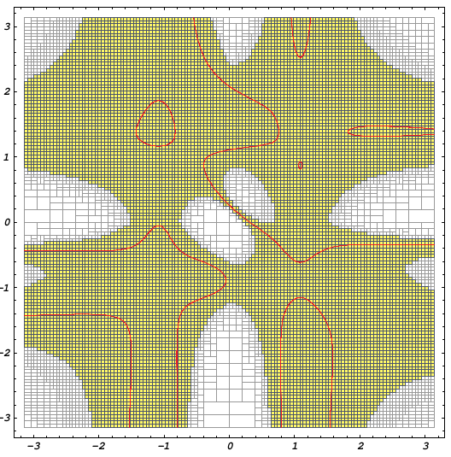
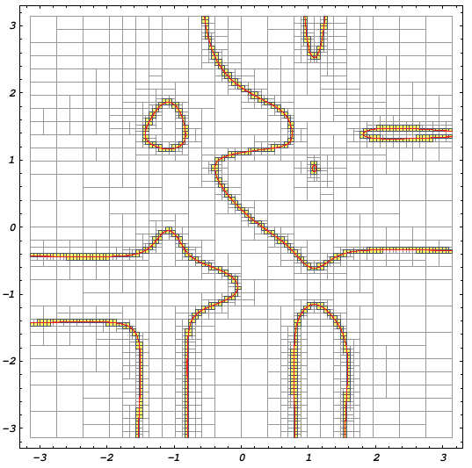
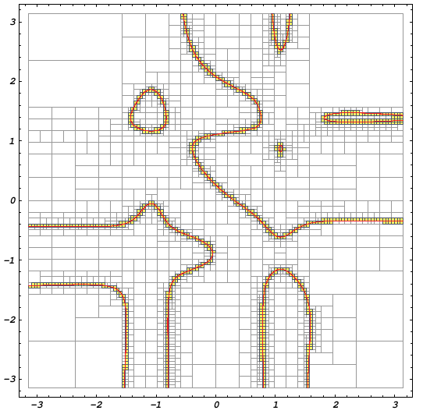
Finding global roots of cos2x sin3y + sin3x cos2y - cos2x cos3y + sin3xsin2y = 0
(First turn function into polynomial, with error term). Sol’ns in yellow.
On left, “Natural Extension” inclusion function: too many potential solutions.
In the middle, “Centered Form” is much improved:
On right, “Corner Form” is even better. Note upper right corner. Large region excluded quickly, without need for further subdivision.

Slide 10
Hash Table (and/or malloc)
Implement a concurrent hash table that lives in global or shared memory.
Implement malloc for global or shared memory.
These will be tricky parallel programming problems!

Slide 11
Build an assembler
Reverse engineer Fermi or Kepler binaries and build an assembler.
Already done for Maxwell: https://github.com/NervanaSystems/maxas

Slide 12
“Speed dating”
Talk to another person about your ideas for 3 minutes.
Will cycle several times.
Goals: hear lots of ideas, connect people with similar ideas,
offer suggestions to each other ideas

