Slide 1
CS 179 Lecture 17
Options Pricing

Slide 2
Computational finance
Broad term, can include ideas from machine learning or signals processing.
One part of computational finance:
How should we price things?
How can we efficiently and accurately compute these prices?
Notes:
Often involves looking at market data, which can be significant. Back-testing is a big deal.
If you like numerical math & high performance computing, computational finance might be a good field to look into.
I’ll actually be working at a high frequency trading company next year because the HPC aspect is interesting. HFT requires large off-line computation as well as low-latency online computation. Get to play with fancy hardware!
I don’t actually know much, this lecture is very much a survey of what’s out there.

Slide 3
What is an option?
Call/put option -
right to buy/sell something at a specific price in a given time period
something = asset or security
specific price = “striking price” or “exercise price”
time period is often a maturity or expiration date
Notes:
basket options: asset is a linear combination of other assets. More complicated to model because higher dimensional space.

Slide 4
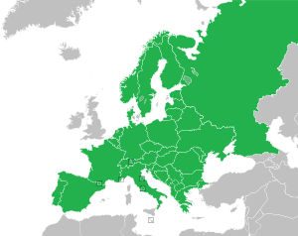
European options
European options are the simplest form of options.
Can only exercise a European option on the expiration date

Slide 5
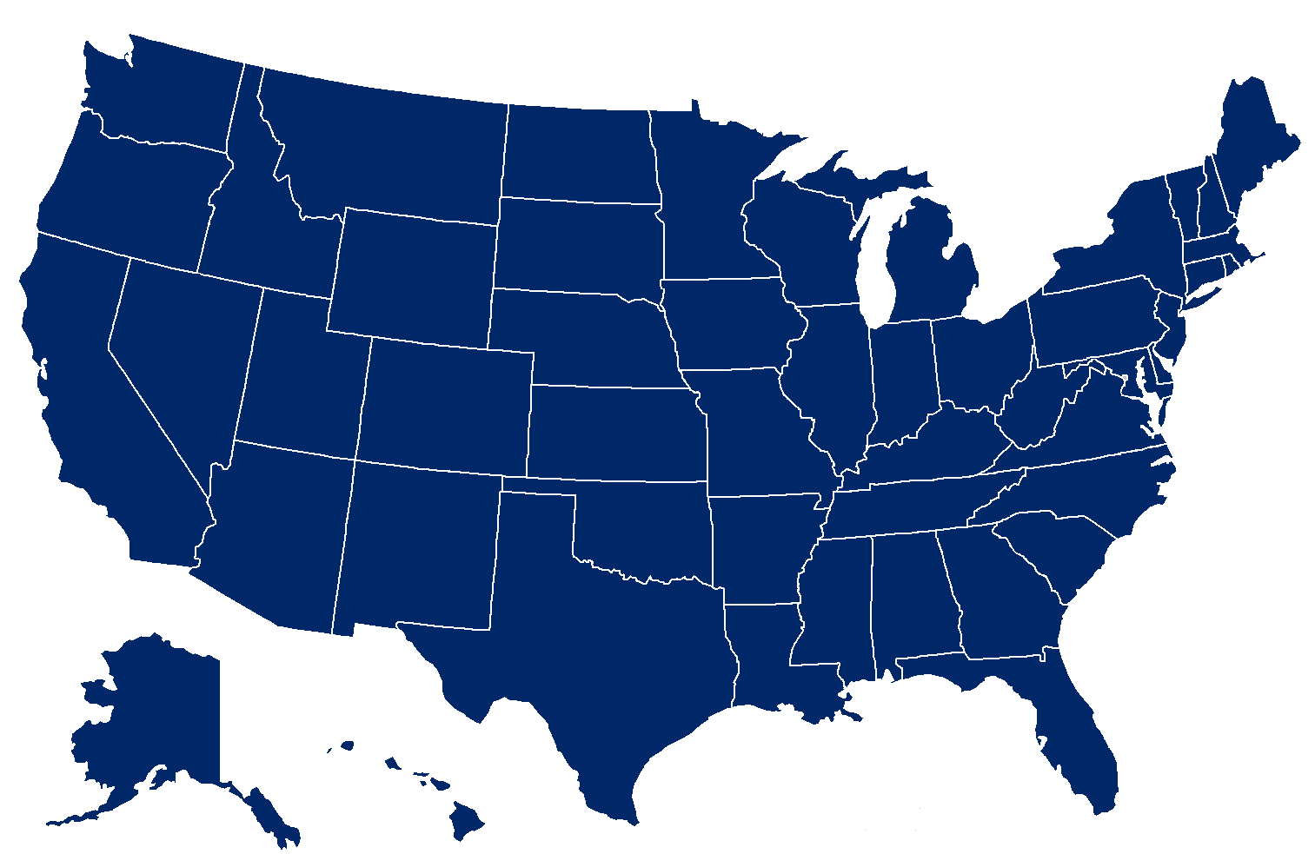
American options
An American option can be exercised at any time between purchase and the expiration date.

Slide 6
Options pricing
How much should it cost to buy an option?
Example: GOOG currently trades for $540. How much would you pay to be able to sell GOOG for $400 at any point in the next year?
Need to make modelling assumptions about behavior of asset prices.
Notes:
What type of option is this?

Slide 7
Formalization
S_{t} - price of asset at time t, spot price
K - striking price
T - time of expiration
Value of option at maturity?
Call option: max(S_{T}- K, 0)
Put option: max(K - S_{T}, 0)
Notes:
max is because you don’t need to exercise option
Call is max(S-K, 0), because you have right to buy at K but market is at S, so you can resale at S
Put is max(K-S), because you can sell something for K rather than S.

Slide 8
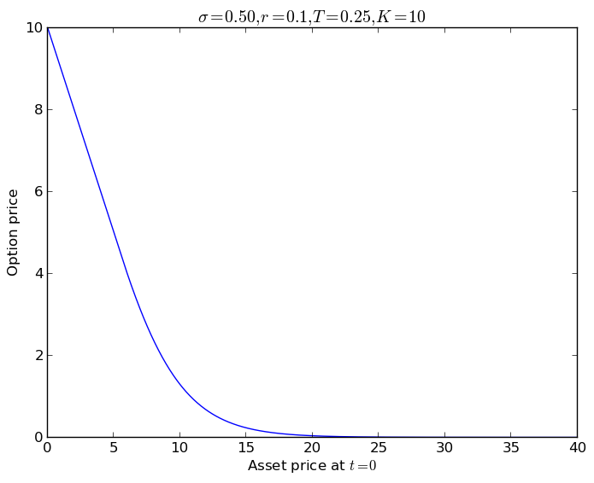
American put option pricing by Black-Scholes
Notes:
Geometric brownian motion with parameter sigma
r is risk-free return rate.
T = .25 represents one quarter
K = 10 is strike price (price we can sell at)
If spot price is below K, model is linear. As spot prices raises, the probability of getting below 10 decreases so value of option falls.
maybe this looks like a boundary value problem

Slide 9
Options pricing & GPUs
Sometimes options pricing has an analytic (easy to compute) solution.
Oftentimes not the case…
No closed form for American options under Black-Scholes assumptions. The rest of the lecture is on American options.
Notes:
European put and call options can be analytically calculated using Black-Scholes.
requires assumptions that spot price is GBM (no jumps), fixed volatility, no arbitrage, risk-free interest rate, no transaction costs.
many models with less assumptions are more accurate but less easy to compute (and no analytic solution)

Slide 10
Options pricing & GPUs
3 widely used schemes to price options (that can’t be analytically priced):
Monte Carlo methods
Finite differencing (differential equations, Black-Scholes)
Binomial option pricing model
All 3 ways are very different algorithmically!

Slide 11
Monte Carlo methods
Monte Carlo methods approximate difficult to compute statistics by sampling from the generating distribution.
Let’s randomly generate asset prices over time.
Parallel Forall blog post on Monte Carlo options pricing

Slide 12
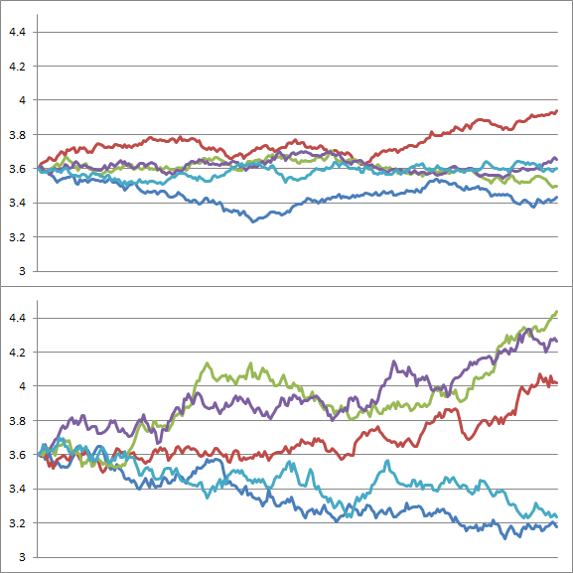
Simulated asset prices (from NVIDIA blog post)
Notes:
difference between the plots is volatility

Slide 13
Predicting exercise time
Besides generating the asset price paths, we also need to predict at which point the option would be exercised for each path.
The Longstaff-Schwartz algorithm uses a linear regression at each time-step to decide whether to exercise.

Slide 14
Monte Carlo parallelism
Run different path simulations in parallel.
Can use cuRAND for path generation and cuSOLVER for linear regressions.

Slide 15
Pricing options with PDEs
Can model options price as a PDE in 2 variables: time and asset price.
Known boundary conditions at:
time=expiration
spot price = 0
spot price = ∞
Price is solution to equation at time = 0.

Slide 16
Black-Scholes & American options
The Black-Scholes equation dictates how option price changes in time and spot price. Same equation for European and American options.
B-S requires some stochastic calculus to derive, not going to go into it.
B-S used to compute analytic solution for European options, but boundary conditions are different for American options.

Slide 17
Finite Differencing
Finite differencing is a simple way to numerically solve differential equations
Discretize the equation and solve on a grid.
Replace derivatives with approximations (use Taylor series)

Slide 18
Finite differencing example
Compute value at time (n+1) from 3 different locations at time n. This is a sparse matrix multiplication! r depends on grid size in both dimensions.
Above is an “explicit” method as time (n+1) depends only on time n. There also implicit schemes that require solving a sparse linear system at both time steps.
Notes:
the convolutions from set 1 were also matrix multiplications

Slide 19
Finite differencing parallelization
Perform sparse matrix multiplication or sparse system solving on GPU.

Slide 20
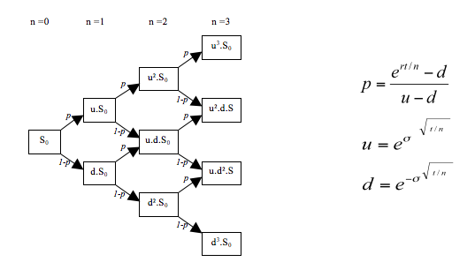
Binomial options pricing model diagram (from Wikipedia)
Notes:
Fewer total nodes than finite differencing grid (but still O(n^2))

Slide 21
Binomial options pricing
A dynamic programming problem with convenient assumptions.
At each time step, asset price goes up by factor “u” or down by factor “d”.
Let u * d = 1.

Slide 22
Finishing binomial pricing
Assign option values to each node at expiration time
Work backwards in time to assign each node an option value based on the values of its two children based on interest-discounted expected value. For American option, take max at each node of exercising or keeping option.

Slide 23
Parallelizing binomial pricing
Less easy than parallelizing other models because of serial algorithm across times.
Can use data parallelism to compute time i prices from time (i+1).
Can also use task parallelism to directly compute time (i-1), i directly from (i+1). Each (i-1) node just depends on 4 nodes rather than 2. Repeating work isn’t illegal!

Slide 24
Conclusion
GPUs are useful for option pricing and computational finance.
Some of these algorithms exhibit “MATLAB-parallelism”
Some parts of finance can greatly benefit from the parallel computing ideas we’ve discussed in this course.
Notes:
Hopefully this lecture gave you a pointer in the right direction if you are interested in learning more about these types of algorithms

