Slide 1
CS 179 Lecture 15
Set 5 & machine learning

Slide 2
Set 5 goals
Practice overlapping computation with data movement on a streaming workload…
while building a machine learning system

Slide 3
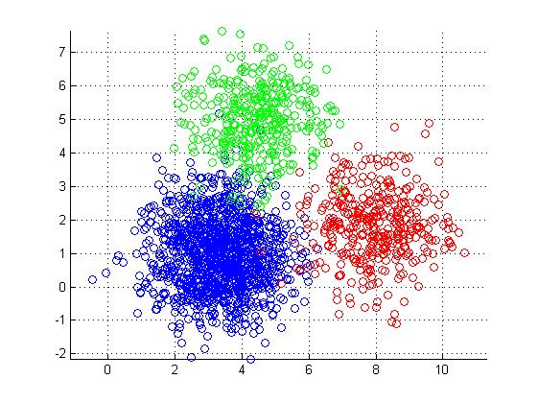
Set 5 description
Cluster a stream of business review from Yelp.

Slide 4
Representing text as vectors
Yelp reviews are text. How can we quantify the similarity between two snippets of text?
“The doctor has horrible bedside manner”
“The enchiladas were the best I’ve ever had!”
One solution is to represent the snippets as numerical vectors.

Slide 5
Bag of words approach
A very simple but very common approach. Count occurrences of each word
Loses all information on ordering of words.
 | cats | dogs | hats | love | eat
cats love hats | 1 | 0 | 1 | 1 | 0
cats eat hats | 1 | 0 | 1 | 0 | 1
cat eat cats | 2 | 0 | 0 | 0 | 1
document-term
matrix
Notes:
Want to normalize words when computing document-term matrix. cats = cat. Runs = run = running. Called stemming. Also do things like lowercase.
For the Yelp dataset, there were about 350,000 total terms (didn’t do stemming). Through out all words appearing less than 10 times and got down to 65,000 terms. 1.5 million documents. sparse matrix

Slide 6
Latent Semantic Analysis
Idea: Compute the singular value decomposition (SVD) of the document-term matrix. Singular values correspond to words that commonly appear together, which oftentimes correspond to our notion of a topic.
This is called latent semantic analysis.
Represent each document as coefficients of top-k singular vectors.
Notes:
Did SVD on term-document matrix to represent each vector as a 50 component vector.

Slide 7
Clustering
Group data points based on some sort of similarity. Clustering is a very common unsupervised learning problem.
Many variants of clustering:
hard/soft
hierarchical
centroid
distribution (Gaussian mixture models)
density
Notes:
hard/soft: does each point belong to 1 cluster or multiple clusters to different degrees (confidences)
hierarchical - clusters are part of other clusters. top-down (divisive) and bottom-up (agglomerative) algorithms exist
centroid - represent each cluster as a single point
distribution - a cluster is a probability distribution
density - a cluster is an area with a higher density of data points next to areas of lower density
can think of LSA as a form of soft clustering (component values indicate how much point belongs to cluster)

Slide 8
k-means clustering
Very popular centroid-based hard clustering algorithm.
def k_means(data, k):
randomly initialize k “cluster centers”
while not converged:
for each data point:
assign data point to closest cluster center
for each cluster center:
move cluster center to average of points in cluster
return cluster centers
Notes:
Hard points: choice of k, random initialization.
NP-hard to find optimal solution (minimizing distance to cluster centers), this just finds local optima. can get bad outputs.
How could we parallelize this?

Slide 9
Stream clustering
Can we cluster if we can only see each data point once?
def sloppy_k_means(int k):
randomly initialize k “cluster centers”
for each data point:
assign data point to closest cluster center
update closest cluster center with respect to data point
return cluster centers
This algorithm will give poor clustering.

Slide 10
Cheating at streaming algorithms
Idea: Use a streaming algorithm to create a smaller dataset (sketch) with properties similar to stream. Use expensive algorithm on sketch.
k_means(sloppy_k_means(stream, 20 * k), k)
Strategy described here, used by Apache Mahout. If length of stream is known (and finite), use k*log(n) clusters for sketch.

Slide 11
Parallelization
def sloppy_k_means(int k):
randomly initialize k “cluster centers”
for each data point:
assign data point to closest cluster center
update closest cluster center with respect to data point
return cluster centers
What can we parallelize here?

Slide 12
Batching for parallelization
def sloppy_k_means(int k):
randomly initialize k “cluster centers”
for each batch of data points:
par-for point in batch:
assign data point to closest cluster center
update cluster centers with respect to batch
return cluster centers

Slide 13
Batching
Changing the computation slightly to process a batch of data at a time is a common theme in parallel algorithms.
Although it does change the computation slightly, batching still leads to some sort of local minima of the loss function.
When you already aren’t going to find an optimal solution, cutting corners isn’t that bad :)

Slide 14
Data transfer issues
Your program for set 5 will read LSA representations of reviews from stdin and will sloppy cluster them.
Your tasks:
overlap data transfer and computation between host and device (hopefully saturate interface on haru)
implement sloppy clustering algorithm
analyze latency and throughput of system

Slide 15
Final comments on set
Set 5 should be out Tuesday evening.
Details are still getting worked out. Might involve using multiple GPUs. Will be relatively open-ended.

Slide 16
General machine learning on GPU
Already seen k-means clustering…
Many machine learning numerical algorithms rely on just a few common computational building blocks.
element-wise operations on vectors/matrices/tensors
reductions along axes of vectors/matrices/tensors
matrix multiplication
solving linear systems
convolution (FFT)

Slide 17
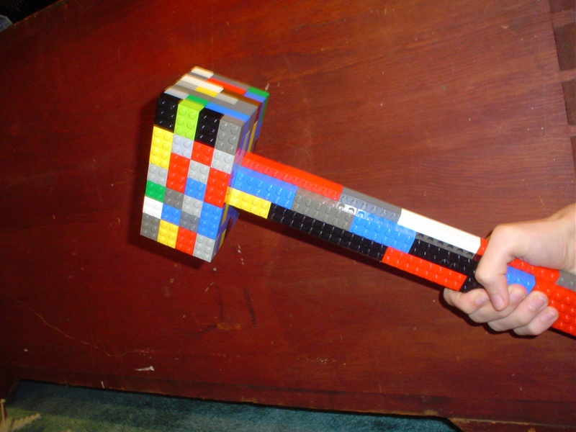
Computational building blocks
These building blocks are why scientific scripting (MATLAB or Numpy) is so successful.
Often want to use the GPU by using a framework rather than writing your own CUDA code.
image from Todd Lehman
Notes:
Have super fast implementations of building blocks, and then use a convenient language to tie the blocks together.

Slide 18
When to NOT write your own CUDA
Heuristic: If you could write it efficiently in “clean” MATLAB, you could likely accelerate it solely through using libraries either from NVIDIA (cuBLAS, cuSPARSE, cuFFT) or the community (Theano, Torch)
Better to write less CUDA and then
call into a lot
Notes:
Scientists in general want to use code to enable their research, not just write code. The less time they spend programming, the better.
Writing in C/CUDA is more time consuming than writing in Python.
Think of CUDA as a way to make libraries rather than applications. Less CUDA code is often better.
To get truly maximum performance, you might need to move larger and larger components to CUDA. Abstractions aren’t perfect.

Slide 19
When to write your own CUDA
Vectorized scripting languages must use a lot of memory when considering all combinations of input.
Example: What is the maximum distance between pairs of n points?
Most vectorized MATLAB implementations will store all n² distances, and then compute the maximum over these. Quadratic memory and time.
An implementation in a language with loops (that you actually want to use) takes linear memory and quadratic time.
Notes:
k-means clustering in an example of this.

Slide 20
What this week will cover
Today: Theano (Python library that makes GPU computing easy)
Rest of week: parallelizing machine learning yourself, how to write your own CUDA code

Slide 21
Theano
Python library designed primarily for neural nets, but useful for any sort of machine learning that involves training by gradient descent.
Key idea: Express computation as a directed graph through a Numpy-like interface.

Slide 22
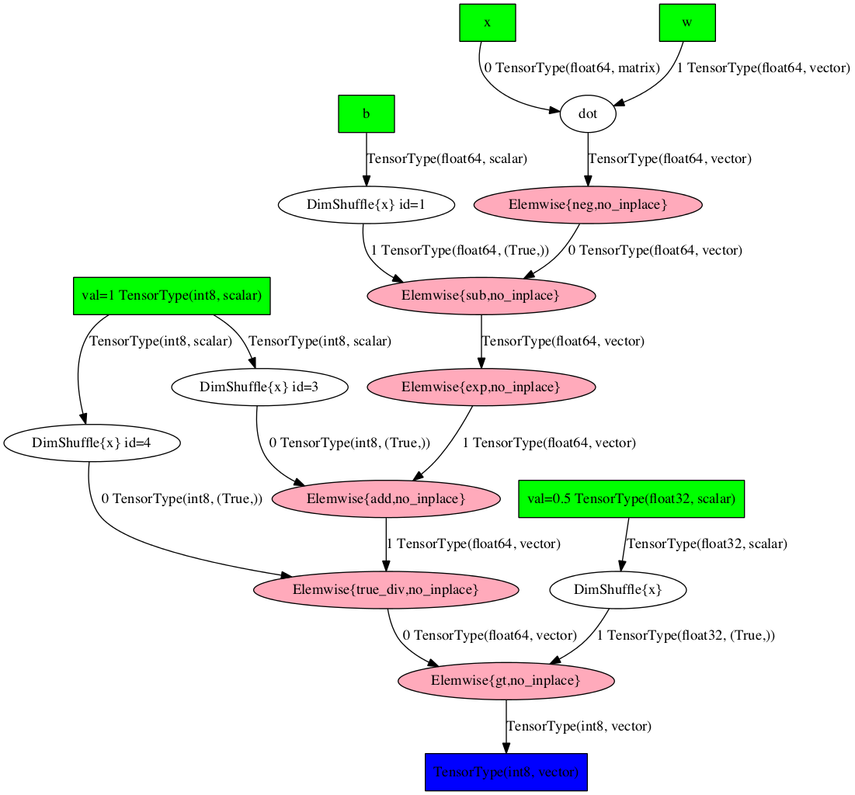
A Theano computation graph (upper part computes exp(w*x - b) )

Slide 23
Benefits of computational graph
Due to abstraction, can execute graph on any hardware for which all graph nodes are implemented. Multi-threaded C, GPU, etc. Can also optimize graph itself (and correct for numerical instability).
Can automatically compute gradient of any graph node output with respect to any other graph node (automatic differentiation)
Notes:
Computational graphs are the future in my opinion. Need to generate code at runtime to do as well as possible.

Slide 24
Simple Theano example
import theano
import theano.tensor as T
input = T.matrix()
output = 1 / (1 + T.exp(-x))
logistic = theano.function([input], output)
logistic([[0.0, 1.0], [3.14, -1.0]])

Slide 25
Conclusion
Set 5 will hopefully be fun (esp since set 6 will be based on same code)
When working on an application, don’t write CUDA unless the complexity is necessary.
Theano is a useful Python library for doing scientific scripting on GPU

