Slide 1
CS 179: GPU Programming
Lecture 7

Slide 2
Week 3
Goals:
More involved GPU-accelerable algorithms
Relevant hardware quirks
CUDA libraries

Slide 3
Outline
GPU-accelerated:
Reduction
Prefix sum
Stream compaction
Sorting (quicksort)

Slide 4
Reduction
Find the sum of an array:
(Or any associative operator, e.g. product)
CPU code:
float sum = 0.0;
for (int i = 0; i < N; i++)
sum += A[i];

Slide 5
Add two arrays fffffffffffffffffffff
A[] + B[] -> C[] fffffffffffffffffffffffff
CPU code:
float *C = malloc(N * sizeof(float));
for (int i = 0; i < N; i++)
C[i] = A[i] + B[i];
Find the sum of an array:
(Or any associative operator, e.g. product)
CPU code:
float sum = 0.0;
for (int i = 0; i < N; i++)
sum += A[i];

Slide 6
Reduction vs. elementwise add
Add two arrays
(multithreaded pseudocode)
Sum of an array
(multithreaded pseudocode)
(allocate memory for C)
(create threads, assign indices)
...
In each thread,
for (i from beginning region of thread)
C[i] <- A[i] + B[i]
Wait for threads to synchronize...
f
(set sum to 0.0)
(create threads, assign indices)
...
In each thread,
(Set thread_sum to 0.0)
for (i from beginning region of thread)
thread_sum += A[i]
“return” thread_sum
Wait for threads to synchronize...
for j = 0,…,#threads-1:
sum += (thread j’s sum)

Slide 7
Reduction vs. elementwise add
Add two arrays
(multithreaded pseudocode)
Sum of an array
(multithreaded pseudocode)
(allocate memory for C)
(create threads, assign indices)
...
In each thread,
for (i from beginning region of thread)
C[i] <- A[i] + B[i]
Wait for threads to synchronize...
f
(set sum to 0.0)
(create threads, assign indices)
...
In each thread,
(Set thread_sum to 0.0)
for (i from beginning region of thread)
thread_sum += A[i]
“return” thread_sum
Wait for threads to synchronize...
for j = 0,…,#threads-1:
sum += (thread j’s sum)
Serial recombination!

Slide 8
Reduction vs. elementwise add
Serial recombination has greater impact with more threads
CPU – no big deal
GPU – big deal
Sum of an array
(multithreaded pseudocode)
(set sum to 0.0)
(create threads, assign indices)
...
In each thread,
(Set thread_sum to 0.0)
for (i from beginning region of thread)
thread_sum += A[i]
“return” thread_sum
Wait for threads to synchronize...
for j = 0,…,#threads-1:
sum += (thread j’s sum)
Serial recombination!

Slide 9
Reduction vs. elementwise add (v2)
Add two arrays
(multithreaded pseudocode)
Sum of an array
(multithreaded pseudocode)
(allocate memory for C)
(create threads, assign indices)
...
In each thread,
for (i from beginning region of thread)
C[i] <- A[i] + B[i]
Wait for threads to synchronize...
f
(set sum to 0.0)
(create threads, assign indices)
...
In each thread,
(Set thread_sum to 0.0)
for (i from beginning region of thread)
thread_sum += A[i]
Atomically add thread_sum to sum
Wait for threads to synchronize...
1

Slide 10
Reduction vs. elementwise add (v2)
Add two arrays
(multithreaded pseudocode)
Sum of an array
(multithreaded pseudocode)
(allocate memory for C)
(create threads, assign indices)
...
In each thread,
for (i from beginning region of thread)
C[i] <- A[i] + B[i]
Wait for threads to synchronize...
f
(set sum to 0.0)
(create threads, assign indices)
...
In each thread,
(Set thread_sum to 0.0)
for (i from beginning region of thread)
thread_sum += A[i]
Atomically add thread_sum to sum
Wait for threads to synchronize...
1
Serialized access!

Slide 11
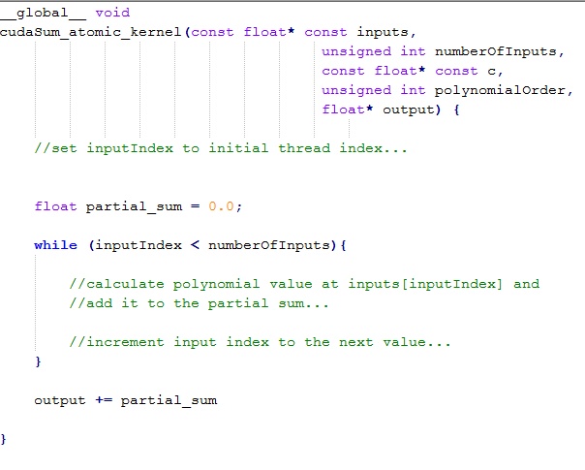
Naive reduction
Suppose we wished to accumulate our results…

Slide 12
Naive reduction
Suppose we wished to accumulate our results…
Thread-unsafe!

Slide 13
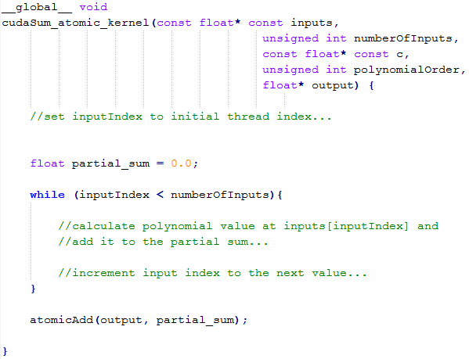
Naive (but correct) reduction

Slide 14
GPU threads in naive reduction
http://telegraph.co.uk/

Slide 15
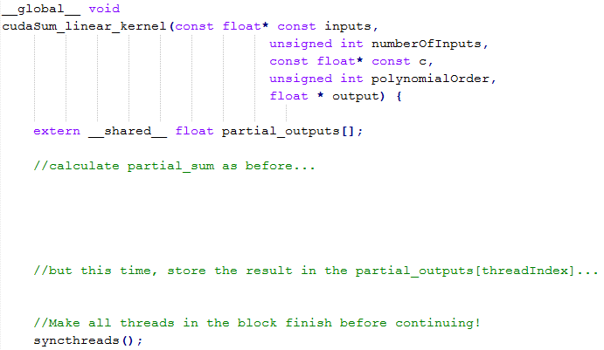
Shared memory accumulation

Slide 16
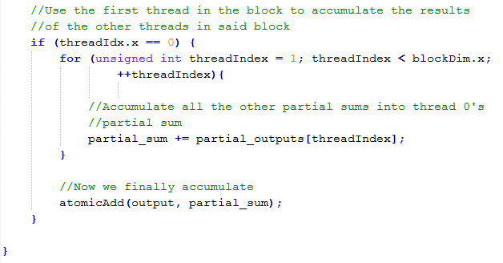
Shared memory accumulation (2)

Slide 17
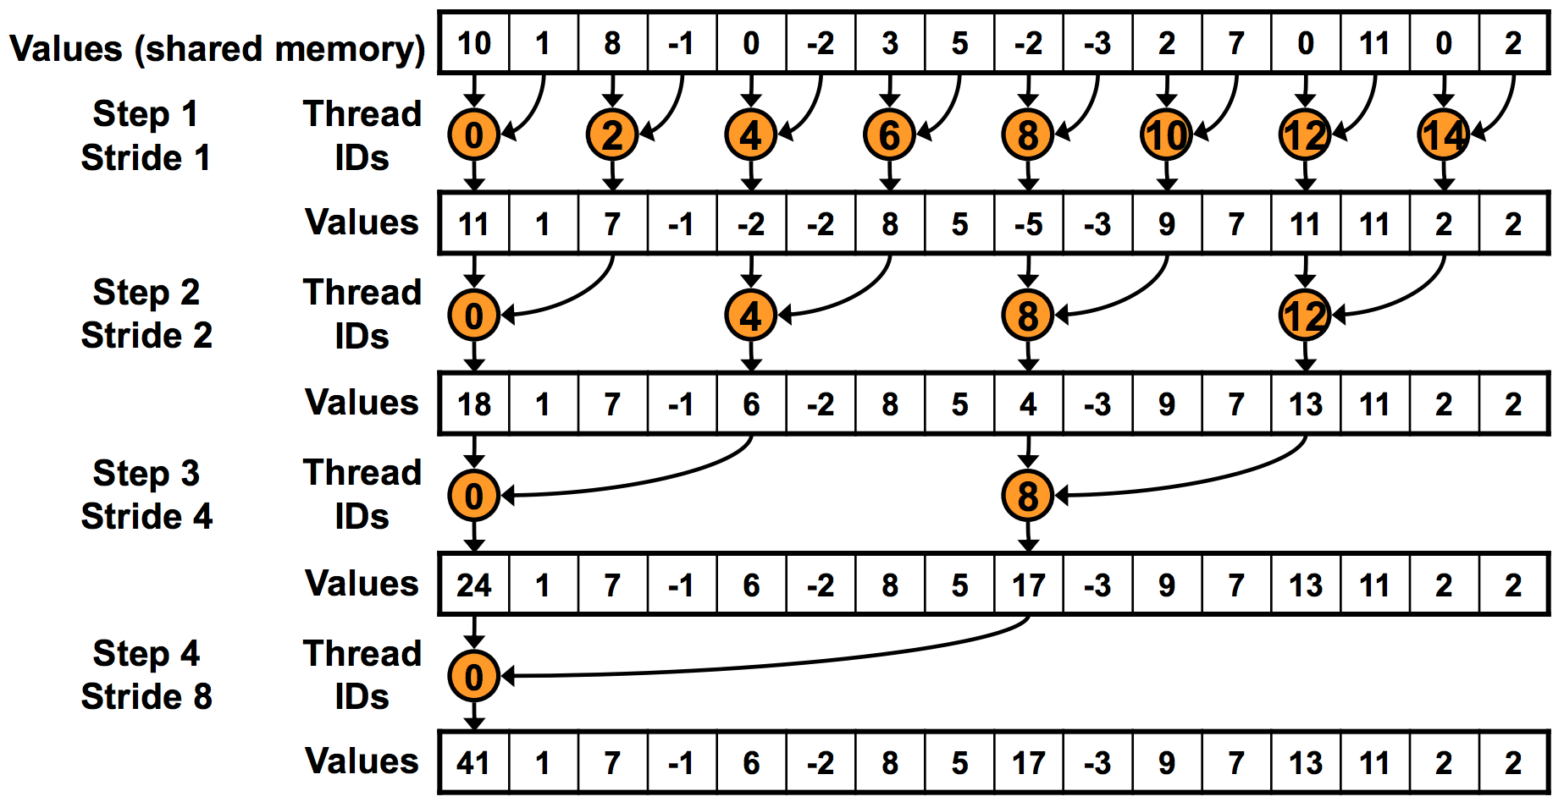
“Binary tree” reduction
One thread atomicAdd’s this to global result

Slide 18
“Binary tree” reduction
Use __syncthreads() before proceeding!

Slide 19
“Binary tree” reduction
Divergence!
Uses twice as many warps as necessary!

Slide 20
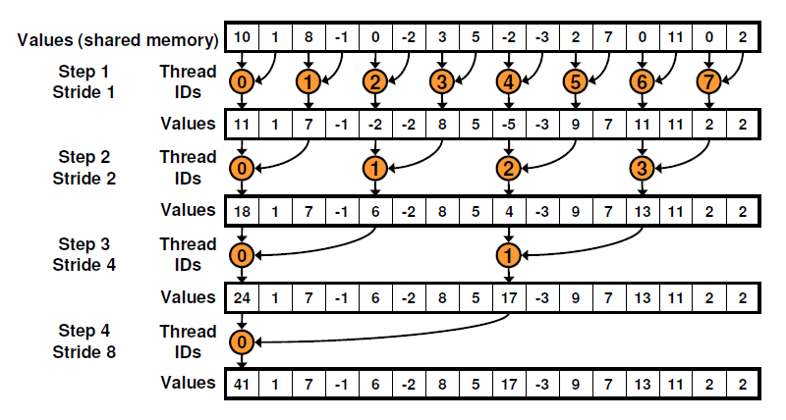
Non-divergent reduction

Slide 21
Non-divergent reduction
Bank conflicts!
1st iteration: 2-way,
2nd iteration: 4-way (!), …

Slide 22
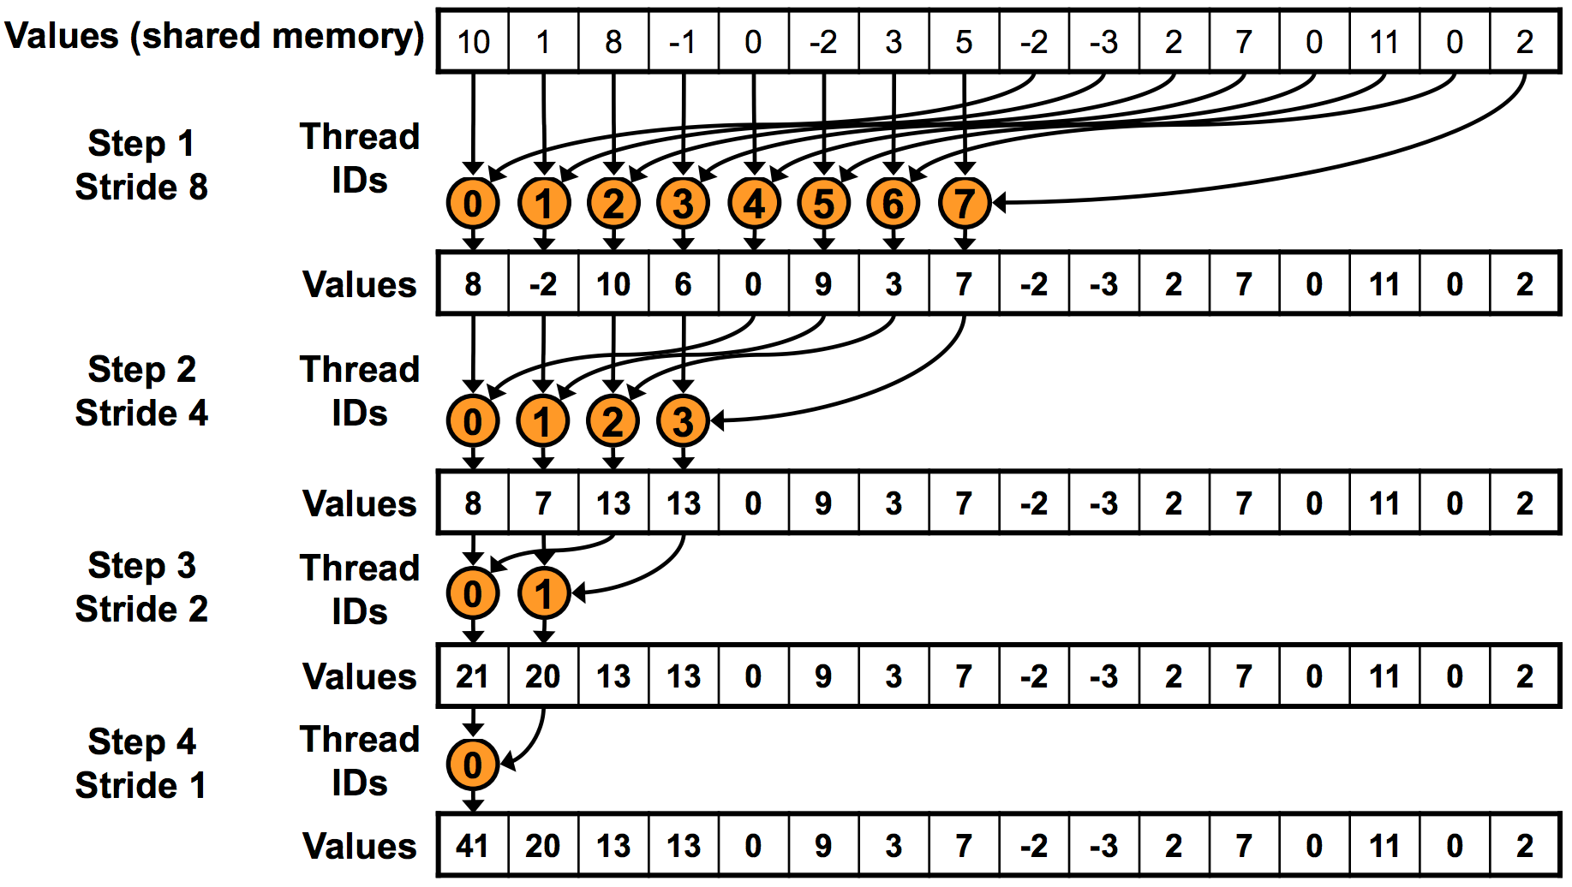
Sequential addressing

Slide 23
Reduction
More improvements possible
“Optimizing Parallel Reduction in CUDA” (Harris)
Code examples!
Moral:
Different type of GPU-accelerized problems
Some are “parallelizable” in a different sense
More hardware considerations in play

Slide 24
Outline
GPU-accelerated:
Reduction
Prefix sum
Stream compaction
Sorting (quicksort)

Slide 25
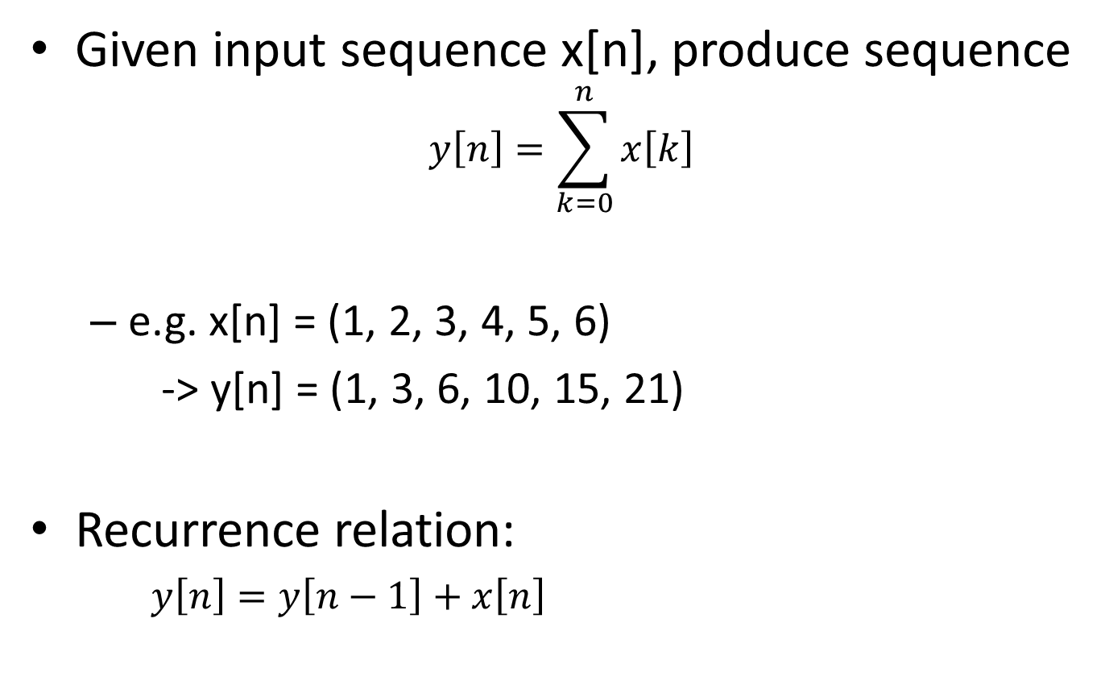
Prefix Sum
Given input sequence x[n], produce sequence
$$y\left[n\right]=\sum_{k=0}^{n}{x\left[k\right]}$$
e.g. x[n] = (1, 2, 3, 4, 5, 6)
-> y[n] = (1, 3, 6, 10, 15, 21)
Recurrence relation:
$y\left[n\right]=y\left[n−1\right]+x\left[n\right]$

Slide 26
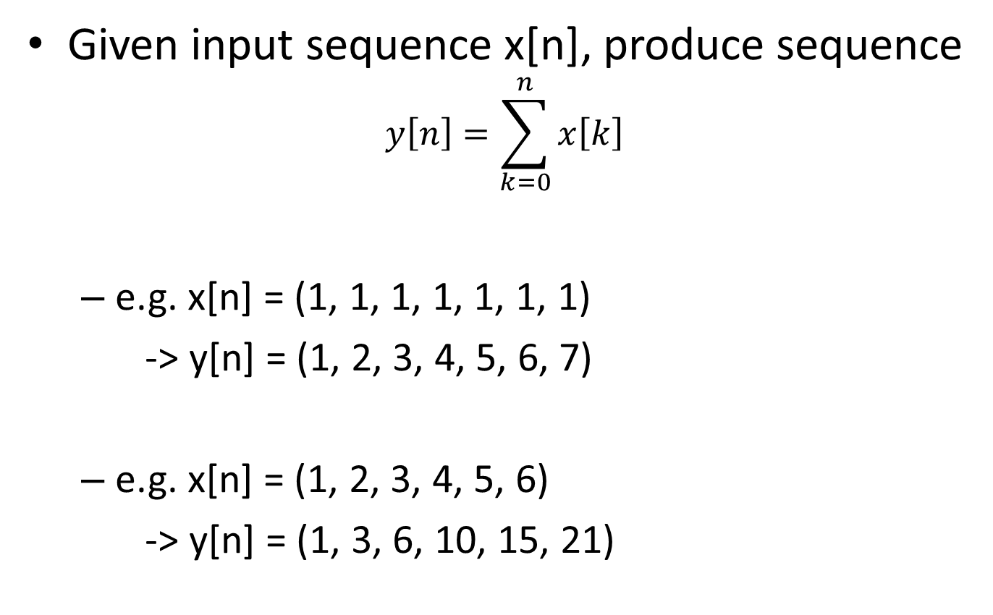
Prefix Sum
Given input sequence x[n], produce sequence
$$y\left[n\right]=\sum_{k=0}^{n}{x\left[k\right]}$$
e.g. x[n] = (1, 1, 1, 1, 1, 1, 1)
-> y[n] = (1, 2, 3, 4, 5, 6, 7)
e.g. x[n] = (1, 2, 3, 4, 5, 6)
-> y[n] = (1, 3, 6, 10, 15, 21)

Slide 27
Prefix Sum
Recurrence relation:
$y\left[n\right]=y\left[n−1\right]+x\left[n\right]$
Is it parallelizable? Is it GPU-accelerable?
Recall:
$y\left[n\right]=x\left[n\right]+x\left[n−1\right]+…+x[n−\left(K−1\right)]$
Easily parallelizable!
$y\left[n\right]=c∙x\left[n\right]+\left(1−c\right)∙y\left[n−1\right]$
Not so much

Slide 28
Prefix Sum
Recurrence relation:
$y\left[n\right]=y\left[n−1\right]+x\left[n\right]$
Is it parallelizable? Is it GPU-accelerable?
Goal:
Parallelize using a “reduction-like” strategy

Slide 29
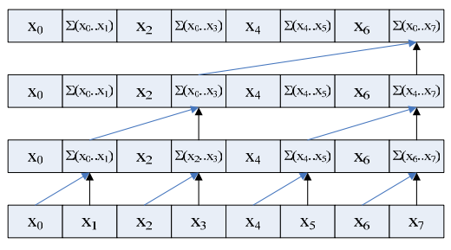
Prefix Sum sample code (up-sweep)
[1, 3, 3, 10, 5, 11, 7, 36]
[1, 3, 3, 10, 5, 11, 7, 26]
[1, 3, 3, 7, 5, 11, 7, 15]
[1, 2, 3, 4, 5, 6, 7, 8]
Original array
We want:
[0, 1, 3, 6, 10, 15, 21, 28]
(University of Michigan EECS, http://www.eecs.umich.edu/courses/eecs570/hw/parprefix.pdf

Slide 30
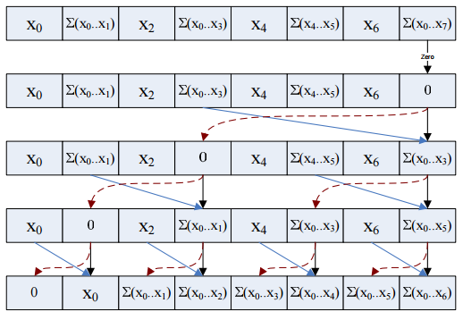
Prefix Sum sample code (down-sweep)
Original: [1, 2, 3, 4, 5, 6, 7, 8]
[1, 3, 3, 10, 5, 11, 7, 36]
[1, 3, 3, 10, 5, 11, 7, 0]
[1, 3, 3, 0, 5, 11, 7, 10]
[1, 0, 3, 3, 5, 10, 7, 21]
[0, 1, 3, 6, 10, 15, 21, 28]
Final result
(University of Michigan EECS, http://www.eecs.umich.edu/courses/eecs570/hw/parprefix.pdf

Slide 31
Prefix Sum (Up-Sweep)
Use __syncthreads() before proceeding!
Original array
(University of Michigan EECS, http://www.eecs.umich.edu/courses/eecs570/hw/parprefix.pdf

Slide 32
Prefix Sum (Down-Sweep)
Use __syncthreads() before proceeding!
Final result
(University of Michigan EECS, http://www.eecs.umich.edu/courses/eecs570/hw/parprefix.pdf

Slide 33
Prefix sum
Bank conflicts!
2-way, 4-way, …

Slide 34
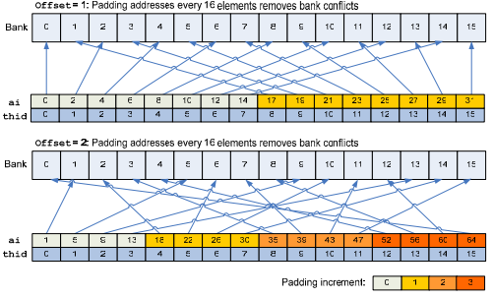
Prefix sum
Bank conflicts!
2-way, 4-way, …
Pad addresses!
(University of Michigan EECS, http://www.eecs.umich.edu/courses/eecs570/hw/parprefix.pdf

Slide 35
Why does the prefix sum matter?

Slide 36
Outline
GPU-accelerated:
Reduction
Prefix sum
Stream compaction
Sorting (quicksort)

Slide 37
Stream Compaction
Problem:
Given array A, produce subarray of A defined by boolean condition
e.g. given array:
Produce array of numbers > 3
2 | 5 | 1 | 4 | 6 | 3
5 | 4 | 6

Slide 38
Stream Compaction
Given array A:
GPU kernel 1: Evaluate boolean condition,
Array M: 1 if true, 0 if false
GPU kernel 2: Cumulative sum of M (denote S)
GPU kernel 3: At each index,
if M[idx] is 1, store A[idx] in output at position (S[idx] - 1)
2 | 5 | 1 | 4 | 6 | 3
0 | 1 | 0 | 1 | 1 | 0
0 | 1 | 1 | 2 | 3 | 3
5 | 4 | 6

Slide 39
Outline
GPU-accelerated:
Reduction
Prefix sum
Stream compaction
Sorting (quicksort)

Slide 40
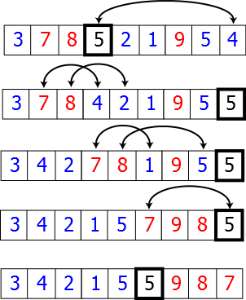
GPU-accelerated quicksort
Quicksort:
Divide-and-conquer algorithm
Partition array along chosen pivot point
Pseudocode:
quicksort(A, lo, hi):
if lo < hi:
p := partition(A, lo, hi)
quicksort(A, lo, p - 1)
quicksort(A, p + 1, hi)
Sequential version

Slide 41
GPU-accelerated partition
Given array A:
Choose pivot (e.g. 3)
Stream compact on condition: ≤ 3
Store pivot
Stream compact on condition: > 3 (store with offset)
2 | 5 | 1 | 4 | 6 | 3
2 | 1
2 | 1 | 3
2 | 1 | 3 | 5 | 4 | 6

Slide 42
GPU acceleration details
Continued partitioning/synchronization on sub-arrays results in sorted array

Slide 43
Final Thoughts
“Less obviously parallelizable” problems
Hardware matters! (synchronization, bank conflicts, …)
Resources:
GPU Gems, Vol. 3, Ch. 39

