Slide 1
CS 179 Lecture 4
GPU Compute Architecture

Slide 2
This is my first lecture ever
Tell me if I’m not speaking loud enough, going too fast/slow, etc.
Also feel free to give me lecture feedback over email or at office hours.
Notes:
I’ve put almost no code examples/function signatures in these lectures so I can focus on concepts.
I trust that students can Google “how to limit CUDA register usage” so I don’t need to put a syntax example in my slides.
My goal is to get you to the point where you realize you need to limit register usage (or do whatever).
If after this set, people think they would learn better with more code snippets in my slides, I’m open to that change.

Slide 3
Today
kernel<<<gridSize, blockSize>>>(arg1, arg2);
What does this actually do?
How does the GPU execute this?
Reference: CUDA Handbook, Ch 7-8
Notes:
Its impossible to take full advantage of GPU hardware if you don’t know about the hardware.
Start at the top (high-level of hardware), go down (to smaller hardware components), and then come back up today.

Slide 4
Compilation, runtime, drivers, etc
Interesting…
but much less useful than architecture
Maybe we’ll cover these later in term!
Notes:
Creating binaries from CUDA kernels and transferring these binaries to the GPU is interesting, but less applicable than hardware knowledge.
Useful for debugging.

Slide 5
Streaming Multiprocessors
a streaming multiprocessor (SM) ≈ a CPU
SMs have:
registers (1000’s!)
caches
warp schedulers
execution cores
GPUs have 1-20 SMs
Notes:
Ask if people have taken CS 24, know what a register/cache is. If not, given super fast explanation.
More on warp schedulers later. They choose which ready-to-execute work gets to execute on a given clock.
Execution cores perform integer and floating point instructions.
Most GPUs used for CUDA are top-end GPUs and have 10-15 SMs

Slide 6
Nvidia Architecture Names
Family names:
Tesla (2006) → Fermi (2010) → Kepler (2012) → Maxwell (2014)
Engineering names:
GT218 → GF110 → GK104 → GM206
Compute capabilities (CC):
1.x → 2.x → 3.x → 5.x
GPU → CC table here
Notes:
named after scientists, Pascal and Volta next
GPGPU relatively new, a lot of changes between architectures (different number of cores, caches, etc)
Also different from programming perspective (new instructions, double support)
Haro & Mako are Fermi, Minuteman & MX are Kepler
When I say anything about hardware, I’m talking about Fermi and later. I’ll try to distinguish between Fermi and Kepler.
I know Kepler the best and will talk about it the most. We don’t have access to any Maxwell GPUs anyway.

Slide 7
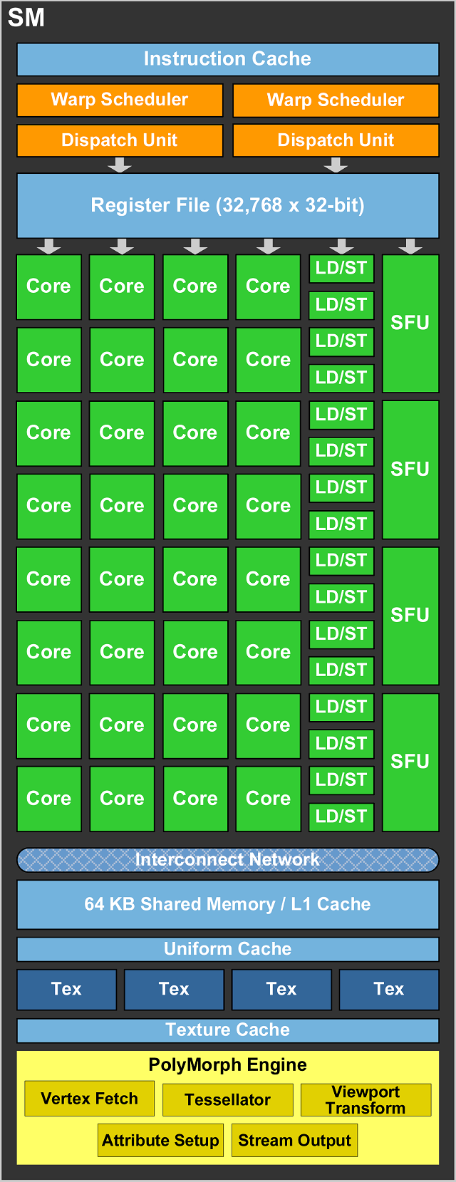
GF110 SM
Notes:
much more complicated now
SFU = Special Function Units, amazing for transcendentals (exp, sin)
GPUs have much better support of 32 bit applications rather than 64, so use floats (instead of doubles) when you can and 32 bit ints rather than 64 bit.
Floats are often faster than doubles because they are smaller (cuts IO in half)
Multiple instructions to do 64 bit integer math. Pointers on GPUs are 64 bits (on 64 bit OS)
I’ve been bitten before by doing a bunch of math to compute an array index (which is eventually added to a pointer) and compiler decides to offset math in 64 bits (divides were horrible)
half precision floating point exists for storage but not math. would be interested to see if someone get better math performance by storing half precision.

Slide 8
Warps
warp = group of threads that always execute same instructions simultaneously
Single instruction multiple thread (SIMT) programming model, similar to SIMD (D=data)
Warp size has always been 32 threads.
Notes:
SIMD on CPUs includes SSE (128 bits = 4 floats), AVX (256 bits = 8 floats), AVX 512 (16 floats).
Nvidia does 1024 bits = 32 floats.
warps are a more natural primitive to think about than threads (because warps can act independently, threads don’t)

Slide 9
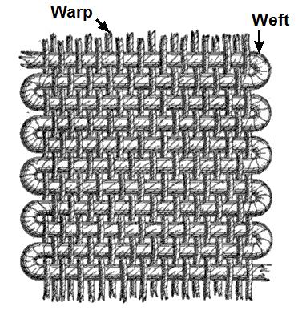
Why warps?
Warps require less hardware than having each thread act independently
OpenCL equivalent is cooperative thread array (CTA)
Notes:
warps make chips smaller, cheaper, possible.

Slide 10
Warp Divergence
int idx = threadIdx.x + blockSize.x * (threadIdx.y + blockSize.y * threadidx.z);
bool branch = (idx % 32 < 16);
if (branch) {
foo();
} else {
bar();
}
Different branches taken within a warp.
How can GPU handle this?
Notes:
I said warps must execute identical instructions. How could this be handled?
For thread ids (and thus warp membership), x has the smallest stride, followed by y (stride blockSize.x), followed by z (stride blockSize.x * blockSize.y).

Slide 11
Warp Divergence
int idx = threadIdx.x + blockSize.x * (threadIdx.y + blockSize.y * threadidx.z);
bool branch = (idx % 32 < 16);
if (branch) {
foo();
} else {
bar();
}
First the 16 threads with branch == 1 execute foo() while other 16 threads do nothing

Slide 12
Warp Divergence
int idx = threadIdx.x + blockSize.x * (threadIdx.y + blockSize.y * threadidx.z);
bool branch = (idx % 32 < 16);
if (branch) {
foo();
} else {
bar();
}
Then the other 16 threads execute bar() while the first 16 threads do nothing
Notes:
Takes twice as long to compute (assuming foo and bar take same amount of time)

Slide 13
Warp Divergence
This clearly isn’t good parallelism!
This phenomena is called “divergence”, and we want to avoid it!
Example was 2-way divergence, could have up to 32-way divergence :(
Notes:
What we just saw was 2 way divergence.
2 way divergence also happens if 31 threads in a warp take 1 code path and 1 takes another.
How is 32 way divergence possible? Why not greater than 32 way divergence?

Slide 14
A key idea of GPU programming
Have threads in the same warp do very similar work!
Limits divergence, helps with memory coalescing and avoiding shared memory bank conflicts (more on that next time)
Notes:
I’ll mention shared memory a few more times in this lecture. shared memory is user programmable cache on SM.

Slide 15
Latency & Throughput
CPU = low latency, low throughput
GPU = high latency, high throughput
CPU clock = 3 GHz (3 clocks/ns)
GPU clock = 1 GHz (1 clock/ns)
Notes:
We’ve worked our way down to the bottom, this is the most fundamental idea in the lecture.
latency = how long it takes to accomplish 1 thing
throughput = rate at which you can accomplish infinite things

Slide 16
Instruction & Memory Latency
CPU main memory latency: ~100ns ↗
GPU main memory latency: ~300ns ↗
CPU arithmetic instruction latency: ~1ns ↗
GPU arithmetic instruction latency: ~10ns ↗
GPU numbers are for Kepler; Fermi is ~2x this
Notes:
The CPU instruction latency link is super useful, agn

Slide 17
Hide the latency!
Another key to GPU programming is hiding latency.
While one warp waits on IO or an arithmetic instruction to finish executing, have another warp start executing an instruction!
More warps ⇒ hide more latency
Notes:
eventually instructions are completing on every clock, latency only matters at beginning and we achieve good throughput

Slide 18
Chairlifts hide latency!
Notes:
A chair is always arriving at the top of the lift. This is optimal in some sense.
Now we are at bottom of stack and can start working back up.

Slide 19
SM’s execute warps
Warps execute on a single SM.
SM’s warp schedulers find a warp that is ready to execute and issues it instructions.
ready to execute ⇔ next instruction doesn’t depend on currently executing instructions.
Notes:
everything depends on writes (or at least other writes do)
instruction dependencies are tricky, multiple adds to same accumulator depend on each other
warp schedulers find execution units to actually perform instructions

Slide 20
Instruction Dependencies
acc += x0;
acc += x1;
acc += x2;
acc += x3;
...
All instructions write to same register…
Next instruction can’t begin executing until previous finishes
Notes:
Instruction dependencies are important to think about for high performance computing on x86, Nvidia architectures.
This is just an unrolled for loop.

Slide 21
Instruction Dependencies
acc0 += x0;
acc1 += x1;
acc0 += x2;
acc1 += x3;
…
acc = acc0 + acc1;
Adds to acc0 and acc1 are independent and can run in parallel!
This is called instruction level parallelism (ILP)
Notes:
adds to acc0 are completely independent from adds to acc1.
If you were going to actually write this, it would be a for loop that processes two elements at a time.
Note this is uglier than the simple approach. How do you process list if there’s an odd number of elements?
General theme: When you write high performance code, you get closer and closer to writing assembly (because you have assembly in mind).
Code gets uglier and harder to maintain. Performance and maintainability is a trade-off, don’t prematurely optimize!

Slide 22
Adding coordinates (naive)
z0 = x[0] + y[0];
z1 = x[1] + y[1];
x0 = x[0];
y0 = y[0];
z0 = x0 + y0;
x1 = x[1];
y1 = y[1];
z1 = x1 + y1;
COMPILATION
How is this “assembly” sub-optimal?
Notes:
The x0 = x[0] lines indicate loading from memory into register, about 300 clocks.
Which instructions can overlap? Can we do better at overlapping instructions to hide latency?
HPC involves a lot of worrying about if the compiler is doing what you want.

Slide 23
Adding coordinates (ILP)
z0 = x[0] + y[0];
z1 = x[1] + y[1];
x0 = x[0];
y0 = y[0];
x1 = x[1];
y1 = y[1];
z0 = x0 + y0;
z1 = x1 + y1;
BETTER COMPILATION
Instruction ordering impacts performance
Notes:
Note there is exactly the same set of compiled instructions, just a different ordering. cuts time roughly in half.
For exactly the “source” code written, I expect a decent compiler to do something more like this.
What if we were doing generalized vector add instead of just coordinate (2 component) addition?
Not sure if I trust compiler to unroll loop, reorder unrolled instructions, and then use vectorized instructions.
Realistically, the compiler probably will, but that’s something to be worrying about.
There’s a link on the resource section of the website about “how to write code compiler can actually optimize”
For a GPU matrix multiplication paper, researchers actually wrote their own scripts to find the optimal instruction ordering.

Slide 24
Warp Schedulers
Warp schedulers find a warp that is ready to execute its next instruction and available execution cores and then start execution.
GK110: 4 warp schedulers, 2 dispatchers each.
Starts instructions in up to 4 warps each clock,
and starts up to 2 instructions in each warp.
Notes:
Each scheduler has 2 dispatchers.
Can start 2 instructions at once only if there are no instruction dependencies.
Note that it now takes up to 80 warp instructions to hide latency of warp add (10 cycles) rather than just 10 warp instructions.
GK110 has 15 SMs, so on a single clock up to 15 * 8 = 120 warp instructions initiated => 120 * 32 = 3840 scalar instructions.

Slide 25
Grid, blocks?
Grid has nothing to do with execution.
Each block executes on a single SM (but a SM can execute multiple blocks concurrently)
Shape of threads in block has nothing to do with execution.
Notes:
Grid is just for convenience. From an execution standpoint, might just have a single grid cell that contains all the blocks.
Same for block shape.
Implications of single SM per block: shared cache, want block size to be a multiple of 32 (ask the class)

Slide 26
GK110 (Kepler) numbers
max threads / SM = 2048 (64 warps)
max threads / block = 1024 (32 warps)
32 bit registers / SM = 64k
max shared memory / SM = 48KB
The number of blocks that run concurrently on a SM depends on the resource requirements of the block!
Notes:
ask what max threads / SM and max threads / block mean about how many blocks we need to achieve full occupancy

Slide 27
Occupancy
occupancy = warps per SM / max warps per SM
max warps / SM depends only on GPU
warps / SM depends on warps / block, registers / block, shared memory / block.
Notes:
We fit some integer number of blocks onto each SM.
threads/block matters because (combined with the number of blocks) let’s us know how many warps there are on the SM.
So what determines how many blocks are put on the SM?
register usage / block. You can specify __launch_bounds__ to limit register usage. Can easily get register usage numbers by setting a flag in nvcc.
shmem / block.
Could also consider “register occupancy” or “shared memory occupancy”, but I’ve never heard of anyone doing this.

Slide 28
GK110 Occupancy picture
100% occupancy
2 blocks of 1024 threads
32 registers/thread
24KB of shared memory / block
50% occupancy
1 block of 1024 threads
64 registers/thread
48KB of shared memory / block
Notes:
Higher occupancy is generally better, but certainly not always. Why might lower occupancy be better?
Lower occupancy allows hiding less latency, but there is also (hopefully) less latency to hide because each thread has more resources.
Share that for my GPU matrix multiplication implementation I found 25% occupancy works best (because 128 registers/thread)

Slide 29
Next time
We’ve looked at compute architecture…
Memory IO also has a huge effect on performance
Learn about memory systems on Wednesday

