Slide 1
CS 179: GPU Computing
Lecture 3 / Homework 1
Notes:
Intro
Happy Friday everyone.
If the first day was motivation for GPU computing and parallelizable problems, today is… demotivation.
It’s not because I’m making the homework hard or anything.
(I mentioned that the GPU can help us solve tons of problems – parallelizable problems.)

Slide 2
Recap
Adding two arrays… a close look
Memory:
Separate memory space, cudaMalloc(), cudaMemcpy(), …
Processing:
Groups of threads (grid, blocks, warps)
Optimal parameter choice (#blocks, #threads/block)
Kernel practices:
Robust handling of workload (beyond 1 thread/index)

Slide 3
Parallelization
What are parallelizable problems?

Slide 4
Parallelization
What are parallelizable problems?
e.g.
Simple shading:
for all pixels (i,j):
replace previous color with new color according to rules
Adding two arrays:
for (int i = 0; i < N; i++)
C[i] = A[i] + B[i];

Slide 5
Parallelization
What aren’t parallelizable problems?
Subtle differences!

Slide 6
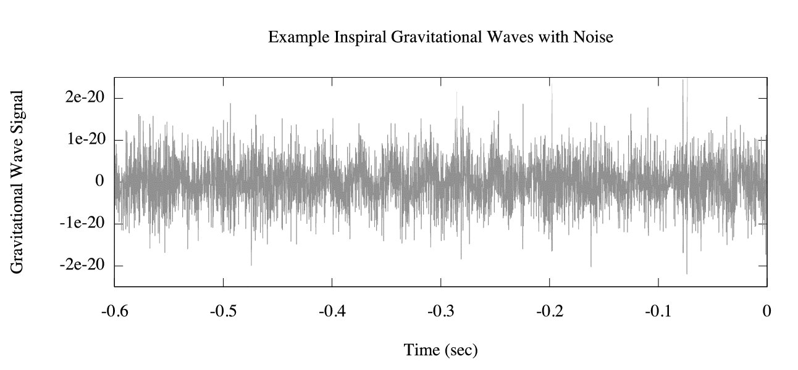
Moving Averages
http://www.ligo.org

Slide 7
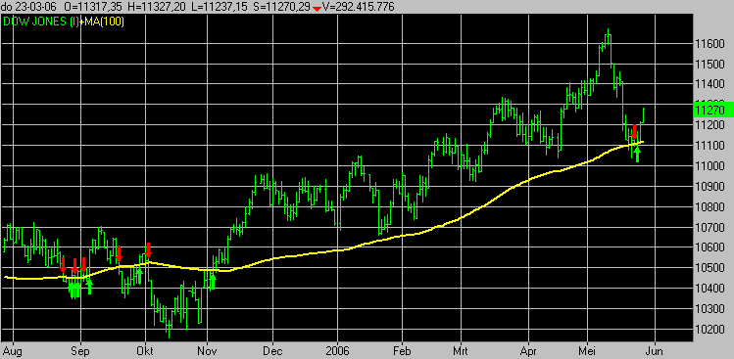
Moving Averages

Slide 8
Simple Moving Average
x[n]: input (the raw signal)
y[n]: simple moving average of x[n]
Each point in y[n] is the average of the last K points!

Slide 9
Simple Moving Average
x[n]: input (the raw signal)
y[n]: simple moving average of x[n]
Each point in y[n] is the average of the last K points!
For all n ≥ K:
$y\left[n\right]=x\left[n\right]+x\left[n−1\right]+…+x[n−\left(K−1\right)]$

Slide 10
Exponential Moving Average
Each point in y[n] follows the relation:
$$y\left[0\right]=x[0]$$
$y\left[n\right]=c∙x\left[n\right]+\left(1−c\right)∙y\left[n−1\right], 0≤c≤1$
“Exponential” – can expand recurrence relation:
$y\left[n\right]=c∙\left( x\left[n\right]+\left(1−c\right)∙x\left[n−1\right]+{\left(1−c\right)}^{2}x\left[n−2\right]+…+{\left(1−c\right)}^{n−1}x\left[1\right] \right)$
$+{\left(1−c\right)}^{n}x\left[0\right]$
Each point in x[n] has an (exponentially) decaying influence!

Slide 12
Comparison
Simple moving average:
$y\left[n\right]=x\left[n\right]+x\left[n−1\right]+…+x[n−\left(K−1\right)]$
Easily parallelizable?
Exponential moving average:
$y\left[n\right]=c∙x\left[n\right]+\left(1−c\right)∙y\left[n−1\right]$
Easily parallelizable?

Slide 13
Comparison
Simple moving average:
$y\left[n\right]=x\left[n\right]+x\left[n−1\right]+…+x[n−\left(K−1\right)]$
Easily parallelizable? Yes
Exponential moving average:
$y\left[n\right]=c∙x\left[n\right]+\left(1−c\right)∙y\left[n−1\right]$
Easily parallelizable? Not so much

Slide 14
Comparison
Simple moving average:
$y\left[n\right]=x\left[n\right]+x\left[n−1\right]+…+x[n−\left(K−1\right)]$
Easily parallelizable? Yes
Exponential moving average:
$y\left[n\right]=c∙x\left[n\right]+\left(1−c\right)∙y\left[n−1\right]$
Easily parallelizable? Not so much
Calculation for y[n] depends on calculation for y[n-1] !

Slide 15
Comparison
SMA pseudocode:
for i = 0 through N-1
y[n] <- x[n] + ... + x[n-(K-1)]
EMA pseudocode:
for i = 0 through N-1
y[n] <- c*x[n] + (1-c)*y[n-1]
Loop iteration i depends on iteration i-1 !
Far less parallelizable!

Slide 16
Comparison
SMA pseudocode:
for i = 0 through N-1
y[n] <- x[n] + ... + x[n-(K-1)]
Better GPU-acceleration
EMA pseudocode:
for i = 0 through N-1
y[n] <- c*x[n] + (1-c)*y[n-1]
Loop iteration i depends on iteration i-1 !
Far less parallelizable!
Worse GPU-acceleration

Slide 17
Morals
Not all problems are parallelizable!
Even similar-looking problems
Recall: Parallel algorithms have potential in GPU computing

Slide 18
Small-kernel convolution
Homework 1 (coding portion)

Slide 19
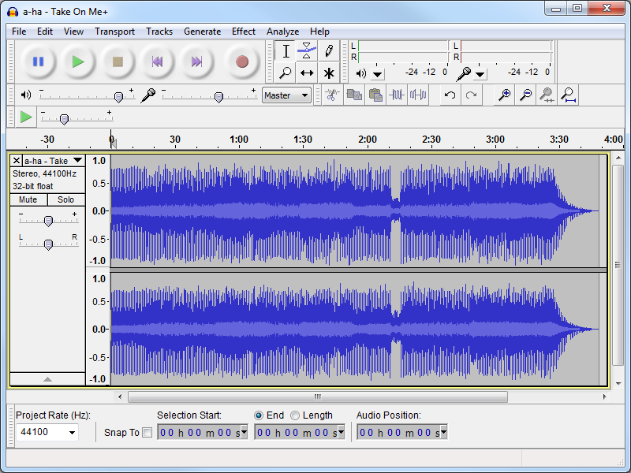
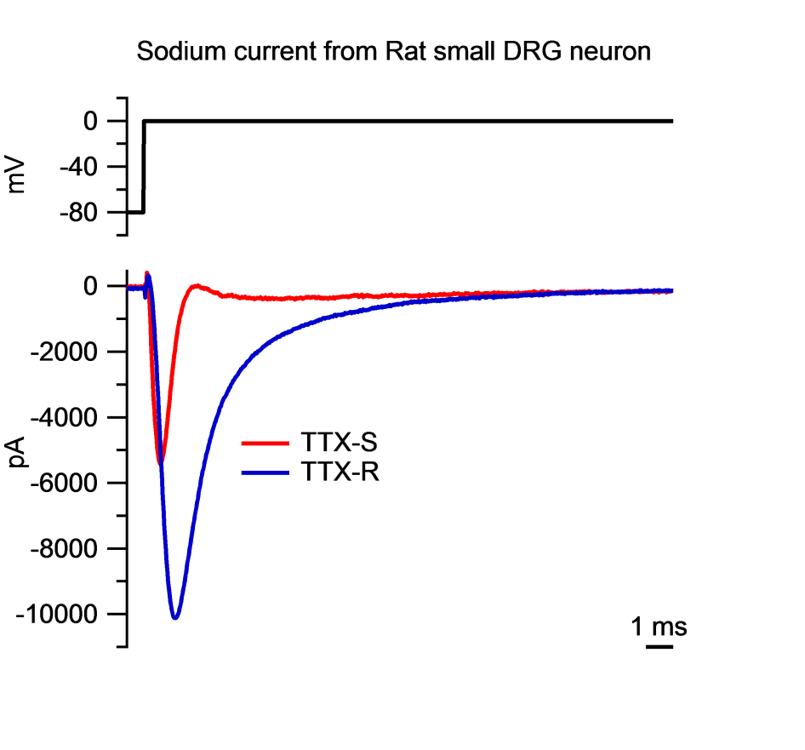
Signals

Slide 20
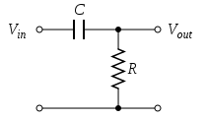
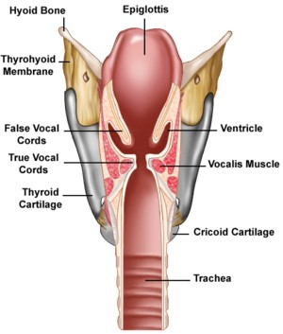
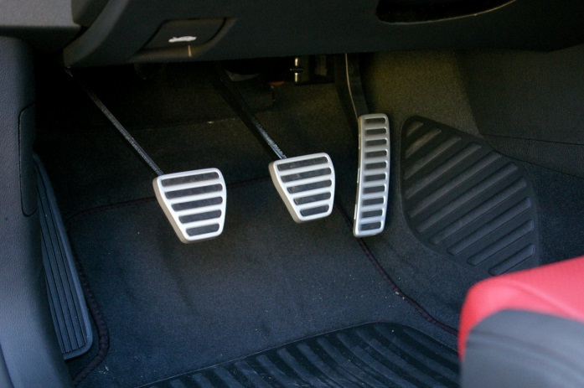
Systems
Given input signal(s), produce output signal(s)

Slide 21
Discretization
Discrete samplings
of continuous signals
Continuous audio signal -> WAV file
Voltage -> Voltage every T milliseconds
(Will focus on discrete-time signals here)

Slide 22
Linear systems
If system has:
$$x_{1}\left[n\right]→y_{1}\left[n\right]$$
$$x_{2}\left[n\right]→y_{2}\left[n\right]$$
Then (for constants a, b):
$$ax_{1}\left[n\right]+{bx}_{2}\left[n\right]→{ay_{1}\left[n\right]+by}_{2}\left[n\right]$$

Slide 23
Linear systems
Consider a tiny piece of the signal

Slide 24
Linear systems
Consider a tiny piece of the signal…
Delta function:
$$δ\left[n−k\right]=\left\{\begin{aligned}1, n=k \\ 0, n≠k\end{aligned}\right.$$
“Signal at a point” k:
$$x\left[k\right]δ\left[n−k\right]$$

Slide 25
Linear systems
If we know that:
$$δ\left[n−k\right]→h_{k}\left[n\right]$$
Then, by linearity:
$$x\left[k\right]δ\left[n−k\right]→x[k]h_{k}\left[n\right]$$
Response at time k defined by response to delta function!

Slide 26
Time-invariance
If:
$$x\left[n\right]→y\left[n\right]$$
Then (for integer m):
$$x\left[n+m\right]→y\left[n+m\right]$$

Slide 27
Time-invariance
If system has:
$$δ\left[n−k\right]→h_{k}\left[n\right]$$
$$δ\left[n−l\right]→h_{l}\left[n\right]$$
Then $h_{k}\left[n\right]$ and $h_{l}\left[n\right]$ are time-shifted versions of each other!

Slide 28
Time-invariance and linearity
Define $h\left[n\right]$ as the impulse response to delta function:
$$δ\left[n\right]→h\left[n\right]$$
Then:
$$δ\left[n−k\right]→h\left[n−k\right]$$
And by linearity:
$$x[k]δ\left[n−k\right]→x[k]h\left[n−k\right]$$

Slide 29
Time-invariance and linearity
Can write our original signal as:
$$x\left[n\right]=\sum_{k=−∞}^{∞}{x\left[k\right]δ[n−k]}$$
Then, since (last slide):
$$x[k]δ\left[n−k\right]→x[k]h\left[n−k\right]$$
By linearity:
$$y\left[n\right]=\sum_{k=−∞}^{∞}{x\left[k\right]h[n−k]}$$

Slide 30
Morals
“Linear time-invariant” (LTI) systems
Lots of them!
Can be characterized entirely by $h\left[n\right]$
Output given from input by:
$$y\left[n\right]=\sum_{k=−∞}^{∞}{x\left[k\right]h[n−k]}$$

Slide 31
Convolution example
Suppose we have input $x\left[0..99\right]$, system given by $h\left[0..3\right]$
Example output value:
$$y\left[50\right]=x\left[47\right]h\left[3\right]+x\left[48\right]h\left[2\right]+x\left[49\right]h\left[1\right]+x\left[50\right]h[0]$$

Slide 32
Computability
$$y\left[n\right]=\sum_{k=−∞}^{∞}{x\left[k\right]h[n−k]}$$
For finite-duration $h\left[n\right]$, sum is computable with this formula
Computed for finite $x[n]$, e.g. audio file
Sum is parallelizable!
Sequential pseudocode (ignoring boundary conditions):
(set all y[i] to 0)
For (i from 0 through x.length - 1)
for (j from 0 through h.length – 1)
y[i] += (appropriate terms from x and h)

Slide 33
This assignment
Accelerate this computation!
Fill in TODOs on assignment 1
Kernel implementation
Memory operations
We give the skeleton:
CPU implementation (a good reference!)
Output error checks
h[n] (default is Gaussian impulse response)
…

Slide 34
The code
Framework code has two modes:
Normal mode (AUDIO_ON zero)
Generates random x[n]
Can run performance measurements on different sizes of x[n]
Can run multiple repeated trials (adjust channels parmeter)
Audio mode (AUDIO_ON nonzero)
Reads input WAV file as x[n]
Outputs y[n] to WAV
Gaussian is an imperfect low-pass filter – high frequencies attenuated!

Slide 35
Demonstration

Slide 36
Debugging tips
Printf
Beware – you have many threads!
Set small number of threads to print
Store intermediate results in global memory
Can copy back to host for inspection
Check error returns!
gpuErrchk macro included – wrap around function calls

Slide 37
Debugging tips
Use small convolution test case
E.g. 5-element x[n], 3-element h[n]

Slide 38
Compatibility
Our machines:
haru.caltech.edu
(We’ll try to get more up as the assignment progresses)
CMS machines:
Only normal mode works
(Fine for this assignment)
Your own system:
Dependencies: libsndfile (audio mode)

Slide 39
Administrivia
Due date:
Wednesday, 3 PM (correction)
Office hours (ANB 104):
Kevin/Andrew: Monday, 9-11 PM
Eric: Tuesday, 7-9 PM

