Slide 1
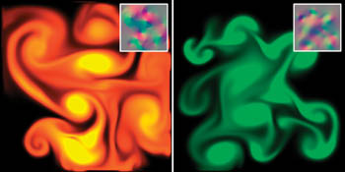
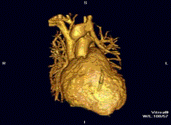
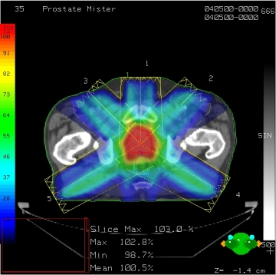
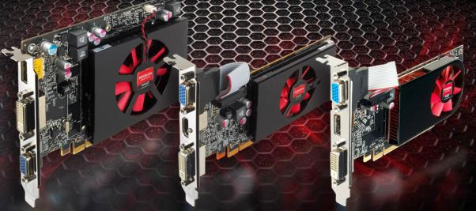
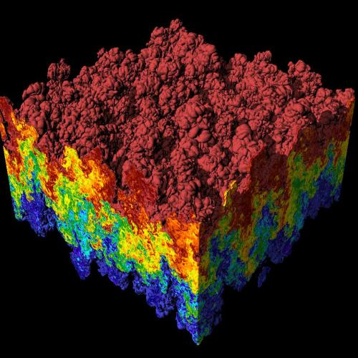
CS 179: GPU Programming
Lecture 1: Introduction
Images: http://en.wikipedia.org
http://www.pcper.com
http://northdallasradiationoncology.com/
GPU Gems (Nvidia)

Slide 2
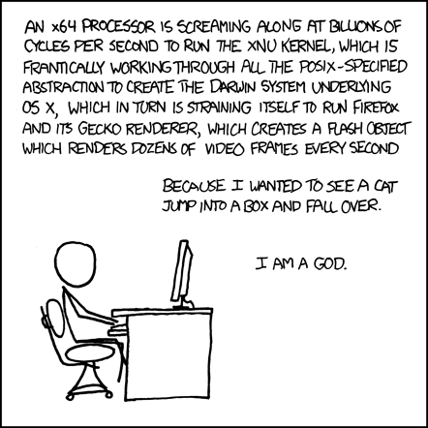
The Problem
Are our computers fast enough?
Source: XKCD Comics (http://xkcd.com/676/)

Slide 3
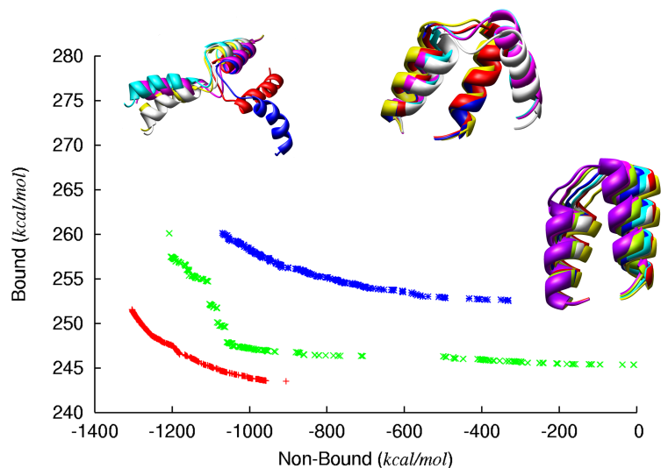
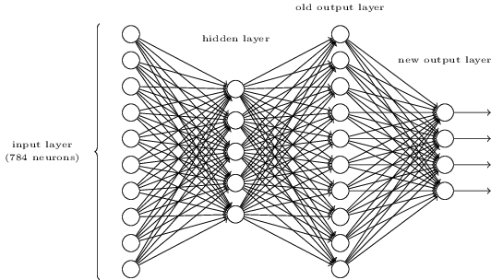
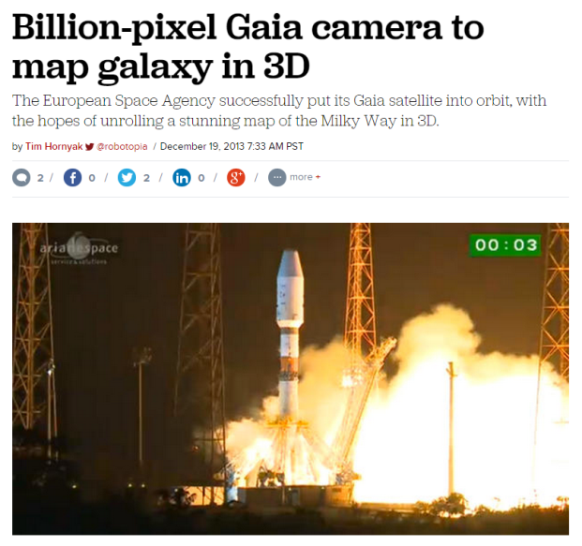
The Problem
Are our computers really fast enough?
http://lauraskelton.github.io/images/posts/5deepnetworklayer.png
http://www.dmi.unict.it/nicosia/research/proteinFolding3.png
http://www.cnet.com/

Slide 4
The Problem
What does it mean to “solve” a computational problem?

Slide 5
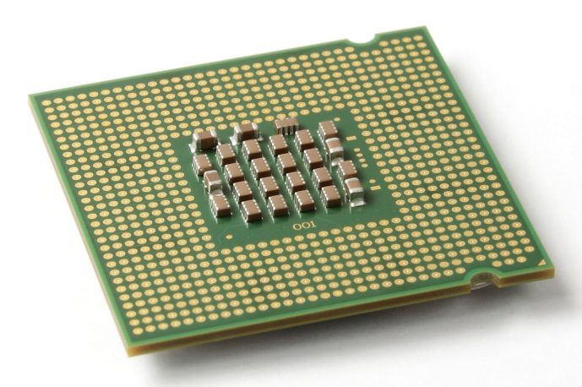
The CPU
The “central processing unit”
Traditionally, applications use CPU for primary calculations
Powerful, general-purpose capabilities
R+D -> Moore’s Law!
Established technology
Wikimedia commons: Intel_CPU_Pentium_4_640_Prescott_bottom.jpg

Slide 6
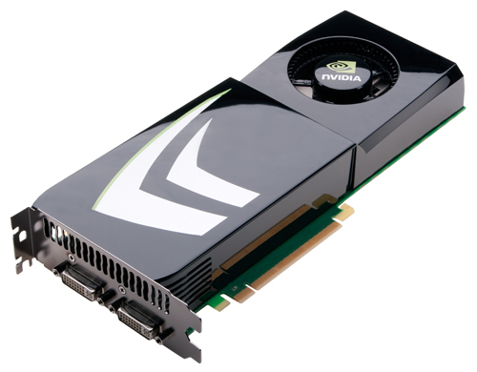
The GPU
Designed for our “graphics”
For “graphics problems”, much faster than the CPU!
What about other problems?

Slide 7
This course in 30 seconds
For certain problems, use
instead of
Images: http://www.nvidia.com,
Wikimedia commons: Intel_CPU_Pentium_4_640_Prescott_bottom.jpg

Slide 8
This course in 60 seconds
GPU: Hundreds of cores!
vs. 2,4,8 cores on CPU
Good for highly parallelizable problems:
Increasing speed by 10x, 100x+

Slide 9
Questions
What is a GPU?
What is a parallelizable problem?
What does GPU-accelerated code look like?
Who cares?

Slide 10
Outline
Motivations
Brief history
“A simple problem”
“A simple solution”
Administrivia

Slide 11
GPUs – The Motivation
Screens!
1e5 – 1e7 pixels
Refresh rate: ~60 Hz
Total: ~1e7-1e9 pixels/sec !
(Very approximate – orders of magnitude)

Slide 12
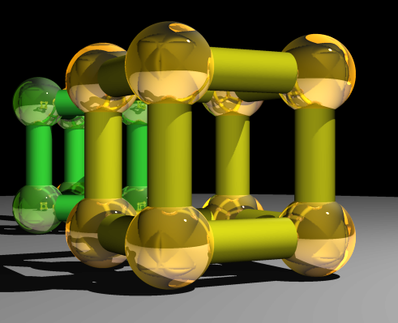
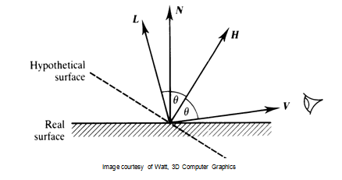
GPUs – The Motivation
Lots of calculations are
“the same”!
e.g. Raytracing:
Goal: Trace light rays, calculate object interaction to produce realistic image
f
Superquadric Cylinders, exponent 0.1, yellow glass balls, Barr, 1981
Watt, 3D Computer Graphics (from http://courses.cms.caltech.edu/cs171/)

Slide 13
GPUs – The Motivation
Lots of calculations are
“the same”!
e.g. Raytracing:
for all pixels (i,j):
Calculate ray point and direction in 3d space
if ray intersects object:
calculate lighting at closest object
store color of (i,j)
Superquadric Cylinders, exponent 0.1, yellow glass balls, Barr, 1981

Slide 14
GPUs – The Motivation
Lots of calculations are
“the same”!
e.g. Simple shading:
for all pixels (i,j):
replace previous color with new color according to rules
"Example of a Shader" by TheReplay - Taken/shaded with YouFX webcam software, composited next to each other in Photoshop. Licensed under CC BY-SA 3.0 via Wikipedia - http://en.wikipedia.org/wiki/File:Example_of_a_Shader.png#/media/File:Example_of_a_Shader.png

Slide 15
GPUs – The Motivation
Lots of calculations are
“the same”!
e.g. Transformations (camera, perspective, …):
for all vertices (x,y,z) in scene:
Obtain new vertex (x’,y’,z’) = T(x,y,z)
h

Slide 16
Outline
Motivations
Brief history
“A simple problem”
“A simple solution”
This course

Slide 17
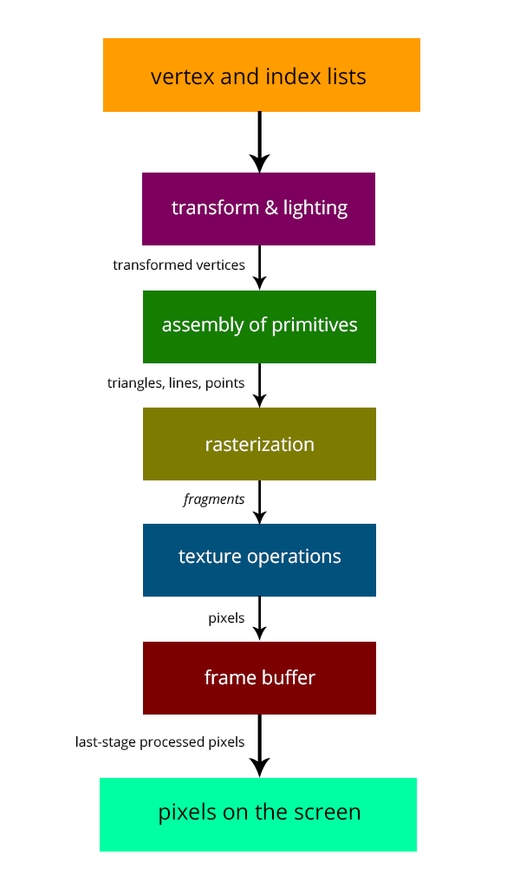
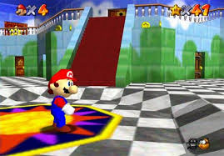
GPUs – Brief History
Fixed-function pipelines
Pre-set functions, limited
options
http://gamedevelopment.tutsplus.com/articles/the-end-of-fixed-function-rendering-pipelines-and-how-to-move-on--cms-21469
Source: Super Mario 64, by Nintendo

Slide 18
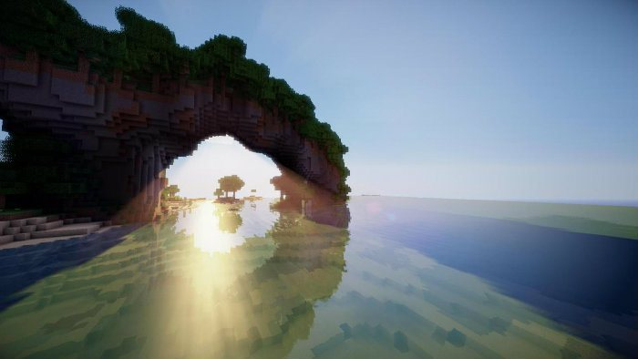
GPUs – Brief History
Shaders
Could implement one’s own functions!
GLSL (C-like language)
Could “sneak in” general-purpose programming!
http://minecraftsix.com/glsl-shaders-mod/

Slide 19
GPUs – Brief History
CUDA (Compute Unified Device Architecture)
General-purpose parallel computing platform for NVIDIA GPUs
OpenCL (Open Computing Language)
General heterogenous computing framework
…
Accessible as extensions to C! (and other languages…)

Slide 20
GPUs Today
“General-purpose computing on GPUs” (GPGPU)

Slide 21
Demonstrations

Slide 22
Outline
Motivations
Brief history
“A simple problem”
“A simple solution”
This course

Slide 23
A simple problem…
Add two arrays
A[] + B[] -> C[]
On the CPU:
float *C = malloc(N * sizeof(float));
for (int i = 0; i < N; i++)
C[i] = A[i] + B[i];
Operates sequentially… can we do better?

Slide 24
A simple problem…
On the CPU (multi-threaded, pseudocode):
(allocate memory for C)
Create # of threads equal to number of cores on processor (around 2, 4, perhaps 8)
(Indicate portions of A, B, C to each thread...)
...
In each thread,
For (i from beginning region of thread)
C[i] <- A[i] + B[i]
//lots of waiting involved for memory reads, writes, ...
Wait for threads to synchronize...
Slightly faster – 2-8x (slightly more with other tricks)

Slide 25
A simple problem…
How many threads? How does performance scale?
Context switching:
High penalty on the CPU
Low penalty on the GPU

Slide 26
A simple problem…
On the GPU:
(allocate memory for A, B, C on GPU)
Create the “kernel” – each thread will perform one (or a few) additions
Specify the following kernel operation:
For (all i‘s assigned to this thread)
C[i] <- A[i] + B[i]
Start ~20000 (!) threads
Wait for threads to synchronize...

Slide 27
GPU: Strengths Revealed
Parallelism / lots of cores
Low context switch penalty!
We can “cover up” performance loss by creating more threads!

Slide 28
Outline
Motivations
Brief history
“A simple problem”
“A simple solution”
This course

Slide 29
GPU Computing: Step by Step
Setup inputs on the host (CPU-accessible memory)
Allocate memory for inputs on the GPU
Allocate memory for outputs on the host
Allocate memory for outputs on the GPU
Copy inputs from host to GPU
Start GPU kernel
Copy output from GPU to host
(Copying can be asynchronous)

Slide 30
The Kernel
Our “parallel” function
Simple implementation

Slide 31
Indexing
Can get a block ID and thread ID within the block:
Unique thread ID!

Slide 32
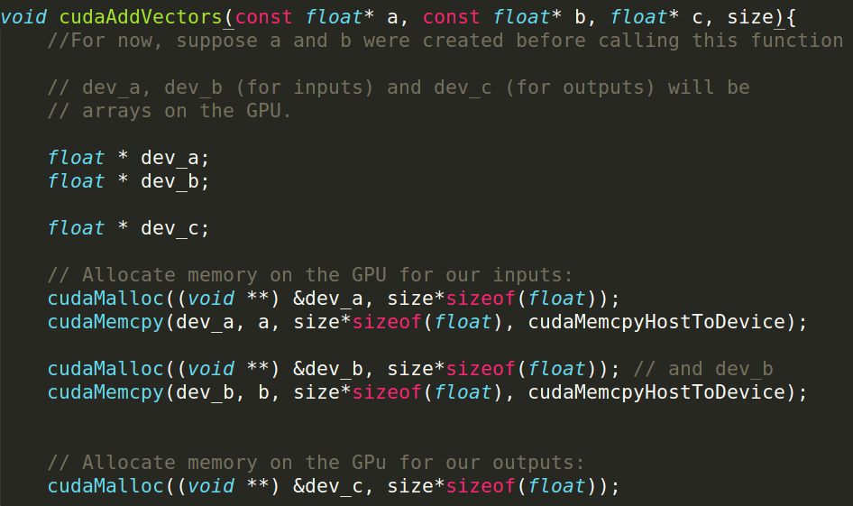
Calling the Kernel

Slide 33
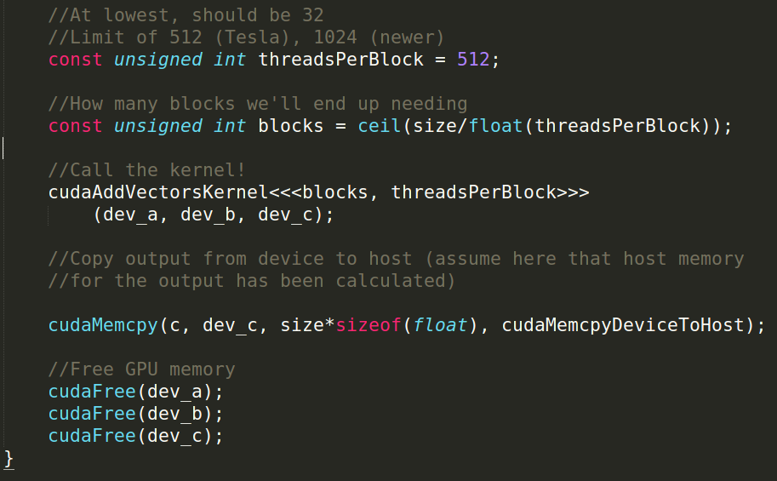
Calling the Kernel (2)

Slide 34
Summary
For many highly parallelizable problems…
GPU offers massive performance increase!
Making difficult problems easy
Putting impossible problems within reach

Slide 35
Outline
Motivations
Brief history
“A simple problem”
“A simple solution”
This course

Slide 36
This Course
General topics:
GPU computing /parallelization
Audio, linear algebra, medical engineering,
machine learning, finance, …
CUDA (parallel computing platform)
Libraries, optimizations, etc
Prerequisites:
C/C++ knowledge

Slide 37
Administrivia
Course Instructors/TA’s:
Kevin Yuh (kyuh@caltech.edu)
Eric Martin (emartin@caltech.edu)
CS179: GPU Programming
Website: http://courses.cms.caltech.edu/cs179/
Overseeing Instructor:
Al Barr (barr@cs.caltech.edu)
Class time:
ANB 107, MWF 3:00 PM

Slide 38
Course Requirements
Option 1:
Homework:
7 assignments
Each worth 10% of grade
Due Wednesdays, 5 PM 3 PM (chg’d 4/3/2015)
Final project:
3-week project
30% of grade

Slide 39
Course Requirements
Option 2:
Homework:
5 assignments
Each worth 10% of grade
Due Wednesdays, 5 PM 3 PM (chg’d 4/3/2015)
Final project:
5-week project
50% of grade
Difference: Exchange sets 6,7 for more time on project

Slide 40
Projects
Topic – your choice!
Project scale
5-week projects: Significantly more extensive
Solo or pairs
Expectations set accordingly
Idea generation:
Keep eyes open!
Talk to us
We hope to bring guests!

Slide 41
Administrivia
Collaboration policy:
Discuss ideas and strategies freely, but all code must be your own
“50 foot rule” (in spirit) – don’t consult your code when helping others with their code

Slide 42
Administrivia
Office Hours: Located in ANB 104
Kevin: Mondays, 9-11 PM
Eric: Tuesdays, 7-9 PM
Extensions on request
Talk to TAs

Slide 43
Machines
Primary machines (multi-GPU, remote access):
haru.caltech.edu
mako.caltech.edu (pending)
E-mail me your preferred username!
Change your password
Separately on each machine (once mako is up)
Use passwd command

Slide 44
Machines
Secondary (CMS) machines:
mx.cms.caltech.edu
minuteman.cms.caltech.edu
Use your CMS login
Not all assignments work here!

Slide 45
Machines
Alternative: Use your own! (Harder):
Must have an NVIDIA CUDA-capable GPU
Virtual machines won’t work!
Exception: Machines with I/O MMU virtualization and certain GPUs
Special requirements for:
Hybrid/optimus systems
Mac/OS X
Setup is difficult! (But we have some instructions)
May need to modify assignment makefiles

Slide 46
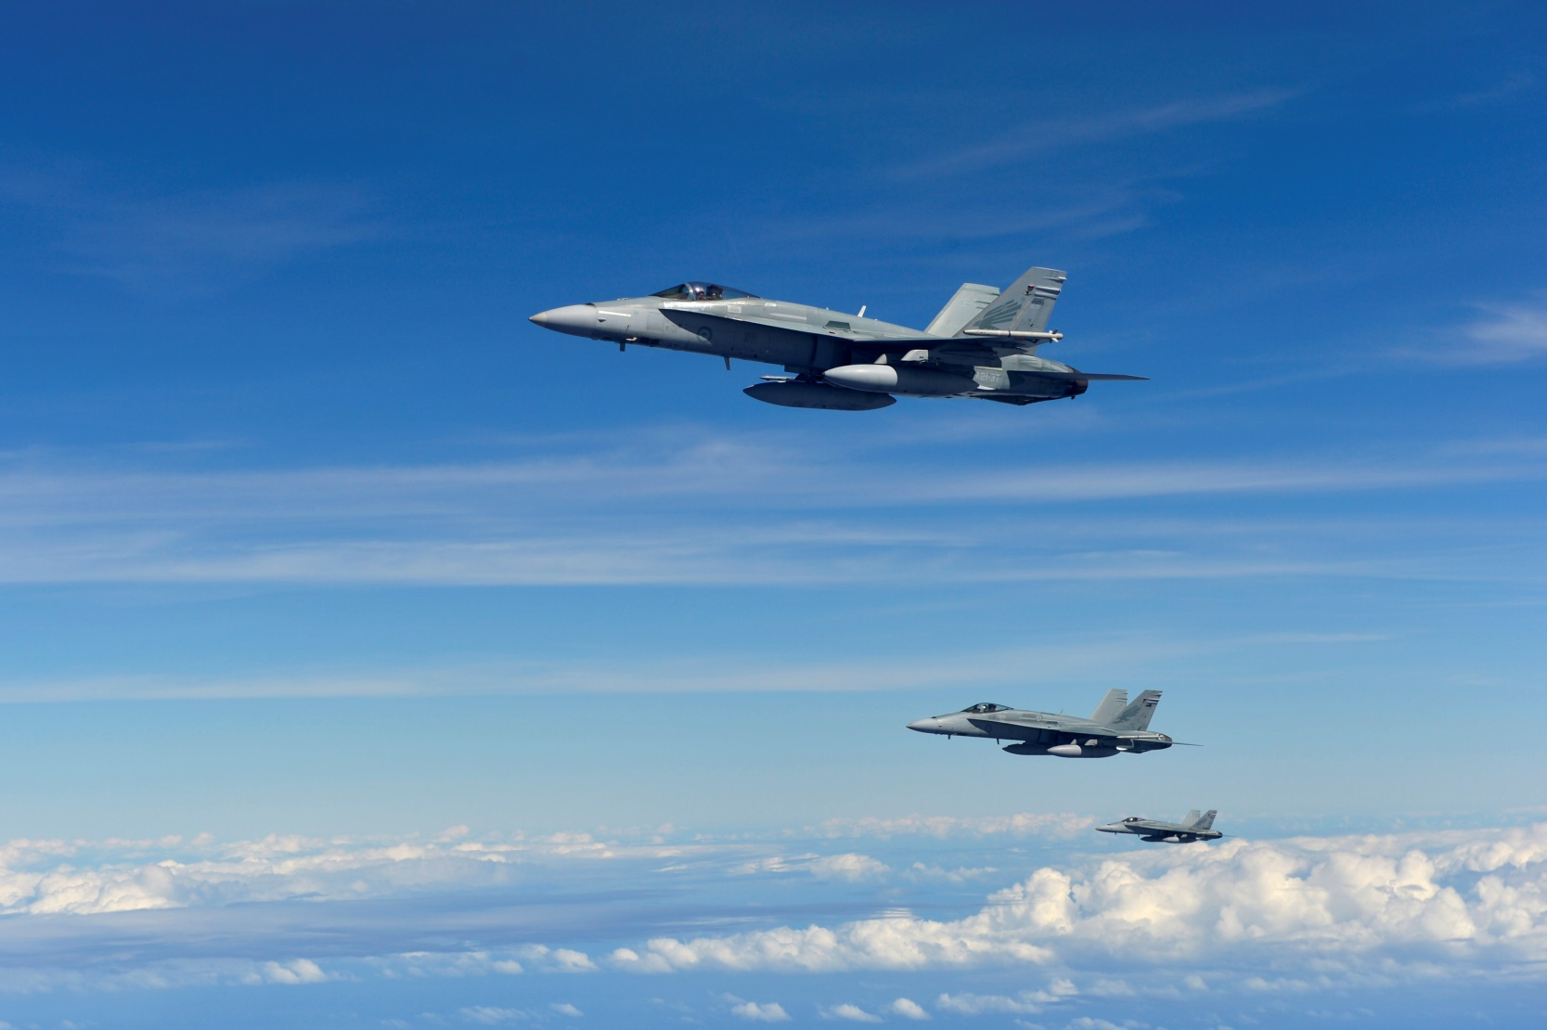
Final remarks for the day…
"Three RAAF FA-18 Hornets in formation after refueling" by U.S. Air Force photo by Senior Airman Matthew Bruch - http://www.flickr.com/photos/pacificairforces/8472331771/in/photostream. Licensed under Public Domain via Wikimedia Commons - http://commons.wikimedia.org/wiki/File:Three_RAAF_FA-18_Hornets_in_formation_after_refueling.jpg#/media/File:Three_RAAF_FA-18_Hornets_in_formation_after_refueling.jpg

Slide 47
Welcome to the course!

