Slide 1
CS 179: Lecture 17
Convolutional Nets in cuDNN

Slide 2
Last Time
Motivation for convolutional neural nets
Forward and backwards propagation algorithms for convolutional neural nets (at a high level)
Down-sampling data using pooling operations
Foreshadowing to how we will use cuDNN to do it

Slide 3
Today
Understanding cuDNN’s internal representations for convolutions and pooling objects
Implementing convolutional nets using cuDNN

Slide 4
More Specifically …
Today, we will discuss how to use cuDNN SW to
Perform convolutions (can use FFT or straight computation)
Backpropagate gradients with respect to convolutions
Perform “pooling” operations for dimensionality reduction and backpropagate their gradients
Much of this material can help HW6 -- should be a good additional resource in addition to the NVIDIA docs.

Slide 5
SW, Representing Convolutions
For tensors and their descriptors, we now also have cudnnFilterDescriptor_t (to describe a conv kernel/filter) and cudnnConvolutionDescriptor_t (to describe an actual convolution)
We also have a cudnnPoolingDescriptor_t to represent a “pooling” operation (max pool, mean pool, etc.)
See https://machinelearningmastery.com/pooling-layers-for-convolutional-neural-networks/
These have their own constructors, accessors, mutators, and destructors

Slide 6
Recap: Convolutions
Consider a $c$-by-$h$-by-$w$ convolutional kernel or filter array $K$ and a $C$-by-$H$-by-$W$ array representing an image $X$
The convolution (technically cross-correlation) $Z=K⊗X$ is
$$Z\left[i,j,k\right]=\sum_{ℓ=0}^{c−1}{\sum_{m=0}^{h−1}{\sum_{n=0}^{w−1}{K[ℓ,m, n] X\left[i+ℓ, j+m,k+n\right]}}}$$
There are multiple ways to deal with boundary conditions; for now, ignore any indices that are out of bounds
Notes:
A convolution would have minus signs where the cross-correlation has plus signs

Slide 7
Recap: Convolutions ($c=1$)
http://machinelearninguru.com/computer_vision/basics/convolution/convolution_layer.html

Slide 8
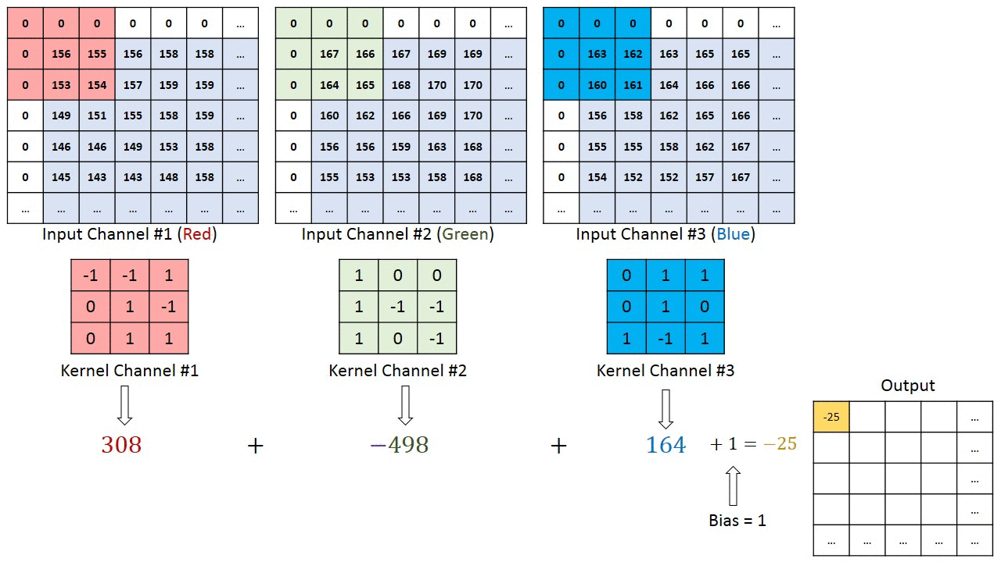
Recap: Convolutions ($c=3$)
Same source as last figure

Slide 9
Relation of Convolution to Fourier Transform
Convolution of g and h in continuous domain defined by:
Convolution Theorem
Fourier transform of convolution of two functions (or signals) is also the pointwise product of their Fourier transforms.
Convolution in one domain (e.g., time domain) equals point-wise multiplication in the other domain (e.g., frequency domain). On GPU we can compute convolutions using the inverse Fourier Transform! (Or not. It will be a choice!) Other choices too.
https://en.wikipedia.org/wiki/Convolution_theorem

Slide 10
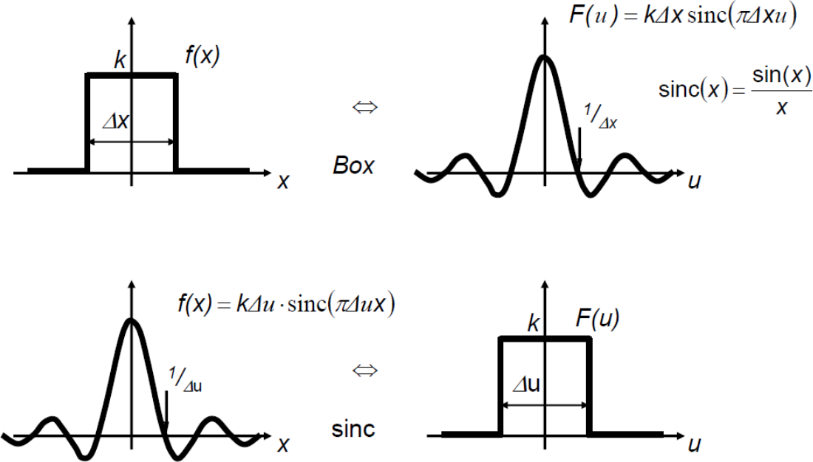
FFT, choice for computing Convolutions on GPUs?
Box Filter in one domain (frequency) is sinc function in other domain (time/space domain)
Can cut off high frequencies by multiplying by box-like filter in frequency domain, which is same as convolving with sinc-like filter in space domain (for antialiasing on CPUs).
FFT on GPUs gives other efficient choices for computing convolutions, for use in NNs
See https://jeheonpark93.medium.com/image-processing-convolution-kernel-aliasing-3dc18ff5e373

Slide 11
SW, Convolutional Filters
cudnnFilterDescriptor_t
Allocate by calling cudnnCreateFilterDescriptor( cudnnFilterDescriptor_t *filterDesc)
Free by calling cudnnDestroyFilterDescriptor( cudnnFilterDescriptor_t filterDesc)
The filter itself is just an array of numbers on the device
We will be using 4D arrays to store filters
However, this is still just a long linear array, like everything else

Slide 12
Convolutional Filters
cudnnFilterDescriptor_t
Set by calling cudnnSetFilter4dDescriptor( cudnnFilterDescriptor_t filterDesc, cudnnDataType_t datatype, cudnnTensorFormat_t format, int k, int c, int h, int w)
Use TENSOR_FORMAT_NCHW for format parameter
k = # of output channels, c = # of input channels

Slide 13
Convolutional Filters
cudnnFilterDescriptor_t
Get contents by calling cudnnGetFilter4dDescriptor( cudnnFilterDescriptor_t filterDesc, cudnnDataType_t *datatype, cudnnTensorFormat_t *format, int *k, int *c, int *h, int *w)
As usual, this function returns by setting pointers to output parameters

Slide 14
Describing Convolutions
cudnnConvolutionDescriptor_t
Allocate with cudnnCreateConvolutionDescriptor( cudnnConvolutionDescriptor_t *convDesc)
Free with cudnnDestroyConvolutionDescriptor( cudnnConvolutionDescriptor_t convDesc)
For HW6 we will be considering 2D convolutions only

Slide 15
Describing Convolutions
cudnnConvolutionDescriptor_t
Set with cudnnSetConvolution2dDescriptor( cudnnConvolutionDescriptor_t convDesc, int pad_h, int pad_w, int u, int v, int dilation_h, int dilation_w, cudnnConvolutionMode_t mode, cudnnDataType_t computeType)

Slide 16
Describing Convolutions
cudnnConvolutionDescriptor_t
pad_h and pad_w are respectively the number of rows and columns of zeros to pad the input with – use $0$ for both
u and v are respectively the vertical and horizontal stride of the convolution (to downsample w/o pooling) – use $1$ for both
Use $1$ for both dilation_h and dilation_w (roughly a stretch factor for filters, but beyond the scope of this class)

Slide 17
Describing Convolutions
cudnnConvolutionDescriptor_t
cudnnConvolutionMode_t is an enum saying whether to do a convolution or cross-correlation. For this set, use CUDNN_CONVOLUTION for the mode argument.
cudnnDataType_t is an enum indicating the kind of data being used (float, double, int, long int, etc.). For this set, use CUDNN_DATA_FLOAT for the computeType argument.

Slide 18
Describing Convolutions
cudnnConvolutionDescriptor_t
Get with cudnnGetConvolution2dDescriptor( cudnnConvolutionDescriptor_t convDesc, int *pad_h, int *pad_w, int *u, int *v, int *dilation_h, int *dilation_w, cudnnConvolutionMode_t *mode, cudnnDataType_t *computeType)

Slide 19
Describing Convolutions
Given descriptors for an input and the filter we want to convolve it with, we can get the shape of the output via cudnnGetConvolution2dForwardOutputDim( cudnnConvolutionDescriptor_t convDesc, cudnnTensorDescriptor_t inputTensorDesc, cudnnFilterDescriptor_t filterDesc, int *n, int *c, int *h, int *w)
As usual, n, c, h, and w are set by reference as outputs

Slide 20
Using these In a Conv Net
All of cuDNN’s functions for forward and backward passes in conv nets will extensively use these descriptor types
This is why we are establishing them now
One more aside before discussing the actual functions for doing the forward and backward passes…

Slide 21
Convolution Algorithms
Many ways to perform convolutions on GPUs!
Do it explicitly
Turn it into a matrix multiplication
Can use FFT to transform into frequency domain, multiply pointwise, and inverse FFT back
cuDNN lets you choose the algorithm you want to use for all operations in the forward and backward passes

Slide 22
Convolution Algorithms
Different algorithms are better suited for different situations!
Most important factor: amount of global memory available for intermediate computations (workspace)
Tradeoff b/w time and space complexity – faster algorithms tend to need more space for intermediate computations
cuDNN lets you specify preferences, and it gives you an algorithm that best matches your preferences

Slide 23
Convolution Algorithms
The choice of algorithm is represented via the enums cudnnConvolution<type>Preference_t and cudnnConvolution<type>Algo_t, and cudnnConvolution<type>AlgoPerf_t, where <type> is one of Fwd, BwdFilter, and BwdData
Feel free to look at NVIDIA docs for these types and related functions, but we will be handling them for you in HW6

Slide 24
Forward Pass: Convolution

Slide 25
Forward Pass: Convolution
cudnnConvolutionForward( cudnnHandle_t handle, void *alpha, cudnnTensorDescriptor_t xDesc, void *x, cudnnFilterDescriptor_t kDesc, void *k, cudnnConvolutionDescriptor_t convDesc, cudnnConvolutionFwdAlgo_t algo, void *workSpace, size_t workSpaceBytes, void *beta, cudnnTensorDescriptor_t zDesc, void *z)

Slide 26
Forward Pass: Convolution
This function sets the contents of the output tensor z to alpha[0] * conv(k, x) + beta[0] * z
The convolution algorithm, workspace, and size of the workspace will be supplied to you in HW6 (unnecessary complication for you to consider for this set)
With alpha[0] = 1 and beta[0] = 0, this is exactly what you need to call!

Slide 27
Backward Pass: Convolution
With the neural net architecture given, we will have:
The output of the convolution $Z^{\left(ℓ\right)}=K^{\left(ℓ\right)}⊗X^{\left(ℓ−1\right)}+b^{\left(ℓ\right)}$
The gradient $∇_{Z^{\left(ℓ\right)}}\left[J\right]$ with respect to the output of the convolution (propagated backwards from the next layer)
We want to find the gradients with respect to:
The filter $K^{\left(ℓ\right)}$ and the bias $b^{\left(ℓ\right)}$ to do gradient descent
The input data $X^{\left(ℓ−1\right)}$ to propagate backwards

Slide 28
Backward Pass: Convolution
Key to argument names
x is the input data $X^{\left(ℓ−1\right)}$
k is the filter $K^{\left(ℓ−1\right)}$
dz is the gradient $∇_{Z^{\left(ℓ\right)}}\left[J\right]$ with respect to the output $Z^{\left(ℓ\right)}$
dx is the gradient $∇_{X^{\left(ℓ−1\right)}}\left[J\right]$ with respect to input data $X^{\left(ℓ−1\right)}$
dk is the gradient $∇_{K^{\left(ℓ\right)}}\left[J\right]$ with respect to the filter $K^{\left(ℓ\right)}$
db is the gradient $∇_{b^{\left(ℓ\right)}}\left[J\right]$ with respect to the bias $b^{\left(ℓ\right)}$

Slide 29
Backward Pass: Convolution
Key to argument names
As always, the alpha and beta arguments are pointers to mixing parameters
If we are using a buffer out to accumulate the results of performing an operation op on an input buffer in, we have out = alpha[0] * op(in) + beta[0] * out

Slide 30
Gradient WRT Bias
cudnnConvolutionBackwardBias( cudnnHandle_t handle, void *alpha, cudnnTensorDescriptor_t dzDesc, void *dz, cudnnConvolutionDescriptor_t convDesc, void *beta, cudnnTensorDescriptor_t dbDesc, void *db)
We will handle this for you in HW6

Slide 31
Gradient WRT Filter
cudnnConvolutionBackwardFilter( cudnnHandle_t handle, void *alpha, cudnnTensorDescriptor_t xDesc, void *x, cudnnTensorDescriptor_t dzDesc, void *dz, cudnnConvolutionDescriptor_t convDesc, cudnnConvolutionBwdFilterAlgo_t algo, void *workSpace, size_t workSpaceBytes, void *beta, cudnnFilterDescriptor_t dkDesc, void *dk)

Slide 32
Gradient WRT Input Data
cudnnConvolutionBackwardData( cudnnHandle_t handle, void *alpha, cudnnFilterDescriptor_t kDesc, void *k, cudnnTensorDescriptor_t dzDesc, void *dz, cudnnConvolutionDescriptor_t convDesc, cudnnConvolutionBwdDataAlgo_t algo, void *workSpace, size_t workSpaceBytes, void *beta, cudnnTensorDescriptor_t dxDesc, void *dx)

Slide 33
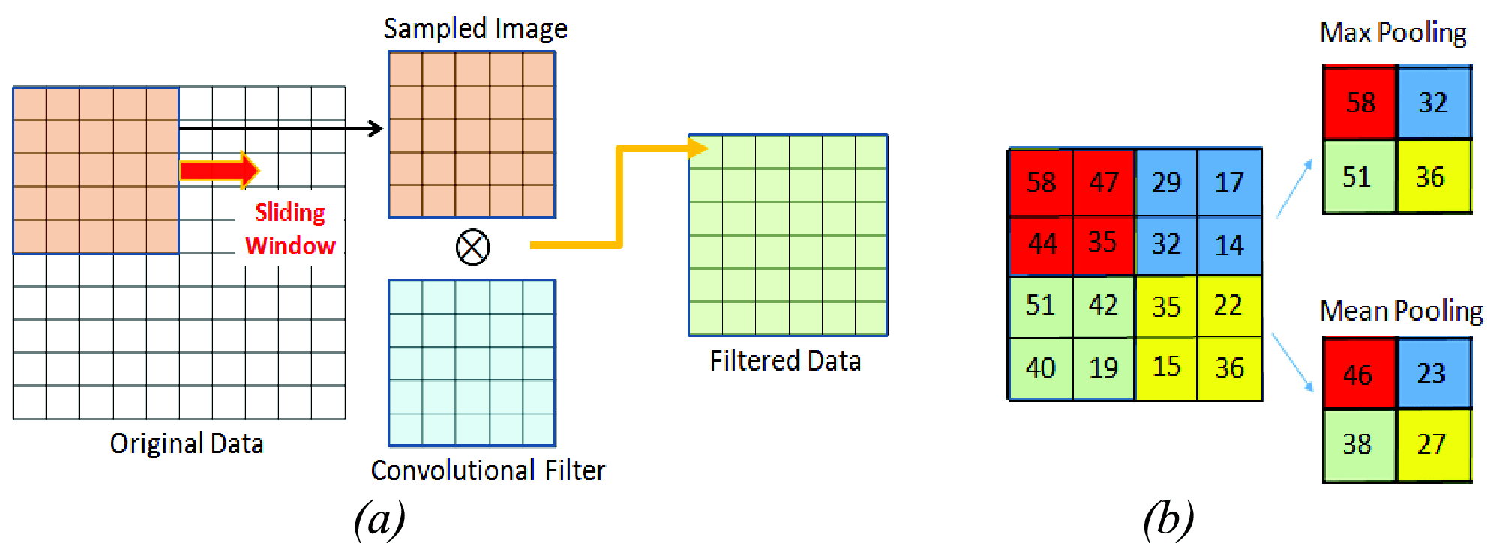
Pooling Operations
Reminder: pooling lets us down-sample or focus on parts of images to reduce dimensionality while preserving information
http://ieeexplore.ieee.org/document/7590035/all-figures

Slide 34
Pooling Operations
cudnnPoolingDescriptor_t
Allocate with cudnnCreatePoolingDescriptor( cudnnPoolingDescriptor_t *poolingDesc)
Free with cudnnDestroyPoolingDescriptor( cudnnPoolingDescriptor_t poolingDesc)
We will only be using 2D pooling operations in HW6

Slide 35
Pooling Operations
cudnnPoolingDescriptor_t
Set with cudnnSetPooling2dDescriptor( cudnnPoolingDescriptor_t poolingDesc, cudnnPoolingMode_t poolingMode, cudnnNanPropagation_t nanProp, int windowHeight, int windowWidth, int verticalPad, int horizontalPad, int verticalStride, int horizontalStride)

Slide 36
Pooling Operations
cudnnPoolingDescriptor_t
cudnnPoolingMode_t is an enum specifying the kind of pooling to do, i.e. max (CUDNN_POOLING_MAX) or average (CUDNN_POOLING_AVERAGE_COUNT_INCLUDE_PADDING or CUDNN_POOLING_AVERAGE_COUNT_EXCLUDE_PADDING)
For nanProp, use CUDNN_PROPAGATE_NAN
Use $0$ for horizontal and vertical padding
Make the strides equal to the window dimensions

Slide 37
Pooling Operations
cudnnPoolingDescriptor_t
Get with cudnnGetPooling2dDescriptor( cudnnPoolingDescriptor_t *poolingDesc, cudnnPoolingMode_t *poolingMode, cudnnNanPropagation_t *nanProp, int *windowHeight, int *windowWidth, int *verticalPad, int *horizontalPad, int *verticalStride, int *horizontalStride)

Slide 38
Pooling Operations
We can get the output shape of a pooling operation on some input using the function
cudnnGetPooling2dForwardOutputDim( cudnnPoolingDescriptor_t poolingDesc, cudnnTensorDescriptor_t inputDesc, int *n, int *c, int *h, int *w)
n, c, h, and w are output parameters to be set by reference

Slide 39
Pooling Operations
To perform a pooling operation in the forward direction, use
cudnnPoolingForward( cudnnHandle_t handle, cudnnPoolingDescriptor_t poolingDesc, void *alpha, cudnnTensorDescriptor_t xDesc, void *x, void *beta, cudnnTensorDescriptor_t zDesc, void *z)

Slide 40
Pooling Operations
To differentiate with respect to a pooling operation, use
cudnnPoolingBackward( cudnnHandle_t handle, cudnnPoolingDescriptor_t poolingDesc, void *alpha, cudnnTensorDescriptor_t zDesc, void *z, cudnnTensorDescriptor_t dzDesc, void *dz, void *beta, cudnnTensorDescriptor_t dxDesc, void *dx)

Slide 41
Pooling Operations
In the previous slides, x is the input to the pooling operation, dx is its gradient, z is the output of the pooling operation, and dz is its gradient
alpha and beta are pointers to mixing parameters as usual
In all cases, the last buffer given as an argument is the output array

Slide 42
Summary
Today, we discussed how to use cuDNN to
Perform convolutions
Backpropagate gradients with respect to convolutions
Perform pooling operations and backpropagate their gradients
For HW6, these slides should be a good alternative reference to the NVIDIA docs.

